Slide 1
Isaiah 17:8-14
ישעיהו יז:ח-יד
Isaiah / ישעיה
http://www.matsati.com

Slide 2
ספר ישעיה פרק יז
ז בַּיּוֹם הַהוּא יִשְׁעֶה הָאָדָם עַל-עֹשֵֹהוּ וְעֵינָיו אֶל-קְדוֹשׁ יִשְֹרָאֵל תִּרְאֶינָה:
Isaiah 17:7
17:7 At that day shall a man look to his Maker, and his eyes shall have respect to the Holy One of Israel. (KJV)
ספר הושע פרק ח
יד וַיִּשְׁכַּ֨ח יִשְׂרָאֵ֜ל אֶת־עֹשֵׂ֗הוּ וַיִּ֙בֶן֙ הֵֽיכָל֔וֹת וִֽיהוּדָ֕ה הִרְבָּ֖ה עָרִ֣ים בְּצֻר֑וֹת וְשִׁלַּחְתִּי־אֵ֣שׁ בְּעָרָ֔יו וְאָכְלָ֖ה אַרְמְנֹתֶֽיהָ׃
Hosea 8:14
8:14 For Israel hath forgotten his Maker, and buildeth temples; and Judah hath multiplied fenced cities: but I will send a fire upon his cities, and it shall devour the palaces thereof. (KJV)
Isaiah / ישעיה
http://www.matsati.com

Slide 3
﻿ספר ישעיה פרק יז
﻿ח וְלֹא יִשְׁעֶה אֶל-הַמִּזְבְּחוֹת מַעֲשֵֹה יָדָיו וַאֲשֶׁר עָשֹוּ אֶצְבְּעֹתָיו לֹא יִרְאֶה וְהָאֲשֵׁרִים וְהָחַמָּנִים: ט בַּיּוֹם הַהוּא יִהְיוּ | עָרֵי מָעֻזּוֹ כַּעֲזוּבַת הַחֹרֶשׁ וְהָאָמִיר אֲשֶׁר עָזְבוּ מִפְּנֵי בְּנֵי יִשְֹרָאֵל וְהָיְתָה שְׁמָמָה: י כִּי שָׁכַחַתְּ אֱלֹהֵי יִשְׁעֵךְ וְצוּר מָעֻזֵּךְ לֹא זָכָרְתְּ עַל-כֵּן תִּטְּעִי נִטְעֵי נַעֲמָנִים וּזְמֹרַת זָר תִּזְרָעֶנּוּ: יא בְּיוֹם נִטְעֵךְ תְּשַֹגְשֵֹגִי וּבַבֹּקֶר זַרְעֵךְ תַּפְרִיחִי נֵד קָצִיר בְּיוֹם נַחֲלָה וּכְאֵב אָנוּשׁ: יב הוֹי הֲמוֹן עַמִּים רַבִּים כַּהֲמוֹת יַמִּים יֶהֱמָיוּן וּשְׁאוֹן לְאֻמִּים כִּשְׁאוֹן מַיִם כַּבִּירִים יִשָּׁאוּן: יג לְאֻמִּים כִּשְׁאוֹן מַיִם רַבִּים יִשָּׁאוּן וְגָעַר בּוֹ וְנָס מִמֶּרְחָק וְרֻדַּף כְּמֹץ הָרִים לִפְנֵי-רוּחַ וּכְגַלְגַּל לִפְנֵי סוּפָה: יד לְעֵת עֶרֶב וְהִנֵּה בַלָּהָה בְּטֶרֶם בֹּקֶר אֵינֶנּוּ זֶה חֵלֶק שׁוֹסֵינוּ וְגוֹרָל לְבֹזְזֵינוּ:
Isaiah / ישעיה
http://www.matsati.com

Slide 4
ספר שמות פרק לד
﻿יג כִּי אֶת-מִזְבְּחֹתָם תִּתֹּצוּן וְאֶת-מַצֵּבֹתָם תְּשַׁבֵּרוּן וְאֶת-אֲשֵׁרָיו תִּכְרֹתוּן:
Shemot / Exodus 34:13
34:13 But ye shall destroy their altars, break their images, and cut down their groves: (KJV)
﻿ספר דברים פרק טז
﻿כא לֹא-תִטַּע לְךָ אֲשֵׁרָה כָּל-עֵץ אֵצֶל מִזְבַּח יְהוָֹה אֱלֹהֶיךָ אֲשֶׁר תַּעֲשֶֹה-לָּךְ:
Devarim / Deuteronomy 16:21
16:21 Thou shalt not plant thee a grove of any trees near unto the altar of the LORD thy God, which thou shalt make thee. (KJV)
Isaiah / ישעיה
http://www.matsati.com

Slide 5
Isaiah / ישעיה
http://www.matsati.com

Slide 6
ספר דברים פרק ח
﻿יא הִשָּׁמֶר לְךָ פֶּן-תִּשְׁכַּח אֶת-יְהוָֹה אֱלֹהֶיךָ לְבִלְתִּי שְׁמֹר מִצְוֹתָיו וּמִשְׁפָּטָיו וְחֻקֹּתָיו אֲשֶׁר אָנֹכִי מְצַוְּךָ הַיּוֹם: יב פֶּן-תֹּאכַל וְשָֹבָעְתָּ וּבָתִּים טֹבִים תִּבְנֶה וְיָשָׁבְתָּ: יג וּבְקָרְךָ וְצֹאנְךָ יִרְבְּיֻן וְכֶסֶף וְזָהָב יִרְבֶּה-לָּךְ וְכֹל אֲשֶׁר-לְךָ יִרְבֶּה: יד וְרָם לְבָבֶךָ וְשָׁכַחְתָּ אֶת-יְהוָֹה אֱלֹהֶיךָ הַמּוֹצִיאֲךָ מֵאֶרֶץ מִצְרַיִם מִבֵּית עֲבָדִים:
Devarim / Deuteronomy 8:11-12
8:11 Beware that thou forget not the LORD thy God, in not keeping his commandments, and his judgments, and his statutes, which I command thee this day: 8:12 Lest when thou hast eaten and art full, and hast built goodly houses, and dwelt therein; 8:13 And when thy herds and thy flocks multiply, and thy silver and thy gold is multiplied, and all that thou hast is multiplied; 8:14 Then thine heart be lifted up, and thou forget the LORD thy God, which brought thee forth out of the land of Egypt, from the house of bondage; (KJV)
Isaiah / ישעיה
http://www.matsati.com

Slide 7
1 Corinthians 11:24-31
11:24 And when he had given thanks, he brake it, and said, Take, eat: this is my body, which is broken for you: this do in remembrance of me. 11:25 After the same manner also he took the cup, when he had supped, saying, this cup is the new testament in my blood: this do ye, as oft as ye drink it, in remembrance of me. 11:26 For as often as ye eat this bread, and drink this cup, ye do shew the Lord's death till he come. 11:27 Wherefore whosoever shall eat this bread, and drink this cup of the Lord, unworthily, shall be guilty of the body and blood of the Lord. 11:28 But let a man examine himself, and so let him eat of that bread, and drink of that cup. 11:29 For he that eateth and drinketh unworthily, eateth and drinketh damnation to himself, not discerning the Lord's body. 11:30 For this cause many are weak and sickly among you, and many sleep. 11:31 For if we would judge ourselves, we should not be judged. (KJV ܘܒ݂ܰܪܷܟ݂ ܘܰܩܨܴܐ ܂ ܘܶܐܡܰܪ ܂ ܣܰܒ݂ܘ ܂ ܐܱܟ݂ܽܘܠܘ ܂ ܗܳܢܰܘ ܦܱ݁ܓ݂ܪܝ ܁ ܕ݁ܥܰܠ ܐܱܦܱ݁ܝ̈ܟܾ݁ܘܢ ܡܶܬ݂ܩܨܷܐ ܂ ܗܳܟ݂ܰܢܳܐ ܗܘܰܝܬܾ݁ܘܢ ܥܳܒ݂ܕܻ݁ܝܢ ܠܕ݂ܽܘܟ݂ܪܴܢܝ ܂ܗܳܟ݂ܰܢܳܐ ܡܶܢ ܒܴ݁ܬ݂ܱܪ ܕܱ݁ܐܚܫܶܡܘ ܆ ܐܴܦ݂ ܟܴ݁ܣܳܐ ܝܰܗ̄ܒ݂ ܂ ܘܶܐܡܰܪ ܂ ܗܳܢܳܐ ܟܴ݁ܣܳܐ ܐܻܝܬ݂ܱܘܗ̄ܝ ܕܻ݁ܝܰܬ݂ܻܩܺܐ ܚܕ݂ܰܬ݂ܴܐ ܒ݁ܕ݂ܶܡܝ ܂ ܗܳܟ݂ܰܢܳܐ ܗܘܰܝܬܾ݁ܘܢ ܥܳܒ݂ܕܻ݁ܝܢ ܇ ܟܾ݁ܠ ܐܷܡܰܬ݂ܝ ܕ݁ܫܳܬ݂ܷܝܢ ܐܢ̄ܬܾ݁ܘܢ ܂ ܠܕ݂ܽܘܟ݂ܪܴܢܝ ܂ ܟܾ݁ܠ ܐܷܡܰܬ݂ܝ ܓܷ݁ܝܪ ܕܴ݁ܐܟ݂ܠܻܝܢ ܐܢ̄ܬܾ݁ܘܢ ܠܱܚܡܳܐ ܗܳܢܳܐ ܁ ܘܫܳܬ݂ܷܝܢ ܐܢ̄ܬܾ݁ܘܢ ܟܴ݁ܣܳܐ ܗܳܢܳܐ ܆ ܡܰܘܬܷ݁ܗ ܗ̄ܽܘ ܕ݁ܡܳܪܱܢ ܡܰܥ̄ܗܕܻ݁ܝܢ ܐܢ̄ܬܾ݁ܘܢ ܂ ܥܕ݂ܰܡܳܐ ܠܡܶܐܬ݂ܻܝܬ݂ܷܗ ܂ ܐܱܝܢܳܐ ܗܳܟ݂ܺܝܠ ܕܴ݁ܐܟ݂ܶܠ ܡܶܢ ܠܱܚܡܶܗ ܕ݁ܡܳܪܝܳܐ ܁ ܘܫܳܬ݂ܷܐ ܡܶܢ ܟܴ݁ܣܶܗ ܂ ܘܠܴܐ ܫܳܘܶܐ ܠܷܗ ܆ ܡܚܰܝܰܒ݂ ܗ̄ܽܘ ܠܱܕ݂ܡܶܗ ܕ݁ܡܳܪܝܳܐ ܘܰܠܦ݂ܰܓ݂ܪܷܗ ܂ ܡܶܛܾܠ ܗܳܢܳܐ ܢܶܗܘܶܐ ܐ̱ܢܳܫ ܒܴ݁ܩܶܐ ܢܰܦ݂ܫܶܗ ܆ ܘܗܳܝܕܷ݁ܝܢ ܐܴܟ݂ܶܠ ܡܶܢ ܠܱܚܡܳܐ ܗܳܢܳܐ ܂ ܘܫܳܬ݂ܷܐ ܡܶܢ ܟܴ݁ܣܳܐ ܗܳܢܳܐ ܂ ܡܰܢ ܕܴ݁ܐܟ݂ܶܠ ܓܷ݁ܝܪ ܘܫܳܬ݂ܷܐ ܡܶܢܶܗ ܟܱ݁ܕ݂ ܠܴܐ ܫܳܘܶܐ ܆ ܚܽܘܝܳܒ݂ܳܐ ܗ̄ܘ ܠܢܰܦ݂ܫܶܗ ܐܴܟ݂ܶܠ ܘܫܳܬ݂ܷܐ ܇ ܕ݁ܠܴܐ ܦ݁ܪܱܫ ܦܱ݁ܓ݂ܪܷܗ ܕ݁ܡܳܪܝܳܐ ܂ ܡܶܛܾܠ ܗܳܢܳܐ ܣܰܓܻ݁ܝ̈ܐܝܺܢ ܒ݁ܟ݂ܽܘܢ ܡܰܪ̈ܥܶܐ ܘܰܟ݂ܪܻ̈ܝܗܶܐ ܆ ܘܣܰܓܻ݁ܝܷ̈ܐܐ ܕ݁ܕ݂ܳܡܟܻ݁ܝܢ ܐܷܠܾܘ ܓܷ݁ܝܪ ܢܰܦ݂ܫܰܢ ܕܴ݁ܝܢܺܝܢ ܗ̄ܘܰܝܢ ܆ ܠܴܐ ܡܶܬ݁ܕ݂ܺܝܢܺܝܢ ܗ̄ܘܰܝܢ ܂)
Isaiah / ישעיה
http://www.matsati.com

Slide 8
DSSSE:EN | DSSSE:Tr | DSSSE:NT
1QHa Col. xiii:30 30 the charge against me with the harp, their grumblings with verses in harmony, with demolition and destruction. Resentment has taken hold of me and pangs like the labours of | 1QHa Col. xiii:30 30 בכנור ריבי ובנגינות יחד תלונתם עם שאה ומשואה זלעופות אחזוני וחבלים כצירי | 1QHa Col. xiii:30 30for which there is no charm. And it has become an incurable pain and a tormenting agony in the bowels of Your servant, causing [my spirit] to stumble and putting an end to
1QHa Col. xvi:10 10 although they do not extend their root to the gully. However, he who causes the holy shoot to grow in the true plantation hides, not | 1QHa Col. xvi:10 10 ואל יובל לא ישלחו שורש ומפריח נצר ק[ו]דש למטעת אמת סותר בלוא | 1QHa Col. xvi:10 10and its branches roosts for all the birds. All the tre[es] by the water rise over it, for in their stand they grow tall,
1QHa Col. xvi:28 28 to bitterness and an incurable pain which does not stop, […] over me like those who go down to Sheol, and with | 1QHa Col. xvi:28 28 למרורים וכאיב אנוש לאין עצור […]מה עלי כיורדי שאול ועם | 1QHa Col. xvi:28 28agonies. I have become like a man who is forsaken by […] there is no refuge for me. For my agony breaks out
Isaiah / ישעיה
http://www.matsati.com

Slide 9
“The description of the activity in vv. 10b and 11 is reminiscent of that attributed to the Adonis cult, where potted plants were force-bloomed and then allowed to die as symbolic of the fertility cycle of the world. This cult was a Greek version of the Tammuz worship, which is mentioned in the Bible (Ezek. 8) and which was widely practiced in the ancient Near East. The worshipers believed that by reenacting the myth of the dying and rising vegetation-god they would secure a good crop for themselves. Whether or not the particular practices of the Adonis cult are in view here (Kissane, with Skinner, cautions that the similarities are only general, not specific), it is clear that the people are seeking to supply their own needs through their own activity. Such an approach can only be the result of a prior abandoning of the God who had shown himself both willing and able to care for them. strange shoots (lit. “shoots of strangeness”) is interpreted by some as meaning “shoots of a strange (god).” They have then suggested that pleasant plants refers to the plants of (the god) Naaman (the sweet one = Adonis?). However, pleasant is used elsewhere in the book without any overtones of the divine name (32:12), and the form of strange is adjectival, not nominal (zār), so that the present reading seems preferable. Probably the reference to these exotic and beautiful plants does symbolize the lush and opulent Canaanite religion, which promised such a beautiful harvest.” (John N. Oswalt, The Book of Isaiah, Chapters 1–39, The New International Commentary on the Old Testament (Grand Rapids, MI: Wm. B. Eerdmans Publishing Co., 1986), 354.)
Isaiah / ישעיה
http://www.matsati.com

Slide 10
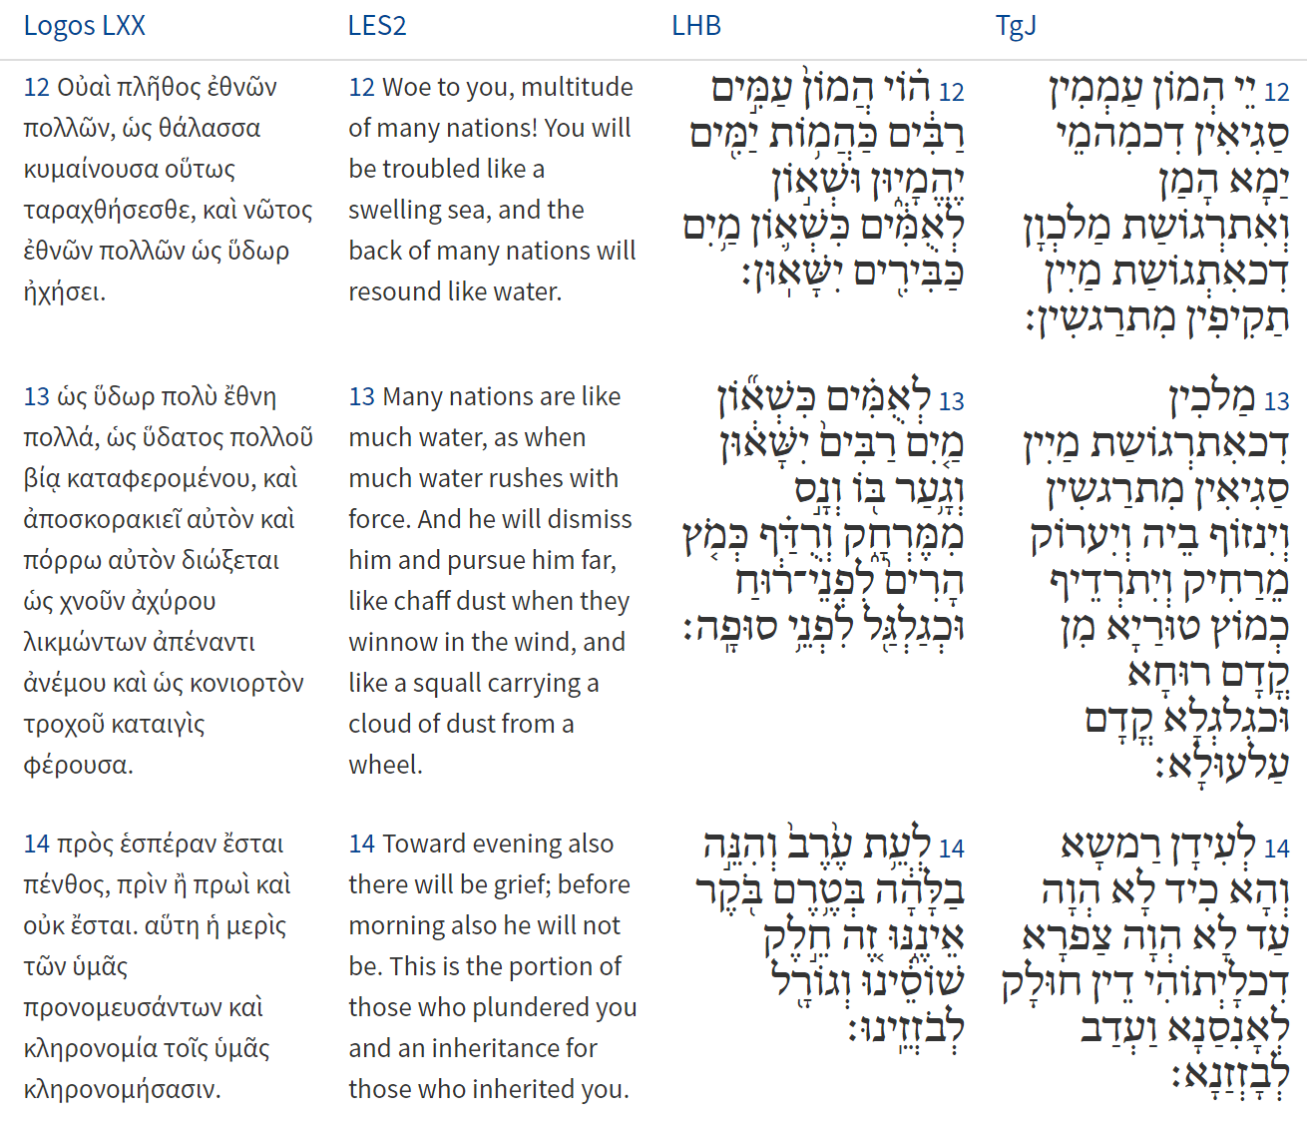
Isaiah / ישעיה
http://www.matsati.com

Slide 11
Rabbinic Literature
ספרות רבנית
Part 2
Isaiah / ישעיה
http://www.matsati.com

Slide 12
Targum Jonathan son of Uziel Isaiah 17:8-14
17:8 He shall not rest upon the altars, the work of his hands, or stay himself upon that which his fingers have prepared, neither upon the groves nor upon the sun-images. 17:9 At that time the cities of their strength shall be as a fortification that was laid desolate and waste from before the children of Israel, and each shall be a desolation. 17:10 Because thou hast forsaken the God of thy salvation, and thou hast not remembered the fear of the Mighty One, whose WORD was thy support; therefore thou hast planted a choice plant, and hast multiplied despicable works. 17:11 After that ye were sanctified to be a people, there ye made your works despicable; and also when ye came to the land, the place of my Shekinah, there it was your duty to worship me; ye forsook my worship, and ye served idols: ye abhorred repentance till the day of your destruction came, then your sorrow was a breathing out of soul. 17:12 Woe to the multitude of many people, which make a noise like the noise of the sea, and to the tumultuous assembly of kings, which roar like the roaring of mighty waters. 17:13 The kings roar like the roaring of many waters, and he shall rebuke him, and he shall flee far off, and shall be driven as the chaff of the hills before the wind, and like a rolling thing before the whirlwind. 17:14 And at eveningtide behold, as if he had not been; and before the morning behold, as if he had not been. This is the portion of those that hate us, and the lot of those who spoil us. (TgJ)
Isaiah / ישעיה
http://www.matsati.com

Slide 13
ספר משלי פרק יד
יב יֵשׁ דֶּרֶךְ יָשָׁר לִפְנֵי-אִישׁ וְאַחֲרִיתָהּ דַּרְכֵי-מָוֶת:
Rashi on Isaiah 17:8 Part 1
לא יראה. לא יחשבו בעיניו:
he shall not regard [lit. he shall not see.] They shall not be important in his eyes
Isaiah / ישעיה
http://www.matsati.com

Slide 14
ספר דברים פרק לב
﻿טו וַיִּשְׁמַן יְשֻׁרוּן וַיִּבְעָט שָׁמַנְתָּ עָבִיתָ כָּשִֹיתָ וַיִּטּשׁ אֱלוֹהַּ עָשָֹהוּ וַיְנַבֵּל צוּר יְשֻׁעָתוֹ:
Devarim / Deuteronomy 32:15
32:15 But Jeshurun waxed fat, and kicked: thou art waxen fat, thou art grown thick, thou art covered with fatness; then he forsook God which made him, and lightly esteemed the Rock of his salvation. (KJV)
﻿ספר דברים פרק לב
﻿יח צוּר יְלָדְךָ תֶּשִׁי וַתִּשְׁכַּח אֵל מְחֹלֲלֶךָ:
Devarim / Deuteronomy 32:18
32:18 Of the Rock that begat thee thou art unmindful, and hast forgotten God that formed thee. (KJV)
Isaiah / ישעיה
http://www.matsati.com

Slide 15
Rashi on Isaiah 17:10 Part 1-2
על כן תטעי וגו'. על כן כאשר נטעתיך מתחילה נטעתי נטע נעמנים שנים עשר בני יעקב ובהעלות נטעיך לזמורות נתנו זרע שאינו הגון כזמורות זרות שאינם ממין גפן אלא דומים לגפן:
because I planted you Because, when I planted you in the beginning, I planted a pleasant planting, twelve sons of Jacob, and when your saplings raised branches, they gave forth improper seed, like strange branches which are not of the species of the vine but resemble the vine.
תזרענו. תתנו זרעך באותו נטע ועוד י"ל וזמורות זר תזרענו התחתנת בכותים ונתערבו בכם:
you sow it You give your seed into that sapling. [It is also possible to say that “and with the branch of a stranger you sow it,” means that you intermarry with the nations and they mingled with you.]
Isaiah / ישעיה
http://www.matsati.com

Slide 16
ΕΥΑΓΓΕΛΙΟΝ ΚΑΤΑ ΙΩΑΝΝΗΝ 15:8
8 ἐν τούτῳ ἐδοξάσθη ὁ πατήρ μου, ἵνα καρπὸν πολὺν φέρητε καὶ γένησθε ἐμοὶ μαθηταί.
John 15:8
15:8 Herein is my Father glorified, that ye bear much fruit; so shall ye be my disciples. (KJV)
Isaiah / ישעיה
http://www.matsati.com

Slide 17
Rashi on Isaiah 17:11 Part 1-6
On the day of your planting you mingled Heb. תְּשַׂגְשֵׂנִי, an expression of mingling. Your branches became mingled with sorts of grasses and mixtures that spoil the branches of the vine. That is to say that in the place where I planted you for Me as a vineyard, there you corrupted your deeds. That is what Ezekiel said to them (20:5): “On the day I chose Israel, and I lifted My hand to the seed of the house of Jacob, and I became known to them in the land of Egypt.” And it says further (verse 8): “And they rebelled against Me and they refused to obey...” Here, too, תְּשַׂגְשֵׂנִי, you became mingled with the abominations of Egypt. and in the morning you cause your seed to blossom And on the morrow, when I took you out of there, and I brought you into the land, there, too, your evil seed you caused to blossom. a heap of harvest on a day of sickness a heap of bad harvest that lies by day and by night, that harvest is stricken ill, it has reached a day of distress. [Rashi in printed editions.] [Since it is difficult to make sense of this comment of Rashi, Parshandatha prefers the reading of most mss.:] a heap of harvest on a day of sickness a heap of bad harvest, as “on a day of sickness” proves, that harvest reached a day of distress. a heap Heb. נֵד. This is an expression of a tall heap. Comp. (Exodus 15:8) “Running water stood erect like a heap (נֵד).” Also (Ps. 33:3), “He gathers like a heap (כַּנֵּד).” [ The words:] נֵד and נוֹד are not the same [i.e., נֵד is a heap or a stack, and נוֹד is a flask.] and mortal pain that you were paid your reward. mortal Heb. אָנוּשׁ, distressed by severe illness. Comp. (II Sam. 12: 15) “And he became mortally ill (וַיֵּאָנַשׁ),” also (Micah 1:9), “For her wounds are mortal (אֲנוּשָׁה) .” Alternatively and in the morning you cause your seed to blossom Before the heat comes, you have blossomed, and it is customary for the vineyard to blossom when the heat comes, and the one that blossoms in the morning does not thrive. This is in the Midrash of Rabbi Tanhuma (Sh’lach 12).
Isaiah / ישעיה
http://www.matsati.com

Slide 18
Midrash Tanchuma, Ki Tisa 4:3
However, the rabbis held that this verse refers to the nations of the world. The idolaters are many (rabim), as it is written: The uproar of many peoples (Isa. 17:12). They said to Israel: You are a nation that heard at Sinai: I am the Lord Thy God, thou shalt have no other gods before Me (Exod. 20:3), yet at the end of forty days you said of a calf: This is your god, O Israel (ibid. 32:4). How can they enjoy salvation, since it says: There is no salvation for him in God (Ps. 3:3)? But Thou, O Lord, art a shield about me suggests that Israel cried out: Master of the Universe, do You agree with them, since You have said: He that sacrificeth unto the gods shall be utterly destroyed (Exod. 22:19)? A shield about me alludes to the merit of the fathers; my glory implies that You will cause your Shekhinah to dwell in our midst when You said: Build Me a Sanctuary that I may dwell among them (ibid. 25:8); and lifter up of the head indicates that instead of sentencing us to destruction, You permitted us to lift up the head, that is, to be forgiven because of Moses, as it is said: Thou liftest up the head.
ספר שמות פרק כב
יט זֹבֵחַ לָאֱלֹהִים יָחֳרָם בִּלְתִּי לַיהוָֹה לְבַדּוֹ:
Shemot / Exodus 22:20
22:20 “Whoever sacrifices to any god other than the Lord must be destroyed. (NIV)
Isaiah / ישעיה
http://www.matsati.com

