Slide 1
Isaiah 17:1-7
ישעיהו יז:א-ז
Isaiah / ישעיה
http://www.matsati.com

Slide 2
﻿ספר ישעיה פרק יז
א מַשָּׂא דַּמָּשֶֹק הִנֵּה דַמֶּשֶֹק מוּסָר מֵעִיר וְהָיְתָה מְעִי מַפָּלָה: ב עֲזֻבוֹת עָרֵי עֲרֹעֵר לַעֲדָרִים תִּהְיֶינָה וְרָבְצוּ וְאֵין מַחֲרִיד: ג וְנִשְׁבַּת מִבְצָר מֵאֶפְרַיִם וּמַמְלָכָה מִדַּמֶּשֶֹק וּשְׁאָר אֲרָם כִּכְבוֹד בְּנֵי-יִשְֹרָאֵל יִהְיוּ נְאֻם יְהֹוָה צְבָאוֹת: ד וְהָיָה בַּיּוֹם הַהוּא יִדַּל כְּבוֹד יַעֲקֹב וּמִשְׁמַן בְּשָֹרוֹ יֵרָזֶה: ה וְהָיָה כֶּאֱסֹף קָצִיר קָמָה וּזְרֹעוֹ שִׁבֳּלִים יִקְצוֹר וְהָיָה כִּמְלַקֵּט שִׁבֳּלִים בְּעֵמֶק רְפָאִים: ו וְנִשְׁאַר-בּוֹ עוֹלֵלֹת כְּנֹקֶף זַיִת שְׁנַיִם שְׁלשָׁה גַּרְגְּרִים בְּרֹאשׁ אָמִיר אַרְבָּעָה חֲמִשָּׁה בִּסְעִפֶיהָ פֹּרִיָּה נְאֻם-יְהֹוָה אֱלֹהֵי יִשְֹרָאֵל: ז בַּיּוֹם הַהוּא יִשְׁעֶה הָאָדָם עַל-עֹשֵֹהוּ וְעֵינָיו אֶל-קְדוֹשׁ יִשְֹרָאֵל תִּרְאֶינָה:
Isaiah / ישעיה
http://www.matsati.com

Slide 3
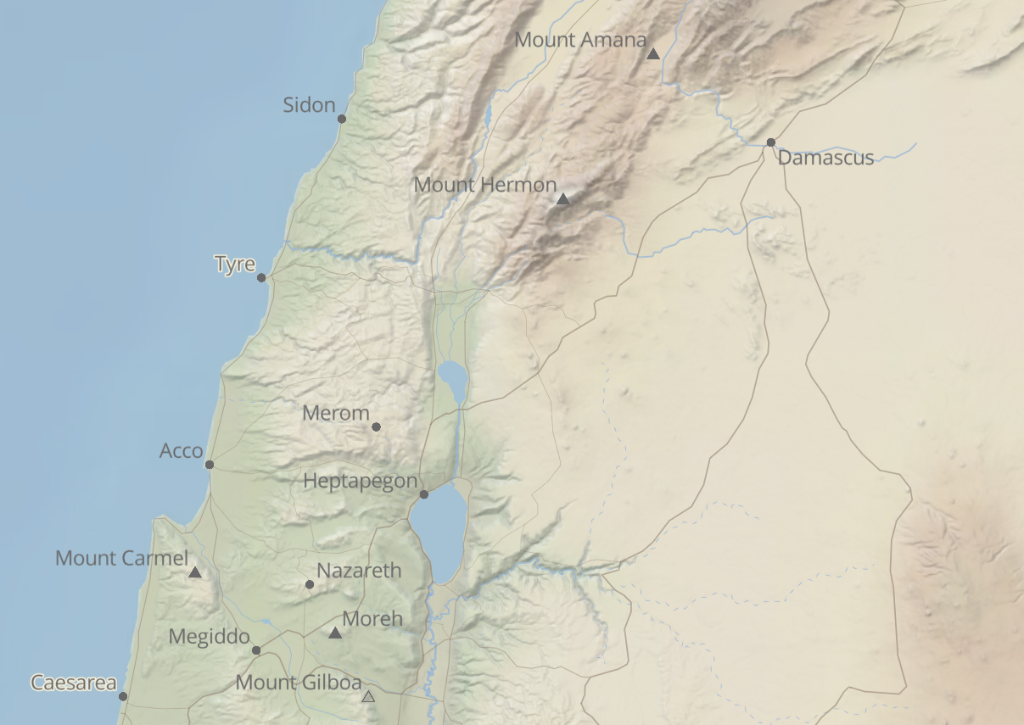
Isaiah / ישעיה
http://www.matsati.com

Slide 4
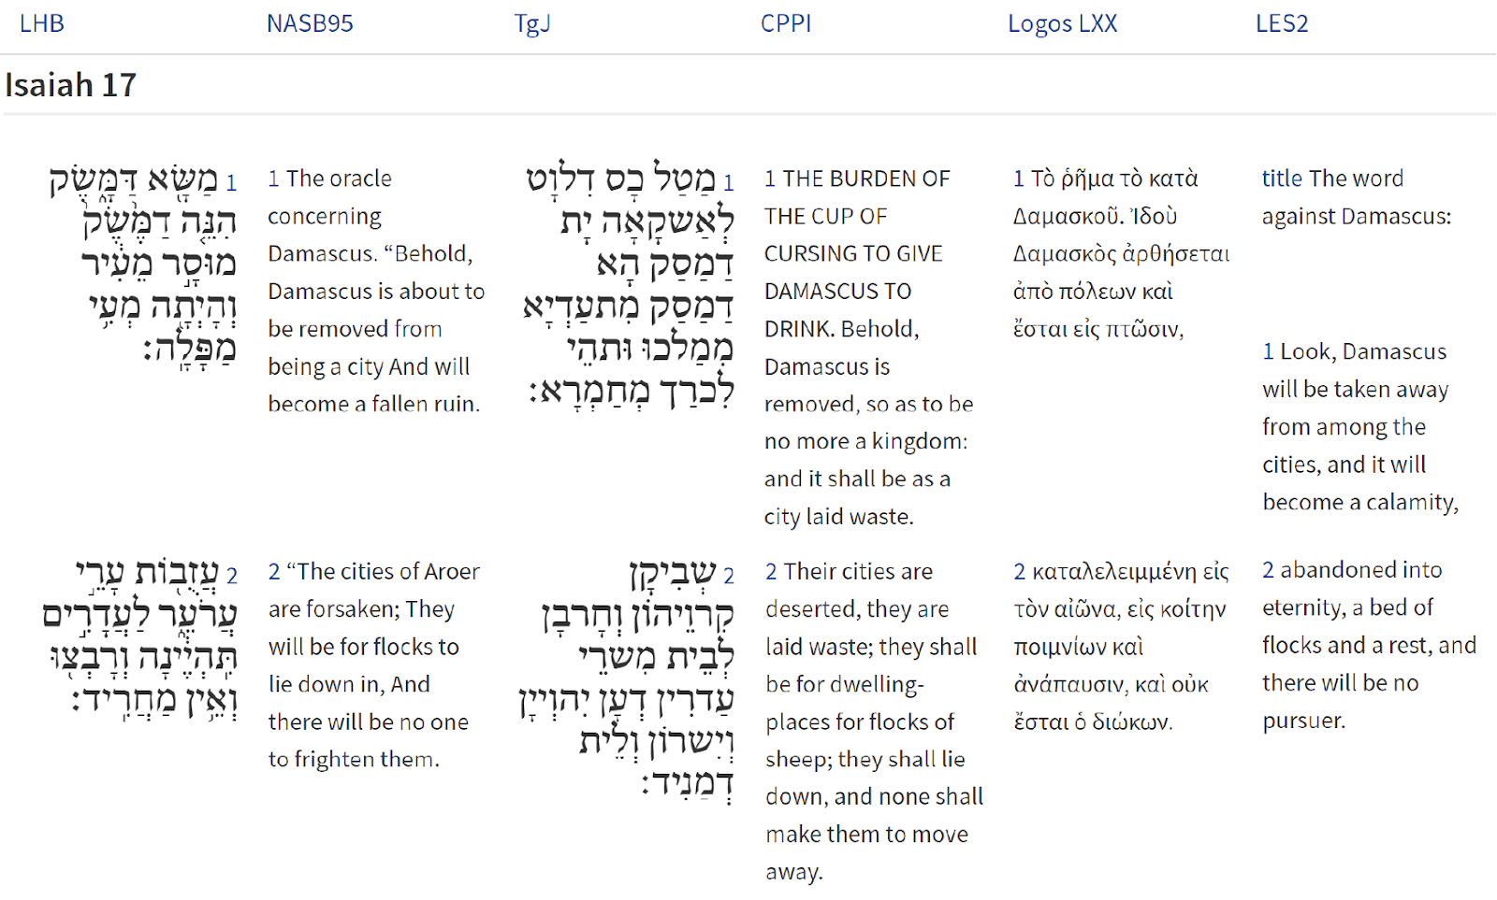
Isaiah / ישעיה
http://www.matsati.com

Slide 5
Isaiah / ישעיה
http://www.matsati.com

Slide 6
ספר במדבר יג
לא וַיּוֹצִ֜יאוּ דִּבַּ֤ת הָאָ֙רֶץ֙ אֲשֶׁ֣ר תָּר֣וּ אֹתָ֔הּ אֶל־בְּנֵ֥י יִשְׂרָאֵ֖ל לֵאמֹ֑ר הָאָ֡רֶץ אֲשֶׁר֩ עָבַ֨רְנוּ בָ֜הּ לָת֣וּר אֹתָ֗הּ אֶ֣רֶץ אֹכֶ֤לֶת יוֹשְׁבֶ֙יהָ֙ הִ֔וא וְכָל־הָעָ֛ם אֲשֶׁר־רָאִ֥ינוּ בְתוֹכָ֖הּ אַנְשֵׁ֥י מִדּֽוֹת׃ לג וְשָׁ֣ם רָאִ֗ינוּ אֶת־הַנְּפִילִ֛ים בְּנֵ֥י עֲנָ֖ק מִן־הַנְּפִלִ֑ים וַנְּהִ֤י בְעֵינֵ֙ינוּ֙ כַּֽחֲגָבִ֔ים וְכֵ֥ן הָיִ֖ינוּ בְּעֵינֵיהֶֽם׃
Bamidbar / Numbers 13:32-33
13:32 And they brought up ﻿an evil report of the land which they had searched unto the children of Israel, saying, The land, through which we have gone to search it, is a land that eateth up the inhabitants thereof; and ﻿all the people that we saw in it are ﻿men of a great stature. 13:33 And there we saw ﻿the giants, the sons of Anak, which come of ﻿the giants: and we were in our own sight as ﻿grasshoppers, and so we were in their sight. (KJV)
Isaiah / ישעיה
http://www.matsati.com

Slide 7
Luke 10:1-3
10 And after these things, Jesus separated from among his disciples seventy other persons, and sent them, two and two, before his face, to every place and city whither he was to go. 2 And he said to them: The harvest is great, and the laborers few: pray ye, therefore, the lord of the harvest, that he would send laborers into his harvest. 3 Go ye: lo, I send you forth, as sheep among wolves. (JM)
ܒܴ݁ܬ݂ܱܪ ܗܳܠܷܝܢ ܆ ܦ݁ܪܱܫ ܝܶܫܽܘܥ ܡܶܢ ܬܱ݁ܠܡܺܝ̈ܕ݂ܰܘܗ̄ܝ ܐ̱ܚܪܴ̈ܢܶܐ ܂ ܫܰܒ݂ܥܺܝܢ ܂ ܘܫܰܕܱ݁ܪ ܐܷܢܽܘܢ ܬ݁ܪܷ̈ܝܢ ܬ݁ܪܷ̈ܝܢ ܩܕ݂ܳܡ ܦܱ݁ܪܨܾܘܦܷ݁ܗ ܇ ܠܟ݂ܽܠ ܐܱܬ݂ܱܪ ܘܰܡܕ݂ܺܝܢܳܐ ܂ ܕܱ݁ܥܬ݂ܻܝܕ݂ ܗܘܳܐ ܠܡܺܐܙܰܠ ܀ܘܶܐܡܰܪ ܠܗܽܘܢ ܚܨܴܕ݂ܳܐ ܣܰܓܻ݁ܝ ܁ ܘܦ݂ܳܥ̈ܠܷܐ ܙܥܽܘܪܻ̈ܝܢ ܂ ܒ݁ܥܰܘ ܗܳܟ݂ܺܝܠ ܡܶܢ ܡܳܪܷܐ ܚܨܴܕ݂ܳܐ ܆ ܕ݁ܢܰܦܷ݁ܩ ܦܴ݁ܥ̈ܠܷܐ ܠܱܚܨܴܕ݂ܶܗ ܀ ܙܶܠܘ ܂ ܗܳܐ ܐܷܢܳܐ ܡܫܰܕܱ݁ܪ ܐ̱ܢܳܐ ܠܟ݂ܽܘܢ ܂ ܐܱܝܟ݂ ܐܷܡܪܷ̈ܐ ܒܱ݁ܝܢܰܝ ܕܻ݁ܐܒ݂ܷ̈ܐ ܂
Isaiah / ישעיה
http://www.matsati.com

Slide 8
Rabbinic Literature
ספרות רבנית
Part 2
Isaiah / ישעיה
http://www.matsati.com

Slide 9
Targum Jonathan son of Uziel Isaiah 17:1-7
17:1 The burden of the cup of cursing to give Damascus to drink. Behold, Damascus is removed, so as to be no more a kingdom: and it shall be as a city laid waste. 17:2 Their cities are deserted, they are laid waste; they shall be for dwelling-places for flocks of sheep; they shall lie down, and none shall make them to move away. 17:3 The government shall cease from Ephraim, and the kingdom from Damascus, and the remnant of the solitary ones from Syria, and their glory shall be as the glory of the children of Israel, saith the Lord of hosts. 17:4 And it shall come to pass at that time, that the glory of Jacob shall be humbled, and the riches of his glory shall be carried away. 17:5 And it shall be, as when one gathereth the standing harvest, and reapeth the ears with his arm; and it shall be as one that is gathering ears in the valley of giants. 17:6 Yet a gleaning shall be left in it, as in the shaking of the olive tree, two or three berries on the top of the uppermost branch; so shall the righteous be left lonely in the midst of the world, among the kingdoms, saith the Lord, the God of Israel. 17:7 At that time a man shall stay himself upon the service of his Maker, and his eyes shall hopefully look for the Word, the Holy One of Israel. (TgJ)
Isaiah / ישעיה
http://www.matsati.com

Slide 10
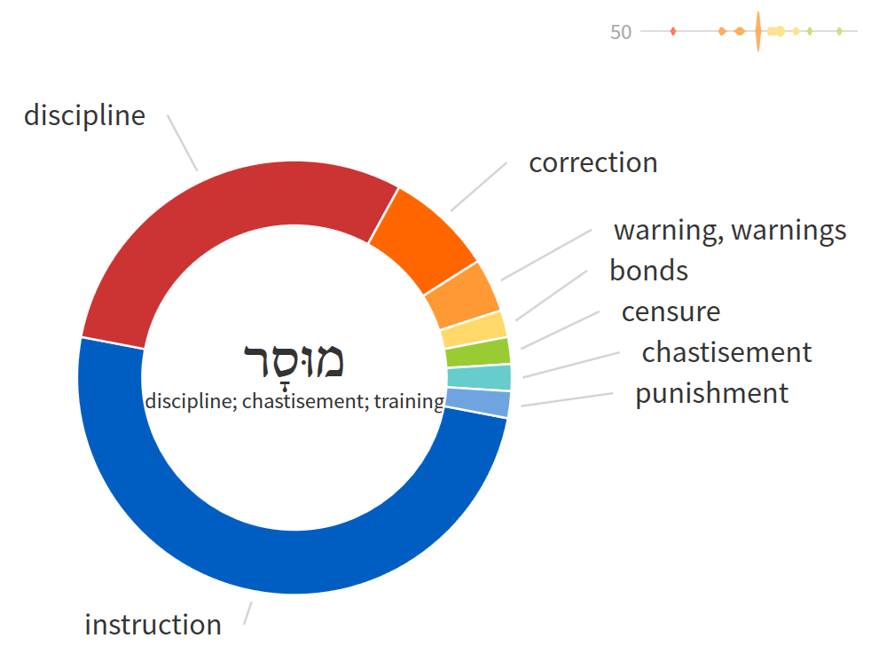
ספר בראשית פרק ד
﻿ז הֲלוֹא אִם-תֵּיטִיב שְֹאֵת וְאִם לֹא תֵיטִיב לַפֶּתַח חַטָּאת רֹבֵץ וְאֵלֶיךָ תְּשׁוּקָתוֹ וְאַתָּה תִּמְשָׁל-בּוֹ:
ΓΕΝΕΣΙΣ 4:7
4:7 οὐκ, ἐὰν ὀρθῶς προσενέγκῃς, ὀρθῶς δὲ μὴ διέλῃς, ἥμαρτες; ἡσύχασον, πρὸς σὲ ἡ ἀποστροφὴ αὐτοῦ, καὶ σὺ ἄρξεις αὐτοῦ.
Bereshit / Genesis 4:7
4:7 If thou doest well, shalt thou not be accepted? and if thou doest not well, sin lieth at the door. And unto thee shall be his desire, and thou shalt rule over him. (KJV)
Isaiah / ישעיה
http://www.matsati.com

Slide 11
Rashi on Isaiah 17.2 Part 1
The cities of Aroer are abandoned; Jonathan renders this as an expression of destruction. Comp. (Jer. 51:58) “shall be destroyed (עַרְעֵר תִּתְעַרְעַר), and he explained it in reference to the cities of Aram, i. e., Jonathan renders it: Their cities are abandoned, they are destroyed. The Midrash Aggadah (introduction to Lam. Rabbah 10 [with variations], Yalkut Machin) asks in amazement, since Aroer was [part] of Eretz Israel, as it is said (Num. 32:34): “and Aroer.'' He is dealing with Damascus and he announces matters concerning Aroer? But, since in Damascus there were streets as numerous as the days of the solar year, and in each one was a pagan deity, which they would worship one day in the year, and the Israelites made them all into one group and worshiped all of them every day, he, therefore, mentioned the downfall of Aroer juxtaposed to Damascus. I explain it, however, according to the simple meaning of the verse, as follows: Since Rezin and Pekah son of Remaliah joined together, and the prophet prophesying about the downfall of Damascus, and saying, “Behold, Damascus shall be removed from [being] a city,” and the cities of Aroer which belonged to Pekah were already abandoned, for the Reubenites and the Gadites had already been exiled, and they were always given to the flocks of sheep, and the sheep of Moab would lie there undisturbed, he continues to say that the kingdom of Pekah shall continue to be gradually terminated, and that Samaria, too, shall be captured in the days of Hoshea, and then (v. 3) And a fortress shall cease from Ephraim and a kingdom from Damascusfor Rezin shall be killed.
Isaiah / ישעיה
http://www.matsati.com

Slide 12
הַבְּשׂוֹרָה עַל־פִּי לוּקַס פרק יג
א בְּאוֹתָהּ עֵת הָיוּ שָׁם אֲנָשִׁים שֶׁסִּפְּרוּ לוֹ עַל הַגְּלִילִיִּים אֲשֶׁר פִּילָטוֹס עֵרַב אֶת דָּמָם בְּזִבְחֵיהֶם. ב הֵשִׁיב לָהֶם יֵשׁוּעַ׃ ״הַאִם מִפְּנֵי שֶׁהַגְּלִילִיִּים הָאֵלֶּה סָבְלוּ זֹאת סְבוּרִים אַתֶּם שֶׁהֵם הָיוּ חוֹטְאִים גְּדוֹלִים יוֹתֵר מִכָּל אַנְשֵׁי הַגָּלִיל? ג לֹא! אוֹמֵר אֲנִי לָכֶם. אַךְ אִם לֹא תַּחְזְרוּ בִּתְשׁוּבָה, כֻּלְכֶם תֹּאבְדוּ כְּמוֹתָם.
Luke 13:1-3
13:1 There were present at that season some that told him of the Galilaeans, whose blood Pilate had mingled with their sacrifices. 13:2 And Jesus answering said unto them, Suppose ye that these Galilaeans were sinners above all the Galilaeans, because they suffered such things? 13:3 I tell you, Nay: but, except ye repent, ye shall all likewise perish. (KJV)
Isaiah / ישעיה
http://www.matsati.com

Slide 13
Rashi on Isaiah 17.5 Part 1-2
והיה כאסוף קציר קמה. כמו שבעת קצירת קמה אוסף הקוצר צבת הקמה ביד אחת וזרועו השנית שבלים יקצור במגל כן יעקור סנחרב ויגלה הכל ואף לקט הנושר בשעת קציר' ילקט וישאנו כלומ' אף הבורחים לא ימלטו מידו וילקטום (כמו שמלקט שבלים סא"א):
And it shall be like gathering the harvest of the standing grain Just as at the time of the harvest, the reaper gathers the bundle of the standing grain in his one hand and with his other arm he reaps the ears, so will Sennacherib uproot and exile everyone, and even the gleanings that fall at the time of harvest he will gather and carry it off. That is to say that even those who flee will not escape his hand, and they will gather them [var. and he will gather them] [like one who gathers ears].
בעמק רפאים. הוא הגיא אשר על פני ירושלים בספר יהושע תמצא שעמק רפאים סמוכה לירושלים:
in the valley of Rephaim That is the valley that is before Jerusalem. In the Book of Joshua (15:8, 18:16) you will find that the valley of Rephaim adjoins Jerusalem.
Isaiah / ישעיה
http://www.matsati.com

