Slide 1
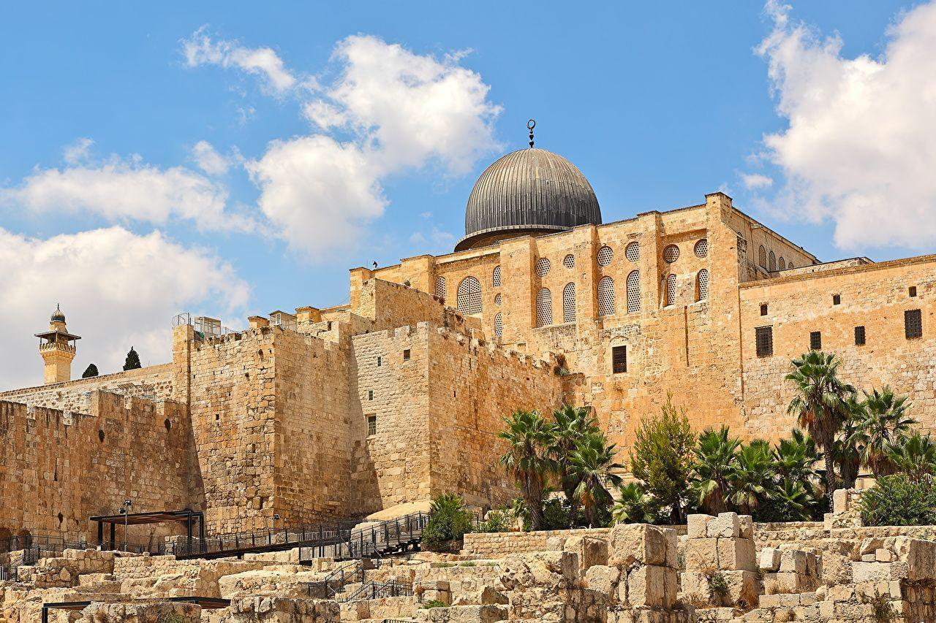

Isaiah 16:8-14
ישעיהו טז:ח-יד
Isaiah / ישעיה
http://www.matsati.com

Slide 2
Psalms (68 times)
Isaiah (55)
Deuteronomy (44)
Genesis (35)
Exodus (31)
Leviticus (13)
Proverbs (8)
Zechariah (7)
Jeremiah (5)
Hosea (5)
א יְהֹון מַסְקֵי מִסִין לִמשִיחָא דְיִשׂרָאֵל דְתַקֵיף עַל דַהְוָה כְמַדבְרָא טוּר כְנִשתָא דְצִיֹון׃
16:1 They shall bring tributes to the Messiah of Israel, who shall prevail over those who are in the wilderness, unto the mountain of the congregation of Zion. (TgJ)
Torah = Genesis(35)
+ Exodus(31)
+ Leviticus(13)
+ Deuteronomy(44)
= 123 times
Isaiah / ישעיה
http://www.matsati.com

Slide 3


























ספר ישעיה פרק טז
﻿ח כִּי שַׁדְמוֹת חֶשְׁבּוֹן אֻמְלָל גֶּפֶן שִֹבְמָה בַּעֲלֵי גוֹיִם הָלְמוּ שְֹרוּקֶּיהָ עַד-יַעְזֵר נָגָעוּ תָּעוּ מִדְבָּר שְׁלֻחוֹתֶיהָ נִטְּשׁוּ עָבְרוּ יָם: ט עַל-כֵּן אֶבְכֶּה בִּבְכִי יַעְזֵר גֶּפֶן שִֹבְמָה אֲרַיָּוֶךְ דִּמְעָתִי חֶשְׁבּוֹן וְאֶלְעָלֵה כִּי עַל-קֵיצֵךְ וְעַל-קְצִירֵךְ הֵידָד נָפָל: י וְנֶאֱסַף שִֹמְחָה וָגִיל מִן-הַכַּרְמֶל וּבַכְּרָמִים לֹא-יְרֻנָּן לֹא יְרֹעָע יַיִן בַּיְקָבִים לֹא-יִדְרֹךְ הַדֹּרֵךְ הֵידָד הִשְׁבַּתִּי: יא עַל-כֵּן מֵעַי לְמוֹאָב כַּכִּנּוֹר יֶהֱמוּ וְקִרְבִּי לְקִיר חָרֶשֹ: יב וְהָיָה כִי-נִרְאָה כִּי-נִלְאָה מוֹאָב עַל-הַבָּמָה וּבָא אֶל-מִקְדָּשׁוֹ לְהִתְפַּלֵּל וְלֹא יוּכָל: יג זֶה הַדָּבָר אֲשֶׁר דִּבֶּר יְהֹוָה אֶל-מוֹאָב מֵאָז: יד וְעַתָּה דִּבֶּר יְהֹוָה לֵאמֹר בְּשָׁלשׁ שָׁנִים כִּשְׁנֵי שָֹכִיר וְנִקְלָה כְּבוֹד מוֹאָב בְּכֹל הֶהָמוֹן הָרָב וּשְׁאָר מְעַט מִזְעָר לוֹא כַבִּיר:
Isaiah / ישעיה
http://www.matsati.com

Slide 4
HESHBON (Hebrew הֶשְׁבּוֹן, heshbon; Greek Εσβους, Esbous) This is a city of Moab mentioned 38 times in the Old Testament. Heshbon was located along the King’s Highway. The first reference to Heshbon describes it as the capital city of Sihon, king of the Amorites-the first king defeated by the Israelites in the Transjordan region (Bamidbar / Numbers 21:21-26). The text indicates that Heshbon had only recently been captured by Sihon, who had deposed the “former king of Moab and taken all his land” (Bamidbar / Numbers 21:26). After the Israelites defeated Sihon, they inhabited Heshbon and the surrounding area (Bamidbar / Numbers 21:25). Later, Sihon’s territory is divided between the tribes of Reuben and Gad, with Heshbon apparently assigned to Reuben (Joshua 13:15–17, 13:24–27). Several prophets refer to Heshbon within oracles against Moab like we find here in Isaiah 15:4 and 16:8-9. (see also Jeremiah 48:2, 48:34, 48:45) It also is mentioned in an oracle against Ammon (Jeremiah 49:3) which suggests that the Ammonites seized control of Heshbon from the Moabites sometime during The three hundred and fifty years of the Iron II period (Between 900 and 750 BCE).
Isaiah / ישעיה
http://www.matsati.com

Slide 5
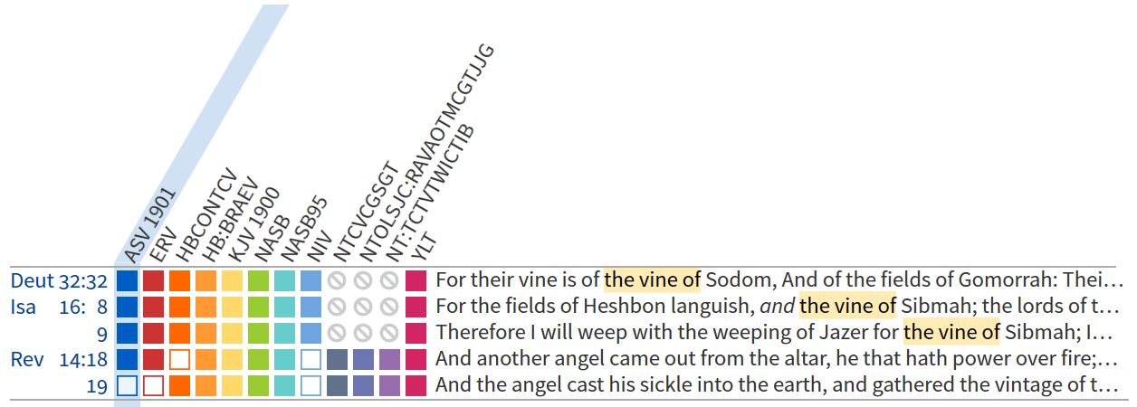

SIBMAH (שִׂבְמָה, sivmah; שְׂבָם, sevam) A town in Moab rebuilt and occupied by the tribe of Reuben. It is named along with Heshbon, Elealeh and Nebo (Bamidbar / Numbers 32:3). While spelled “Sebam” in the Masoretic Text of Bamidbar / Numbers 32:3, it is probably the same place as the Sibmah mentioned in Bamidbar / Numbers 32:38 and Joshua 13:19. In the time of Isaiah and Jeremiah it was a Moabite town, but it is unknown when it was taken from Israel. It was famous for its vineyards (Isaiah 16:8, Jeremiah 48:32). According to Jerome (Commentary on Isaiah, 5) it was about 500 paces from Heshbon.
Isaiah / ישעיה
http://www.matsati.com

Slide 6



ספר הושע פרק יא
א כִּ֛י נַ֥עַר יִשְׂרָאֵ֖ל וָאֹהֲבֵ֑הוּ וּמִמִּצְרַ֖יִם קָרָ֥אתִי לִבְנִֽי׃ ב קָרְא֖וּ לָהֶ֑ם כֵּ֚ן הָלְכ֣וּ מִפְּנֵיהֶ֔ם לַבְּעָלִ֣ים יְזַבֵּ֔חוּ וְלַפְּסִלִ֖ים יְקַטֵּרֽוּן׃ ג וְאָנֹכִ֤י תִרְגַּ֙לְתִּי֙ לְאֶפְרַ֔יִם קָחָ֖ם עַל־זְרֽוֹעֹתָ֑יו וְלֹ֥א יָדְע֖וּ כִּ֥י רְפָאתִֽים׃ ד בְּחַבְלֵ֨י אָדָ֤ם אֶמְשְׁכֵם֙ בַּעֲבֹת֣וֹת אַהֲבָ֔ה וָאֶהְיֶ֥ה לָהֶ֛ם כִּמְרִ֥ימֵי עֹ֖ל עַ֣ל לְחֵיהֶ֑ם וְאַ֥ט אֵלָ֖יו אוֹכִֽיל׃ ה לֹ֤א יָשׁוּב֙ אֶל־אֶ֣רֶץ מִצְרַ֔יִם וְאַשּׁ֖וּר ה֣וּא מַלְכּ֑וֹ כִּ֥י מֵאֲנ֖וּ לָשֽׁוּב׃ ו וְחָלָ֥ה חֶ֙רֶב֙ בְּעָרָ֔יו וְכִלְּתָ֥ה בַדָּ֖יו וְאָכָ֑לָה מִֽמֹּעֲצ֖וֹתֵיהֶֽם׃ ז וְעַמִּ֥י תְלוּאִ֖ים לִמְשֽׁוּבָתִ֑י וְאֶל־עַל֙ יִקְרָאֻ֔הוּ יַ֖חַד לֹ֥א יְרוֹמֵֽם׃ ח אֵ֞יךְ אֶתֶּנְךָ֣ אֶפְרַ֗יִם אֲמַגֶּנְךָ֙ יִשְׂרָאֵ֔ל אֵ֚יךְ אֶתֶּנְךָ֣ כְאַדְמָ֔ה אֲשִֽׂימְךָ֖ כִּצְבֹאיִ֑ם נֶהְפַּ֤ךְ עָלַי֙ לִבִּ֔י יַ֖חַד נִכְמְר֥וּ נִחוּמָֽי׃ ט לֹ֤א אֶֽעֱשֶׂה֙ חֲר֣וֹן אַפִּ֔י לֹ֥א אָשׁ֖וּב לְשַׁחֵ֣ת אֶפְרָ֑יִם כִּ֣י אֵ֤ל אָֽנֹכִי֙ וְלֹא־אִ֔ישׁ בְּקִרְבְּךָ֣ קָד֔וֹשׁ וְלֹ֥א אָב֖וֹא בְּעִֽיר׃
Hosea 11:1-9
Isaiah / ישעיה
http://www.matsati.com

Slide 7
KIR-HARESETH (קִיר חֲרֶשֶׂת) A capital of ancient Moab identified with modern Kerak (M.R. 217066), located ca. 17 miles S of the Arnon and 11 miles E of the Dead Sea. Strategically located on a promontory that overlooks the Dead Sea, Kerak sits astride a major intersection of the King’s Highway and the E–W road across the plateau. This position has witnessed many important events in the region’s history, in the days of Mesha (2 Kings 3:25–27), during the Crusades, and into the present. Kir-hareseth is mentioned in Isaiah 16:7, and Kir-heres, an alternate name, appears in the oracles of Isaiah 16:11 and Jeremiah 48:31, 48:36. KIR, according to Isaiah 15:1, is probably the same town.
Isaiah / ישעיה
http://www.matsati.com

Slide 8
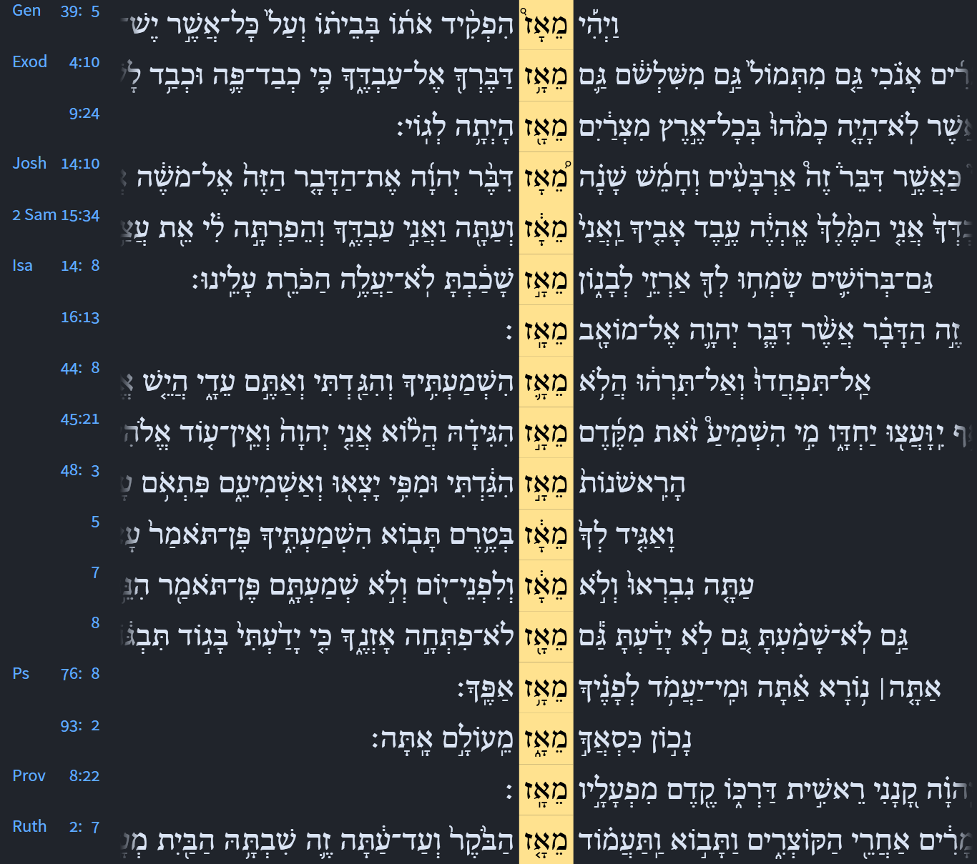


Shemot / Exodus 9:24
9:24 So there was hail, and fire mingled with the hail, very grievous, such as there was none like it in all the land of Egypt since it became a nation.
Isaiah 16:13
16:13 This is the word that the LORD hath spoken concerning Moab since that time.
Isaiah 48:3
48:3 I have declared the former things from the beginning; and they went forth out of my mouth, and I shewed them; I did them suddenly, and they came to pass.
Isaiah / ישעיה
http://www.matsati.com

Slide 9
Rabbinic Literature
ספרות רבנית
Part 2
Isaiah / ישעיה
http://www.matsati.com

Slide 10
Targum Jonathan son of Uziel Isaiah 16:1-7
16:8 Because the armies of Heshbon are spoiled, the multitude of Sebama are killed, the kings of the people have killed their rulers; they reached unto Jazer; they strayed to the desert; their fugitives passed by, they crossed the sea. 16:9 Therefore, as I have brought armies against Jazer, so will I bring slayers against Sibmah; I will water thee with my tears, O Heshbon and Elealeh! for upon thy harvest, and upon thy vintage the robbers have fallen. 16:10 And joy is taken away and gladness out of the fruitful field, and in the vineyards they shall not rejoice, neither shall they play sport; in the vats the treaders shall not tread out the wine; the treading of grapes I have made to cease. 16:11 Wherefore the bowels of the Moabites shall sound as a harp, and their heart shall mourn over the men of the city of their strength. 16:12 And it shall come to pass, that one shall see, that when Moab is wearied out upon his high place, he shall enter his idol-temple to pray, yet he shall not prevail. 16:13 This is the word which the Lord spake concerning the Moabites long ago: 16:14 But now the Lord hath spoken, saying: Within three years, as the years of an hireling, the glory of the Moabites shall come to an end, with all that great multitude; and the remnant shall be small, a few; all their glory shall come to an end. (TgJ)
Isaiah / ישעיה
http://www.matsati.com

Slide 11
Examples of the Lord God having an emotional
response to what happens here on earth.
He has sorrow when we rebel against Him (Bereshit / Genesis 6:6, Tehillim / Psalm 78:40).
He can be provoked to anger by our defiance and rejection of Him (Isaiah 65:1-3, Jeremiah 8:19).
He feels jealousy because of idolatry and worldliness (Shemot / Exodus 20:5, 34:14, Joshua 24:19).
He rejoices with love over His children (Zephaniah 3:17, Isaiah 62:5).
He hates wickedness (Tehillim / Psalm 5:5, 11:5, Mishley / Proverbs 6:16).
He has great compassion for His creation (Tehillim / Psalm 103:8, Joel 2:13).
Isaiah / ישעיה
http://www.matsati.com

Slide 12
Rashi on Isaiah 16:9 Part 1-4
אבכה בבכי יעזר. ת"י כמא דאייתיתי משריין על יעזר כן אייתי קטולין על שבמה ולשון המקרא הנביא אומר כעין קינות יעזר יש לי עליך לקונן את הגפן שבמה:
I will weep with the weeping of Jazer Jonathan paraphrases: As I brought camps upon Jazer, so will I bring killers upon Sibmah, and, according to the wording of the verse, the prophet states: Similar to the lamentations of Jazer, I have to lament over you, the vine of Sibmah.
אריוך דמעתי. אתרוה עליך דמעה יש תיבה משמשת כשתי תיבות כמו בני יצאוני (ירמיהו י׳:כ׳) ארץ הנגב נתתני (יהושע טז) דברו לשלום (בראשית לז):
I will be sated over you with my tears Heb. אַרְיָוֶךְ, I will be sated over you. There are some words that serve as two words. Comp. (Jer. 10:20) “My children went out of meיְצֵאוּנִי)”; Jos. 15:19) “A dry land you have given to meנְתַתָּנִי)”; Gen. 37:4) “To speak to him (דַּבְּרוֹ) peacefully.”
קיצך. תאנים שמייבשין בקיץ:
your figs Heb.קִיצֵךְ), ) the figs that are dried out in the summer.
הידד. קול שודדים ובוזזים: a shout the noise of robbers and spoilers.
Isaiah / ישעיה
http://www.matsati.com

Slide 13
Midrash Bamidbar Rabbah 20:1
"And Balak son of Zippor saw": The Torah says (Deuteronomy 32) "The Rock--perfect is His work for all of His ways are justice." Hashem did not give the non-Jews an opening to say in the future "You have distanced us." What did Hashem do? Just like He set up kings and sages and prophets for the Jews, He set these up for the non-Jews. He set up Shlomo as a king over the Jews and the entire earth, and He did the same for Nebuchadnezzar. This one built the Beit Hamikdash and said "How many praises and supplications there are!" and this one destroyed it and scoffed and said (Isaiah 14): "I will ascend to the heights of the clouds." He gave David riches, and he took his house for His Name. And he gave Haman riches, and he took an entire nation to be slaughtered. All the greatness that the Jews took, you find that the nations took. Another example: He set up Moshe for the Jews and Bilaam for the nations. Understand what the difference is between Jewish prophets and non-Jewish prophets? Jewish prophets exhort the people about their sins, as it says (Ezekiel 3): "And you, son of man, I have appointed you as a watchman etc." And the prophet from among the nations caused a breach to drive the creations from the world. Not only this, but all the prophets were [given prophecy] from the attribute of mercy on the Jews and the non-Jews, as Yirmiyah said (Jeremiah 48): "My heart to Moav is as pipes moan." And as Yechezkel said (Ezekiel 27): "Son of man, lament for Tyre." And this cruel one stood to uproot an entire nation for no reason. Therefore the passage of Bilaam was written, to make it known why Hashem took away the holy spirit from non-Jews, for this one was from them and see what he did.
Isaiah / ישעיה
http://www.matsati.com

Slide 14

Ibn Ezra on Isaiah 16:12 Part 1
והיה כי נראה כי נלאה מואב. עלה על הבמה לע"ז, או נלאה על הבמה כטעם ולא יוכל, והוא הנכון:
Moab is weary, etc. He is tired of going up to the high place for the worship of idols; or it is to be taken in the same sense as ולא יוכל And he shall not prevail. The second explanation is preferable. According to the first explanation, the Moabites visit the high place so often, that they are tired of it; they see that it is without any use for them. According to the second, they wish to worship on the high places, but they are weary before reaching them, because of the continual trouble and anxiety caused by the enemy.
Isaiah / ישעיה
http://www.matsati.com

Slide 15
John 4:5-13
4:5 Then cometh he to a city of Samaria, which is called Sychar, near to the parcel of ground that Jacob gave to his son Joseph. 4:6 Now Jacob's well was there. Jesus therefore, being wearied with his journey, sat thus on the well: and it was about the sixth hour. 4:7 There cometh a woman of Samaria to draw water: Jesus saith unto her, Give me to drink. 4:8 (For his disciples were gone away unto the city to buy meat.) 4:9 Then saith the woman of Samaria unto him, How is it that thou, being a Jew, askest drink of me, which am a woman of Samaria? for the Jews have no dealings with the Samaritans. 4:10 Jesus answered and said unto her, If thou knewest the gift of God, and who it is that saith to thee, Give me to drink; thou wouldest have asked of him, and he would have given thee living water. 4:11 The woman saith unto him, Sir, thou hast nothing to draw with, and the well is deep: from whence then hast thou that living water? 4:12 Art thou greater than our father Jacob, which gave us the well, and drank thereof himself, and his children, and his cattle? 4:13 Jesus answered and said unto her, Whosoever drinketh of this water shall thirst again: (KJV)
ܘܶܐܬ݂ܴܐ ܠܱܡܕ݂ܺܝܢ̄ܬܴ݁ܐ ܕ݁ܫܳܡܪܴ̈ܝܶܐ ܁ ܕ݁ܡܶܬ݂ܩܰܪܝܳܐ ܫܳܟ݂ܰܪ ܂ ܥܰܠ ܓܷ݁ܢ̄ܒ݂ ܩܪܻܝܬ݂ܴܐ ܂ ܕ݁ܝܰܗ̄ܒ݂ ܗ̄ܘܳܐ ܝܰܥܩܽܘܒ݂ ܠܝܰܘܣܶܦ݂ ܒ݁ܪܷܗ ܂ܘܺܐܝܬ݂ ܗ̄ܘܳܐ ܬܱ݁ܡܳܢ ܡܥܺܝܢܳܐ ܕ݁ܡܰܝܴ̈ܐ ܕ݁ܝܰܥܩܽܘܒ݂ ܂ ܗܽܘ ܕܷ݁ܝܢ ܝܶܫܽܘܥ ܠܐܷܐ ܗ̄ܘܳܐ ܡܶܢ ܥܰܡܠܴܐ ܕܾ݁ܐܘܪܚܳܐ ܂ ܘܺܝܬ݂ܷܒ݂ ܗ̄ܘܳܐ ܠܷܗ ܥܰܠ ܡܥܺܝܢܳܐ ܂ ܘܺܐܝܬ݂ ܗ̄ܘܰܝ̈ ܫܶܬ݂ ܫܳܥܺܝ̈ܢ ܂ ܘܶܐܬ݂ܴܬ݂ ܐܱܢ̄ܬ݁ܬ݂ܴܐ ܡܶܢ ܫܳܡܪܻܝܢ ܕ݁ܬ݂ܷܡܠܷܐ ܡܰܝܴ̈ܐ ܂ ܘܶܐܡܰܪ ܠܴܗ ܝܶܫܽܘܥ ܂ ܗܰܒ݂ ܠܻܝ ܡܰܝܴ̈ܐ ܐܷܫܬܷ݁ܐ ܂ ܬܱ݁ܠܡܺܝ̈ܕ݂ܰܘܗ̄ܝ ܓܷ݁ܝܪ ܥܰܠܘ ܗ̄ܘܰܘ ܠܱܡܕ݂ܺܝܢ̄ܬܴ݁ܐ ܂ ܕ݁ܢܶܙܒ݁ܢܽܘܢ ܠܗܽܘܢ ܣܰܝܒܴ݁ܪܬܴ݁ܐ ܂ ܐܴܡܪܴܐ ܠܷܗ ܗܳܝ ܐܱܢ̄ܬ݁ܬ݂ܴܐ ܫܳܡܪܴܝܬܴ݁ܐ ܂ ܐܱܝܟܱ݁ܢܳܐ ܐܱܢ̄ܬ݁ ܝܺܗܽܘܕ݂ܳܝܳܐ ܐܱܢ̄ܬ݁ ܇ ܘܡܶܢܝ ܫܳܐܷܠ ܐܱܢ̄ܬ݁ ܠܡܶܫܬܴ݁ܐ ܂ ܕܻ݁ܐܝܬ݂ܱܝ ܐܱܢ̄ܬ݁ܬ݂ܴܐ ܫܳܡܪܴܝܬܴ݁ܐ ܂ ܠܴܐ ܓܷ݁ܝܪ ܡܶܬ݂ܚܰܫܚܺܝܢ ܝܺܗܽܘܕ݂ܳܝܷ̈ܐ ܥܰܡ ܫܳܡܪܴ̈ܝܶܐ ܂ ܥܢܳܐ ܝܶܫܽܘܥ ܂ ܘܶܐܡܰܪ ܠܴܗ ܂ ܐܷܠܾܘ ܝܳܕ݂ܥܳܐ ܗ̄ܘܰܝܬ݁ܝ ܡܰܘܗܰܒ݂ܬܴ݁ܐ ܕܱ݁ܐܠܴܗܳܐ ܞ ܘܡܰܢܽܘ ܗܳܢܳܐ ܕܷ݁ܐܡܰܪ ܠܷܟ݂ܝ ܂ ܗܰܒ݂ ܠܻܝ ܐܷܫܬܷ݁ܐ ܆ ܐܱܢ̄ܬ݁ܝ ܫܳܐܠܴܐ ܗ̄ܘܰܝܬ݁ܝ ܠܷܗ ܂ ܘܝܳܗܶܒ݂ ܗ̄ܘܳܐ ܠܷܟ݂ܝ ܡܰܝܴ̈ܐ ܚܰܝܷ̈ܐ ܂ ܐܴܡܪܴܐ ܠܷܗ ܐܱܢ̄ܬ݁ܬ݂ܴܐ ܗܳܝ ܂ ܡܳܪܝ ܆ ܠܴܐ ܕܱ݁ܘܠܴܐ ܐܻܝܬ݂ ܠܴܟ݂ ܁ ܘܒ݂ܺܪܴܐ ܥܰܡܺܝܩܳܐ ܂ ܐܱܝܡܶܟܴ݁ܐ ܠܴܟ݂ ܡܰܝܴ̈ܐ ܚܰܝܷ̈ܐ ܂ ܠܡܳܐ ܐܱܢ̄ܬ݁ ܪܱܒ݂ ܐܱܢ̄ܬ݁ ܡܶܢ ܐܱܒ݂ܽܘܢ ܝܰܥܩܽܘܒ݂ ܞ ܗܰܘ ܕ݁ܗܽܘ ܝܰܗ̄ܒ݂ ܠܱܢ ܒܻ݁ܪܴܐ ܗܳܕ݂ܶܐ ܞ ܘܗܽܘ ܡܶܢܳܗ ܐܷܫܬܻ݁ܝ ܘܰܒ݂ܢܱ̈ܘܗ̄ܝ ܘܥܳܢܷ̈ܗ ܂ ܥܢܳܐ ܝܶܫܽܘܥ ܘܶܐܡܰܪ ܠܴܗ ܂ ܟܾ݁ܠ ܕ݁ܢܶܫܬܷ݁ܐ ܡܶܢ ܗܳܠܷܝܢ ܡܰܝܴ̈ܐ ܂ ܬܾ݁ܘܒ݂ ܢܶܨܗܶܐ ܂
Isaiah / ישעיה
http://www.matsati.com

Slide 16
John 4:14-24
4:14 But whosoever drinketh of the water that I shall give him shall never thirst; but the water that I shall give him shall be in him a well of water springing up into everlasting life. 4:15 The woman saith unto him, Sir, give me this water, that I thirst not, neither come hither to draw. 4:16 Jesus saith unto her, Go, call thy husband, and come hither. 4:17 The woman answered and said, I have no husband. Jesus said unto her, Thou hast well said, I have no husband: 4:18 For thou hast had five husbands; and he whom thou now hast is not thy husband: in that saidst thou truly. 4:19 The woman saith unto him, Sir, I perceive that thou art a prophet. 4:20 Our fathers worshiped in this mountain; and ye say, that in Jerusalem is the place where men ought to worship. 4:21 Jesus saith unto her, Woman, believe me, the hour cometh, when ye shall neither in this mountain, nor yet at Jerusalem, worship the Father. 4:22 Ye worship ye know not what: we know what we worship: for salvation is of the Jews. 4:23 But the hour cometh, and now is, when the true worshippers shall worship the Father in spirit and in truth: for the Father seeketh such to worship him. 4:24 God is a Spirit: and they that worship him must worship him in spirit and in truth. (KJV)
ܟܾ݁ܠ ܕܷ݁ܝܢ ܕ݁ܢܶܫܬܷ݁ܐ ܡܶܢ ܡܰܝܴ̈ܐ ܕܷ݁ܐܢܳܐ ܐܷܬܷ݁ܠ ܠܷܗ ܂ ܠܴܐ ܢܶܨܗܶܐ ܠܥܳܠܱܡ ܂ ܐܷܠܴܐ ܡܰܝܴ̈ܐ ܗܳܢܽܘܢ ܕ݁ܝܳܗܶܒ݂ ܐ̱ܢܳܐ ܠܷܗ ܆ ܢܶܗܘܽܘܢ ܒܷ݁ܗ ܡܥܺܝܢܳܐ ܕ݁ܡܰܝܴ̈ܐ ܁ ܕ݁ܢܳܒ݂ܥܺܝܢ ܠܚܰܝܷ̈ܐ ܕܱ݁ܠܥܳܠܱܡ ܂ܐܴܡܪܴܐ ܠܷܗ ܐܱܢ̄ܬ݁ܬ݂ܴܐ ܗܳܝ ܂ ܡܳܪܝ ܆ ܗܰܒ݂ ܠܻܝ ܡܶܢ ܗܳܠܷܝܢ ܡܰܝܴ̈ܐ ܂ ܕ݁ܠܴܐ ܬܾ݁ܘܒ݂ ܐܷܨܗܶܐ ܂ ܘܠܴܐ ܗܘܺܝܬ݂ ܐܴܬ݂ܝܳܐ ܕܴ݁ܠܝܳܐ ܡܶܢ ܗܳܪܟܴ݁ܐ ܂ ܐܴܡܰܪ ܠܴܗ ܝܶܫܽܘܥ ܂ ܙܶܠܝ ܩܪܴܝ ܠܒ݂ܰܥܠܷܟ݂ܝ ܂ ܘܬ݂ܴܝ ܠܗܳܪܟܴ݁ܐ ܂ ܐܴܡܪܴܐ ܠܷܗ ܂ ܠܱܝܬ݁ ܠܻܝ ܒܱ݁ܥܠܴܐ ܂ ܐܴܡܰܪ ܠܴܗ ܝܶܫܽܘܥ ܂ ܫܰܦܻ݁ܝܪ ܐܷܡܰܪܬ݁ܝ ܂ ܕ݁ܠܱܝܬ݁ ܠܻܝ ܒܱ݁ܥܠܴܐ ܂ ܚܰܡܫܳܐ ܓܷ݁ܝܪ ܒܱ݁ܥܠܻܝ̈ܢ ܗܘܰܘ ܠܷܟ݂ܝ ܂ ܘܗܳܢܳܐ ܕܻ݁ܐܝܬ݂ ܠܷܟ݂ܝ ܗܳܫܳܐ ܂ ܠܴܐ ܗܘܳܐ ܒܱ݁ܥܠܷܟ݂ܝ ܂ ܗܳܕ݂ܶܐ ܂ ܫܰܪܻܝܪܬܴ݁ܐ ܐܷܡܰܪܬ݁ܝ ܂ ܐܴܡܪܴܐ ܠܷܗ ܗܳܝ ܐܱܢ̄ܬ݁ܬ݂ܴܐ ܂ ܡܳܪܝ ܆ ܚܳܙܝܳܐ ܐ̱ܢܳܐ ܕܱ݁ܢܒ݂ܺܝܳܐ ܐܱܢ̄ܬ݁ ܂ ܐܱܒ݂ܳܗܰܝ̈ܢ ܒ݁ܗܳܢܳܐ ܛܾܘܪܴܐ ܣܓ݂ܶܕ݂ܘ ܂ ܘܰܐܢ̄ܬܾ݁ܘܢ ܐܴܡܪܻܝܢ ܐܢ̄ܬܾ݁ܘܢ ܂ ܕ݁ܒ݂ܽܐܘܪܻܫܠܷܡ ܗ̄ܽܘ ܐܱܬ݂ܱܪ ܕ݁ܘܳܠܷܐ ܠܡܶܣܓܱ݁ܕ݂ ܂ ܐܴܡܰܪ ܠܴܗ ܝܶܫܽܘܥ ܂ ܐܱܢ̄ܬ݁ܬ݂ܴܐ ܂ ܗܰܝܡܶܢܺܝܢܝ ܕܴ݁ܐܬ݂ܝܳܐ ܫܳܥܬ݂ܴܐ ܆ ܕ݁ܠܴܐ ܒ݁ܗܳܢܳܐ ܛܾܘܪܴܐ ܂ ܘܳܐܦ݂ ܠܴܐ ܒܾ݁ܐܘܪܻܫܠܷܡ ܬܷ݁ܣܓ݁ܕ݂ܽܘܢ ܠܱܐܒ݂ܳܐ ܂ ܐܱܢ̄ܬܾ݁ܘܢ ܣܳܓ݂ܕܻ݁ܝܢ ܐܢ̄ܬܾ݁ܘܢ ܂ ܠܡܶܕܷ݁ܡ ܕ݁ܠܴܐ ܝܳܕ݂ܥܺܝܢ ܐܢ̄ܬܾ݁ܘܢ ܂ ܚܢܰܢ ܕܷ݁ܝܢ ܣܳܓ݂ܕܻ݁ܝܢ ܚ̄ܢܰܢ ܂ ܠܡܳܐ ܕ݁ܝܳܕ݂ܥܺܝܢ ܚ̄ܢܰܢ ܂ ܕ݁ܚܰܝܷ̈ܐ ܡܶܢ ܝܺܗܽܘܕ݂ܳܝܷ̈ܐ ܐܷܢܽܘܢ ܂ ܐܷܠܴܐ ܐܴܬ݂ܝܳܐ ܫܳܥܬ݂ܴܐ ܁ ܘܗܳܫܳܐ ܐܻܝܬ݂ܷܝܗ ܆ ܐܷܡܰܬ݂ܝ ܕ݁ܣܳܓ݂ܾ̈ܘܕ݂ܶܐ ܫܰܪܻ̈ܝܪܷܐ ܢܶܣܓ݁ܕ݂ܽܘܢ ܠܱܐܒ݂ܳܐ ܒ݁ܪܾܘܚܳܐ ܂ ܘܒ݂ܰܫܪܴܪܴܐ ܂ ܐܴܦ݂ ܐܱܒ݂ܳܐ ܓܷ݁ܝܪ ܕܱ݁ܐܝܟ݂ ܗܳܠܷܝܢ ܗ̄ܽܘ ܣܳܓ݂ܽܘ̈ܕ݂ܶܐ ܒܴ݁ܥܶܐ ܂ ܪܾܘܚܳܐ ܗܽܘ ܓܷ݁ܝܪ ܐܱܠܴܗܳܐ ܂ ܘܰܐܝܠܷܝܢ ܕ݁ܣܳܓ݂ܕܻ݁ܝܢ ܠܷܗ ܆ ܒ݁ܪܾܘܚܳܐ ܘܒ݂ܰܫܪܴܪܴܐ ܘܳܠܷܐ ܕ݁ܢܶܣܓ݁ܕ݂ܽܘܢ ܂
Isaiah / ישעיה
http://www.matsati.com

Slide 17
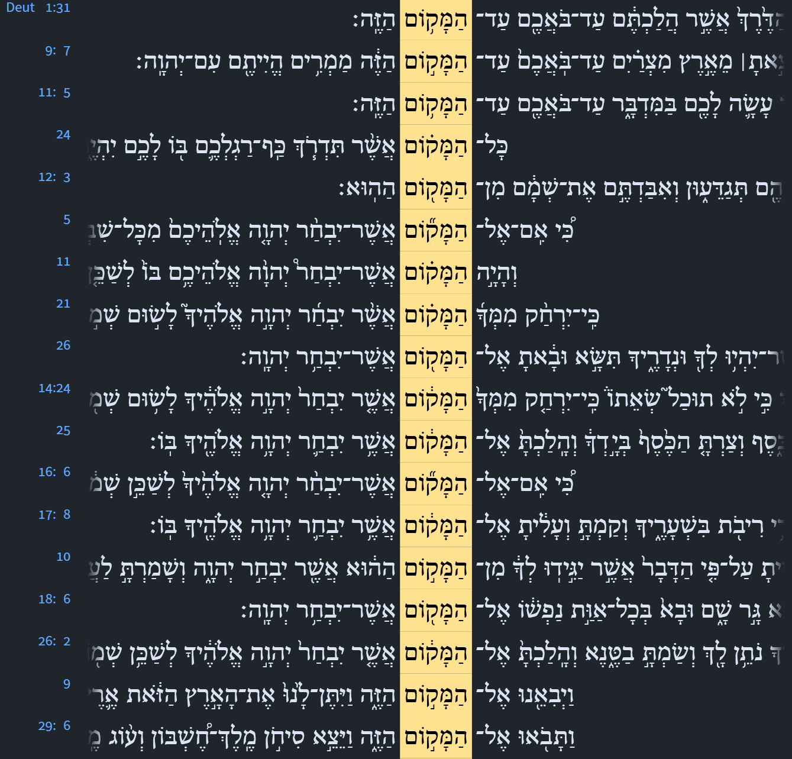

Devarim / Deuteronomy 12:5
But you shall seek the Lord at the place which the Lord your God will choose from all your tribes, to establish His name there for His dwelling, and there you shall come.
Devarim / Deuteronomy 12:11
then it shall come about that the place in which the Lord your God will choose for His name to dwell, there you shall bring all that I command you: your burnt offerings and your sacrifices, your tithes and the contribution of your hand, and all your choice votive offerings which you will vow to the Lord.
Devarim / Deuteronomy 12:21
If the place which the Lord your God chooses to put His name is too far from you, then you may slaughter of your herd and flock which the Lord has given you, as I have commanded you; and you may eat within your gates whatever you desire.
Isaiah / ישעיה
http://www.matsati.com

Slide 18
Devarim / Deuteronomy 16:2
You shall sacrifice the Passover to the Lord your God from the flock and the herd, in the place where the Lord chooses to establish His name.
Devarim / Deuteronomy 16:6
but at the place where the Lord your God chooses to establish His name, you shall sacrifice the Passover in the evening at sunset, at the time that you came out of Egypt.
Devarim / Deuteronomy 16:11
and you shall rejoice before the Lord your God, you and your son and your daughter and your male and female servants and the Levite who is in your town, and the stranger and the orphan and the widow who are in your midst, in the place where the Lord your God chooses to establish His name.
Devarim / Deuteronomy 26:2
that you shall take some of the first of all the produce of the ground which you bring in from your land that the Lord your God gives you, and you shall put it in a basket and go to the place where the Lord your God chooses to establish His name.
Isaiah / ישעיה
http://www.matsati.com

Slide 19
Jude 1:5-10
1:5 I will therefore put you in remembrance, though ye once knew this, how that the Lord, having saved the people out of the land of Egypt, afterward destroyed them that believed not. 1:6 And the angels which kept not their first estate, but left their own habitation, he hath reserved in everlasting chains under darkness unto the judgment of the great day. 1:7 Even as Sodom and Gomorrha, and the cities about them in like manner, giving themselves over to fornication, and going after strange flesh, are set forth for an example, suffering the vengeance of eternal fire. 1:8 Likewise also these filthy dreamers defile the flesh, despise dominion, and speak evil of dignities. 1:9 Yet Michael the archangel, when contending with the devil he disputed about the body of Moses, durst not bring against him a railing accusation, but said, The Lord rebuke thee. 1:10 But these speak evil of those things which they know not: but what they know naturally, as brute beasts, in those things they corrupt themselves. (KJV)
5 ܠܡܰܥ̄ܗܳܕ݂ܽܘܬ݂ܟ݂ܽܘܢ ܕܷ݁ܝܢ ܨܴܒ݂ܶܐ ܐ̱ܢܳܐ ܇ ܟܱ݁ܕ݂ ܝܳܕ݂ܥܺܝܢ ܐܢ̄ܬܾ݁ܘܢ ܟܾ݁ܠܗܶܝܢ ܆ ܕܱ݁ܐܠܴܗܳܐ ܟܱ݁ܕ݂ ܚܕ݂ܳܐ ܙܒ݂ܰܢ ܠܥܰܡܳܐ ܡܶܢ ܡܶܨܪܷܝܢ ܦ݁ܪܱܩ ܆ ܗܳܝ ܕ݁ܬ݂ܱܪ̈ܬܷ݁ܝܢ ܠܱܐܝܠܷܝܢ ܕ݁ܠܴܐ ܗܰܝܡܶܢܘ ܐܱܘܒܷ݁ܕ݂ ܂ 6 ܘܰܠܡܱ̈ܠܱܐܟ݂ܶܐ ܐܱܝܠܷܝܢ ܕ݁ܠܴܐ ܢܛܱܪܘ ܪܻܝܫܳܢܽܘܬ݂ܗܽܘܢ ܇ ܐܷܠܴܐ ܫܒ݂ܰܩܘ ܥܽܘܡܪܴܐ ܕܻ݁ܝܠܗܽܘܢ ܆ ܠܕ݂ܺܝܢܳܐ ܕ݁ܝܰܘܡܳܐ ܪܱܒܴ݁ܐ ܁ ܒܱ݁ܐܣܽܘܪܷ̈ܐ ܠܴܐ ܝܺܕ݂ܺܝ̈ܥܶܐ ܁ ܬ݁ܚܶܝܬ݂ ܥܰܡܛܴܢܳܐ ܂ ܢܳܛܱܪ ܂ 7 ܐܱܝܟܱ݁ܢܳܐ ܕܱ݁ܣܕ݂ܽܘܡ ܘܥܳܡܽܘܪܴܐ ܘܰܡܕ݂ܺܝ̈ܢܳܬ݂ܴܐ ܕܱ݁ܚܕ݂ܳܪܱ̈ܝܗܶܝܢ ܇ ܕ݁ܒ݂ܳܗ ܒܱ݁ܕ݂ܡܽܘܬ݂ܴܐ ܕ݁ܗܳܠܷܝܢ ܙܰܢܻ̈ܝ ܘܶܐܙܰܠ ܒܴ݁ܬ݂ܱܪ ܒܷ݁ܣܪܴܐ ܐ̱ܚܪܻܢܳܐ ܆ ܣܺܝ̈ܡܳܢ ܬ݁ܚܶܝܬ݂ ܬܱ݁ܚܘܺܝܬ݂ܴܐ ܕ݁ܢܽܘܪܴܐ ܕܱ݁ܠܥܳܠܱܡ ܁ ܟܱ݁ܕ݂ ܡܚܰܝ̈ܒ݂ܳܢ ܠܕ݂ܺܝܢܳܐ ܂ 8 ܒܴ݁ܗ ܒܱ݁ܕ݂ܡܽܘܬ݂ܴܐ ܐܴܦ݂ ܗܳܠܷܝܢ ܕܱ݁ܒ݂ܚܷ̈ܠܡܶܐ ܡܶܫܬ݁ܪܱܓ݂ܪܓ݂ܺܝܢ ܆ ܠܒ݂ܶܣܪܴܐ ܡܰܢ ܡܛܱܢܦ݂ܺܝܢ ܂ ܠܡܳܪܾܘܬ݂ܴܐ ܕܷ݁ܝܢ ܛܴܠܡܺܝܢ ܂ ܘܰܠܬ݂ܷܫܒܾ݁ܘܚܬܴ݁ܐ ܡܓ݂ܰܕ݁ܦ݂ܺܝܢ ܂ 9 ܡܺܝܟ݂ܳܐܝܶܠ ܕܷ݁ܝܢ ܪܻܝܫ ܡܰܠܱܐܟ݂ܷ̈ܐ ܇ ܗܰܘ ܕ݁ܥܰܡ ܐܴܟ݂ܶܠܩܰܪܨܴܐ ܟܱ݁ܕ݂ ܕܴ݁ܐܷܢ ܁ ܡܡܰܠܷܠ ܗ̄ܘܳܐ ܡܶܛܾܠ ܦܱ݁ܓ݂ܪܷܗ ܕ݁ܡܽܘܫܶܐ ܆ ܠܴܐ ܐܱܡܪܱܚ ܕ݁ܢܰܝܬܷ݁ܐ ܥܠܱܘܗ̄ܝ ܕܻ݁ܝܢܳܐ ܕ݁ܓ݂ܽܘܕܴ݁ܦ݂ܳܐ ܂ ܐܷܠܴܐ ܐܷܡܰܪ ܆ ܕ݁ܢܶܓ݂ܥܽܘܪ ܒܴ݁ܟ݂ ܡܳܪܝܳܐ ܂ 10 ܗܳܠܷܝܢ ܕܷ݁ܝܢ ܁ ܒܱ݁ܐܝܠܷܝܢ ܕ݁ܠܴܐ ܝܳܕ݂ܥܺܝܢ ܂ ܡܓ݂ܰܕ݁ܦ݂ܺܝܢ ܂ ܒܱ݁ܐܝܠܷܝܢ ܕܷ݁ܝܢ ܕܱ݁ܟ݂ܝܳܢܳܐܝܺܬ݂ ܐܱܝܟ݂ ܚܰܝ̈ܘܳܬ݂ܴܐ ܚܰܪ̈ܫܳܬ݂ܴܐ ܡܦܴ݁ܣܺܝܢ ܆ ܒ݁ܗܶܝܢ ܡܶܬ݂ܚܰܒ݁ܠܻܝܢ ܂
Isaiah / ישעיה
http://www.matsati.com

