Slide 1
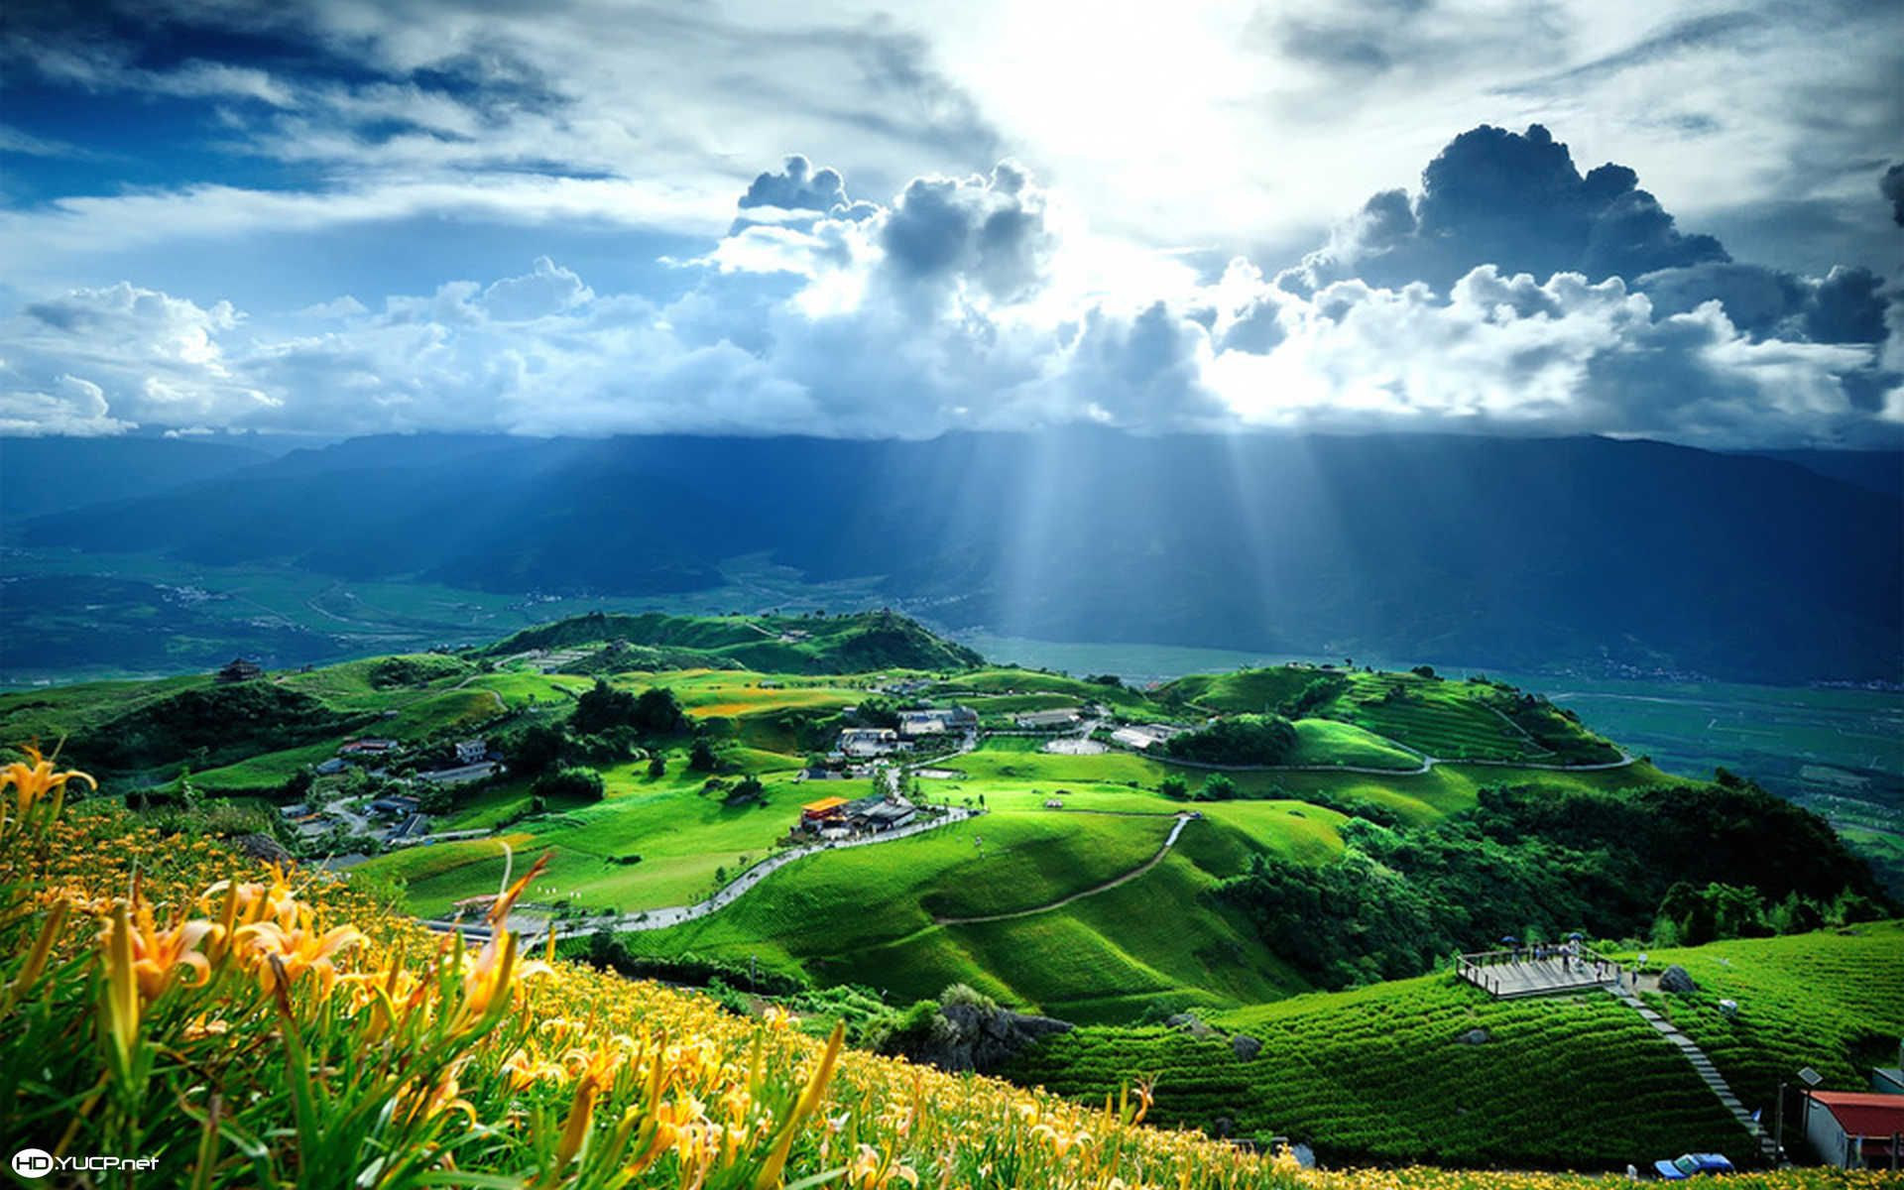

Isaiah 15:1-9
ישעיהו טו:א-ט
Isaiah / ישעיה
http://www.matsati.com

Slide 2


ספר במדבר פרק כא
י וַיִּסְעוּ בְּנֵי יִשְֹרָאֵל וַיַּחֲנוּ בְּאֹבֹת: יא וַיִּסְעוּ מֵאֹבֹת וַיַּחֲנוּ בְּעִיֵּי הָעֲבָרִים בַּמִּדְבָּר אֲשֶׁר עַל-פְּנֵי מוֹאָב מִמִּזְרַח הַשָּׁמֶשׁ: יב מִשָּׁם נָסָעוּ וַיַּחֲנוּ בְּנַחַל זָרֶד: יג מִשָּׁם נָסָעוּ וַיַּחֲנוּ מֵעֵבֶר אַרְנוֹן אֲשֶׁר בַּמִּדְבָּר הַיֹּצֵא מִגְּבֻל הָאֱמֹרִי כִּי אַרְנוֹן גְּבוּל מוֹאָב בֵּין מוֹאָב וּבֵין הָאֱמֹרִי: יד עַל-כֵּן יֵאָמַר בְּסֵפֶר מִלְחֲמֹת יְהוָֹה אֶת-וָהֵב בְּסוּפָה וְאֶת-הַנְּחָלִים אַרְנוֹן: טו וְאֶשֶׁד הַנְּחָלִים אֲשֶׁר נָטָה לְשֶׁבֶת עָר וְנִשְׁעַן לִגְבוּל מוֹאָב:
Bamidbar / Numbers 21:10-15
21:10 And the children of Israel set forward, and pitched in Oboth. 21:11 And they journeyed from Oboth, and pitched at Ijeabarim, in the wilderness which is before Moab, toward the sunrising. 21:12 From thence they removed, and pitched in the valley of Zared. 21:13 From thence they removed, and pitched on the other side of Arnon, which is in the wilderness that cometh out of the coasts of the Amorites: for Arnon is the border of Moab, between Moab and the Amorites. 21:14 Wherefore it is said in the book of the wars of the LORD, What he did in the Red sea, and in the brooks of Arnon, 21:15 And at the stream of the brooks that goeth down to the dwelling of Ar, and lieth upon the border of Moab. (KJV)
Isaiah / ישעיה
http://www.matsati.com

Slide 3




































﻿ספר ישעיה פרק טו
א מַשָּׂא מוֹאָב כִּי בְּלֵיל שֻׁדַּד עָר מוֹאָב נִדְמָה כִּי בְּלֵיל שֻׁדַּד קִיר-מוֹאָב נִדְמָה: ב עָלָה הַבַּיִת וְדִיבֹן הַבָּמוֹת לְבֶכִי עַל-נְבוֹ וְעַל מֵידְבָא מוֹאָב יְיֵלִיל בְּכָל-רֹאשָׁיו קָרְחָה כָּל-זָקָן גְּרוּעָה: ג בְּחוּצֹתָיו חָגְרוּ שָֹק עַל גַּגּוֹתֶיהָ וּבִרְחֹבֹתֶיהָ כֻּלֹּה יְיֵלִיל יֹרֵד בַּבֶּכִי: ד וַתִּזְעַק חֶשְׁבּוֹן וְאֶלְעָלֵה עַד-יַהַץ נִשְׁמַע קוֹלָם עַל-כֵּן חֲלֻצֵי מוֹאָב יָרִיעוּ נַפְשׁוֹ יָרְעָה לּוֹ: ה לִבִּי לְמוֹאָב יִזְעָק בְּרִיחֶהָ עַד-צֹעַר עֶגְלַת שְׁלִשִׁיָּה כִּי | מַעֲלֵה הַלּוּחִית בִּבְכִי יַעֲלֶה-בּוֹ כִּי דֶּרֶךְ חוֹרֹנַיִם זַעֲקַת-שֶׁבֶר יְעֹעֵרוּ: ו כִּי-מֵי נִמְרִים מְשַׁמּוֹת יִהְיוּ כִּי-יָבֵשׁ חָצִיר כָּלָה דֶשֶׁא יֶרֶק לֹא הָיָה: ז עַל-כֵּן יִתְרָה עָשָֹה וּפְקֻדָּתָם עַל נַחַל הָעֲרָבִים יִשָּׂאוּם: ח כִּי-הִקִּיפָה הַזְּעָקָה אֶת-גְּבוּל מוֹאָב עַד-אֶגְלַיִם יִלְלָתָהּ וּבְאֵר אֵילִים יִלְלָתָהּ: ט כִּי מֵי דִימוֹן מָלְאוּ דָם כִּי-אָשִׁית עַל-דִּימוֹן נוֹסָפוֹת לִפְלֵיטַת מוֹאָב אַרְיֵה וְלִשְׁאֵרִית אֲדָמָה:
Isaiah / ישעיה
http://www.matsati.com

Slide 4
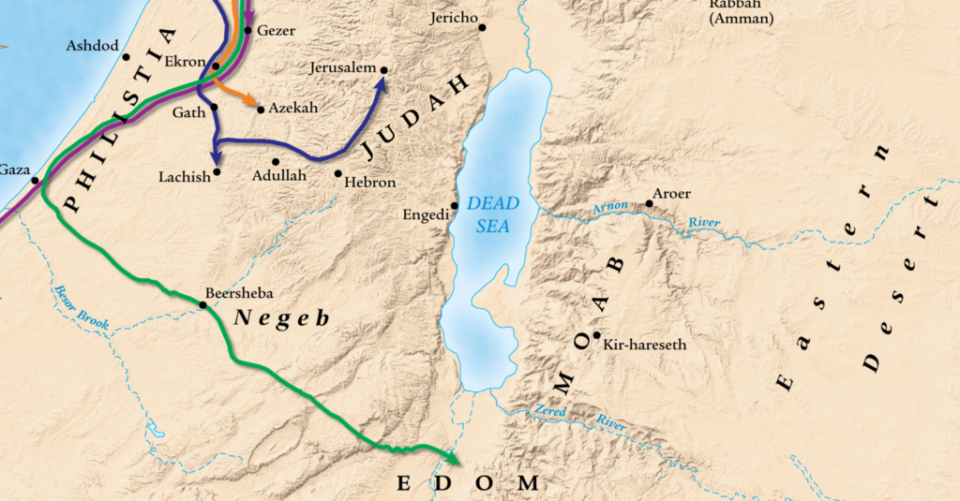
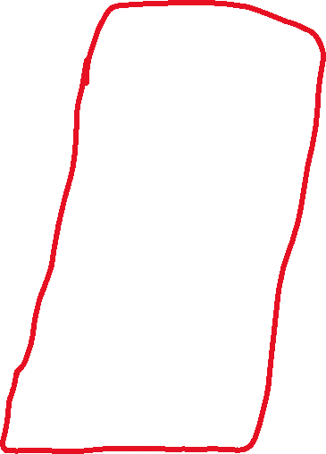
Isaiah / ישעיה
http://www.matsati.com

Slide 5
BAJITH (בַּיִת) This word means “house” in hebrew, and is a word referring to a temple of Moab, sometimes simply translated as “temple” (Isaiah 15:2 ESV) and other times transliterated (Isaiah 15:2 KJV).
DIBON (דִּיבוֹן) The capital city of ancient Moab, mentioned several times in the Hebrew Bible (Bamidbar / Numbers 21:30, 32:3, 32:34, Joshua 13:9, 13:17, Nehemiah 11:25, Isaiah 15:2, Jeremiah 48:18-22). The ancient city of Dibon has been identified with the mound of ruins located north of the modern village of Dhiban, approximately 40 miles south of Amman. Eusebius (260–ca. 339 bc) described Dibon as “a large town near the Arnon” (Eusebius, Onomasticon). The Arab geographer Yaqut (ad 1179–1229) also mentioned “the lowest peaks of the village Dhiban” (cited in Tushingham, “Dibon,” 330, 332). The biblical account demonstrates that the Israelites had a strained relationship with the Moabites, who were descendants of Lot (Bereshit / Genesis 19:36–37, Bamidbar / Numbers 22–24). Bamidbar / Numbers 21:26–30 records that shortly after the Amorite king Sihon defeated the Moabites and conquered Dibon, the Israelites asked Sihon for permission to travel through his territory. Sihon refused and instead attacked the Israelites. With God’s help, the Israelites succeeded in defeating Sihon and capturing Dibon. The territory of Dibon was later allocated to the tribes of Gad (Bamidbar / Numbers 32:34) and Reuben (Joshua 13:15).
Isaiah / ישעיה
http://www.matsati.com

Slide 6
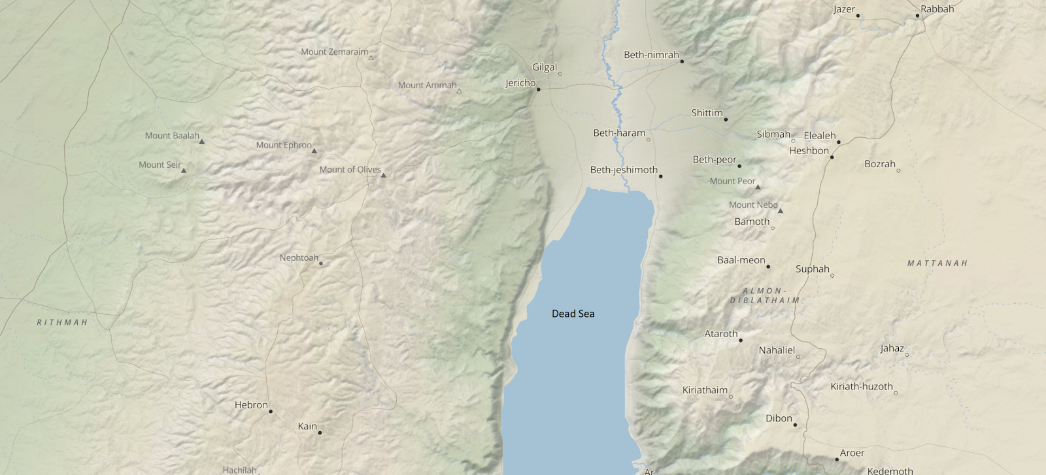
Isaiah / ישעיה
http://www.matsati.com

Slide 7
NEBO OF JUDAH (נְבוֹ) The references to Nebo in the books of Ezra and Nehemiah could refer to a place in Judah settled by people who returned from the exile in Babylon (Ezra 2:29, 10:43, Nehemiah 7:33). Many of the names found in Ezra 2:20–35 are also place names which could indicate the name of the villages where they settled. Alternatively, people may have taken the name of a place where they lived in exile as a family name or personal name (see Elam, Ancestor of a Family of Returned Exiles). There was also a place called Nebo in the Transjordan (Bamidbar / Numbers 32:3, 3:38, Jeremiah 48:1, 48:22). The only indication that a place named Nebo may have existed in Judah comes from these references to a “Nebo” among other names that are also place names from territory occupied by the tribes of Israel and Judah (Ezra 2:29, 10:43, Nehemiah 7:33).
MEDEBA (מֵידְבָא) A city located on the Moabite plains that the Israelites conquered and settled prior to entering the land of Canaan (Bamidbar / Numbers 21:30). The town of Medeba can be identified with the modern city of Madaba, which is located about 19 miles south of Amman on the plains of the Central Jordan Plateau.
Isaiah / ישעיה
http://www.matsati.com

Slide 8
HESHBON (הֶשְׁבּוֹן, Greek Εσβους, Esbous) A city of Moab is mentioned 38 times in the Old Testament. Heshbon was located along the King’s Highway, the primary north-south trade road through the Transjordan region (Younker, “Hesban,” 59). The first reference to Heshbon describes it as the capital city of Sihon, king of the Amorites—the first king defeated by the Israelites in the Transjordan region (Bamidbar / Numbers 21:21–26). The text indicates that Heshbon had only recently been captured by Sihon, who had deposed the “former king of Moab and taken all his land” (Bamidbar / Numbers 21:26 ESV). After the Israelites defeated Sihon, they inhabited Heshbon and the surrounding area (Bamidbar / Numbers 21:25). Later, Sihon’s territory was divided between the tribes of Reuben and Gad, with Heshbon apparently assigned to Reuben (Joshua 13:15–17, 24–27). Several prophets refer to Heshbon within oracles against Moab (Isaiah 15:4, 16:8–9, Jeremiah 48:2, 48:34, 48:45). It also is mentioned in an oracle against Ammon (Jeremiah 49:3)—which suggests that the Ammonites seized control of Heshbon from the Moabites sometime during the Iron II period.
ELEALEH (אֶלְעָלֵא) A town rebuilt by the Reubenites when they claimed territory in the Transjordan (Bamidbar / Num 32:3, 32:37). It is mentioned with Heshbon in Isaiah’s and Jeremiah’s oracles (Isaiah 15:4, 16:9, Jeremiah 48:34).
Isaiah / ישעיה
http://www.matsati.com

Slide 9
JAHAZ (יַהַץ / יַהְצָה). An Amorite site conquered by the Israelites under Moses that was later designated as a Levitical city. Also appears in prophetic oracles against Moab (Isaiah 15:4, Jeremiah 48:21, 48:34). King Sihon of the Amorites engaged the Israelite army in battle at Jahaz after he denied their request to pass through his land. After defeating Sihon, Israel appropriated the territory of the Amorites, which presumably included Jahaz (Bamidbar / Numbers 21:21–31, compare Judges 11:18–23). Deuteronomy adds that Israel destroyed (literally “banned,” וַנַּחֲרֵם, wannacharem) every Amorite city with all of its inhabitants (Devarim / Deuteronomy 2:34). In apportioning the land, Joshua allotted Jahaz to the Reubenites (Joshua 13:18) but later designated it as a Levitical city (Joshua 21:36, 1 Chronicles 6:78, but see Joshua 21:36 LXX: Ιαζηρ, Iazēr). From the scant evidence available concerning Israel’s influence over northern Moab in the following centuries, it appears that Israel held Jahaz only periodically. The Mesha Stele indicates that by the early ninth century Omri conquered Jahaz, and it remained in his possession through the end of Ahab’s reign. After the death of Ahab (ca. 852 bc), King Mesha of Moab revolted against Israel, etc.
Isaiah / ישעיה
http://www.matsati.com

Slide 10
ZOAR (צוֹעַר, צָעִיר, בֶּלַע). One of five cities of the plain. The city to which Lot escaped during the destruction of Sodom and Gomorrah (Bereshit / Genesis 19:22, 23). Formerly called Bela (Bereshit / Genesis 14:2-8) and also referred to by Isaiah and Jeremiah (Isaiah 15:5, Jeremiah 48:34).
WATERS OF NIMRIM (מֵי־נִמְרִים). Waters in Moab that Isaiah and Jeremiah denounced (Isaiah 15:6, Jeremiah 48:34). Because Isaiah associates these waters with Zoar and Horonaim, both of which are located on the south end of the Dead Sea, most scholars prefer to identify the Waters of Nimrim with the once fertile land southeast of the Sea, the modern Wadi Nemeirah.
EGLAIM (אֶגְלַיִם) A village in the south of Moab, which is mentioned in Isaiah’s oracle against Moab (Isaiah 15:8).
BEER-ELIM (בְּאֵר אֵלִים) Area located north of Moab and connected to Eglaim (Isaiah 15:8); also known as the Well of Elim.
Isaiah / ישעיה
http://www.matsati.com

Slide 11
DIMON (דִּימוֹן, dimon). Also Dibon. A Moabite city near the Arnon river (Isaiah 15:9).
ספר עמוס פרק ה
יח ה֥וֹי הַמִּתְאַוִּ֖ים אֶת־י֣וֹם יְהוָ֑ה לָמָּה־זֶּ֥ה לָכֶ֛ם י֥וֹם יְהוָ֖ה הוּא־חֹ֥שֶׁךְ וְלֹא־אֽוֹר׃ יט כַּאֲשֶׁ֨ר יָנ֥וּס אִישׁ֙ מִפְּנֵ֣י הָאֲרִ֔י וּפְגָע֖וֹ הַדֹּ֑ב וּבָ֣א הַבַּ֔יִת וְסָמַ֤ךְ יָדוֹ֙ עַל־הַקִּ֔יר וּנְשָׁכ֖וֹ הַנָּחָֽשׁ׃ כ הֲלֹא־חֹ֛שֶׁךְ י֥וֹם יְהוָ֖ה וְלֹא־א֑וֹר וְאָפֵ֖ל וְלֹא־נֹ֥גַֽהּ לֽוֹ׃
Amos 5:18-20
5:18 Woe unto you that desire the day of the LORD! to what end is it for you? the day of the LORD is darkness, and not light. 5:19 As if a man did flee from a lion, and a bear met him; or went into the house, and leaned his hand on the wall, and a serpent bit him. 5:20 Shall not the day of the LORD be darkness, and not light? even very dark, and no brightness in it? (KJV)
Isaiah / ישעיה
http://www.matsati.com

Slide 12
Rabbinic Literature
ספרות רבנית
Part 2
Isaiah / ישעיה
http://www.matsati.com

Slide 13
Targum Jonathan son of Uziel Isaiah 15:1-9
15:1 THE BURDEN OF THE CUP OF CURSING TO GIVE MOAB TO DRINK. Because in the night Leheyath-Moab is destroyed, and they were asleep. Yea, in the night the fortified city of Moab was subdued, and they were in deep slumber. 15:2 They went up to the houses in Dibon, to the high place, to weep. Over Nebo, and over Medeba the Moabites are howling: on every head is baldness; every beard is shorn. 15:3 In their streets they shall gird themselves with sackcloth: on their house-tops, and in their broad-places all of them shall howl, crying and weeping. 15:4 And the inhabitants of Heshbon and Elealeh shall cry out aloud; unto Jahats is their voice heard: therefore the armed of Moab are howling, and crying out aloud for their souls. 15:5 The Moabites shall think to flee to Zoar, unto Eglath Tiltum Rabb’tha; for the ascent of Luhith they shall ascend it as with weeping; because in the descent of Horonaim they shall declare the cry of the broken in battle. 15:6 For the waters of Nimrim shall become desolate; for the herbage is withered away; the grass faileth, there is no green herb. 15:7 Therefore the remnant of their riches, shall be plundered; and their border, which is by the western sea, shall be taken from them. 15:8 For the cry encompasseth the border of Moab; unto Eglaim are they howling, and unto Beer-Elim they are crying aloud. 15:9 For the waters of Dimon shall be full of blood: for I will appoint upon Dimon an assembly of armies. Upon the escaped of Moab, a king with his army shall ascend; yea, to spoil the remainder of their land. (TgJ)
Isaiah / ישעיה
http://www.matsati.com

Slide 14
Rashi on Isaiah 15:1 Part 1-2
משא מואב. נתנבא ישעיה שיבוא סנחרב על מואב ויגלם כמו שנאמר (לקמן טז) בשלש שנים כשני שכיר ונקלה כבוד מואב:
The harsh prophecy concerning Moab Isaiah prophesied that Sennacherib would come upon Moab and exile them, as it is said (infra 16:14): “In three years, like the years of a hireling, shall the glory of Moab be debased.”
כי בליל שדד ער מואב נדמה. נדמה מואב כאילו ישן דומה ואין יכול להלחם ובליל אחר אשר שודד בו קיר מואב נדמה ת"י ואינון רדימין ער וקיר שתי מדינות מואב הם:
for on the night that Ar of Moab was pillaged, it was as though they were sleeping silently Moab was silent as though they were sleeping silently and were unable to wage war, and on another night when Kir of Moab was pillaged, it was as though they were sleeping silently. Jonathan renders: And they were sleeping. Ar and Kir were two provinces of Moab.
Isaiah / ישעיה
http://www.matsati.com

Slide 15
Matthew 24:42-44
24:42 Therefore keep watch, because you do not know the day on which your Lord will come. 24:43 But understand this: If the homeowner had known in which watch of the night the thief was coming, he would have kept watch and would not have let his house be broken into. 24:44 For this reason, you also must be ready, because the Son of Man will come at an hour you do not expect. (BSB, ܀ 42 ܐܷܬ݁ܬ݁ܥܺܝܪܘ ܗܳܟ݂ܺܝܠ ܆ ܕ݁ܠܴܐ ܝܳܕ݂ܥܺܝܢ ܐܢ̄ܬܾ݁ܘܢ ܒܱ݁ܐܝܕ݂ܳܐ ܫܳܥܬ݂ܴܐ ܐܴܬ݂ܷܐ ܡܳܪܟ݂ܽܘܢ ܀ 43 ܗܳܕ݂ܶܐ ܕܷ݁ܝܢ ܕܱ݁ܥܘ ܂ ܕܷ݁ܐܠܾܘ ܝܳܕ݂ܰܥ ܗ̄ܘܳܐ ܡܳܪܷܐ ܒܱ݁ܝܬܴ݁ܐ ܁ ܒܱ݁ܐܝܕ݂ܳܐ ܡܰܛܱܪܬ݂ܴܐ ܐܴܬ݂ܷܐ ܓܱ݁ܢܳܒ݂ܳܐ ܆ ܡܶܬ݁ܬ݁ܥܺܝܪ ܗ̄ܘܳܐ ܂ ܘܠܴܐ ܫܳܒ݂ܶܩ ܗ̄ܘܳܐ ܕ݁ܢܶܬ݂ܦ݁ܠܷܫ ܒܱ݁ܝܬܷ݁ܗ ܂ 44 ܡܶܛܾܠ ܗܳܢܳܐ ܁ ܐܴܦ݂ ܐܱܢ̄ܬܾ݁ܘܢ ܗܘܰܘ ܡܛܱܝ̈ܒ݂ܺܝܢ ܂ ܕܱ݁ܒ݂ܫܳܥܬ݂ܴܐ ܕ݁ܠܴܐ ܣܳܒ݂ܪܻܝܢ ܐܢ̄ܬܾ݁ܘܢ ܂ ܢܺܐܬ݂ܷܐ ܒ݁ܪܷܗ ܕ݁ܐ̱ܢܳܫܳܐ ܁܀܁܀܁)
Matthew 25:13
25:13 Watch therefore, for ye know neither the day nor the hour wherein the Son of man cometh. (KJV, ܀ 13 ܐܷܬ݁ܬ݁ܥܺܝܪܘ ܗܳܟ݂ܺܝܠ ܂ ܕ݁ܠܴܐ ܝܳܕ݂ܥܺܝܢ ܐܢ̄ܬܾ݁ܘܢ ܠܝܰܘܡܳܐ ܗܰܘ ܂ ܘܠܴܐ ܠܫܳܥܬ݂ܴܐ ܀)
Mark 13:32
13:32 But of that day and that hour knoweth no man, no, not the angels which are in heaven, neither the Son, but the Father. (KJV, ܀ 32 ܥܰܠ ܕܷ݁ܝܢ ܝܰܘܡܳܐ ܗܰܘ ܁ ܘܥܰܠ ܫܳܥܬ݂ܴܐ ܗܳܝ ܆ ܐ̱ܢܳܫ ܠܴܐ ܝܳܕ݂ܰܥ ܂ ܐܴܦ݂ܠܴܐ ܡܰܠܱܐܟ݂ܷ̈ܐ ܕܱ݁ܫܡܰܝܳܐ ܂ ܘܠܴܐ ܒ݁ܪܴܐ ܂ ܐܷܠܴܐ ܐܷܢ ܐܱܒ݂ܳܐ ܀)
Isaiah / ישעיה
http://www.matsati.com

Slide 16
The War Scroll, 1QM, 4Q491–496
The description of the eschatological war.
Col. 1 1For the In[structor, the Rule of] the War. The first attack of the Sons of Light shall be undertaken against the forces of the Sons of Darkness, the army of Belial: the troops of Edom, Moab, the sons of Ammon, 2the [Amalekites,] Philistia and the troops of the Kittim of Assyria. Supporting them are those who have violated the covenant. The sons of Levi, the sons of Judah, and the sons of Benjamin, those exiled to the wilderness, shall fight against them 3with […] against all their troops, when the exiles of the Sons of Light return from the Wilderness of the Peoples to camp in the Wilderness of Jerusalem. Then after the battle they shall go up from that place 4a[nd the king of] the Kittim [shall enter] into Egypt. In his time he shall go forth with great wrath to do battle against the kings of the north, and in his anger he shall set out to destroy and eliminate the strength of 5I[srael. Then the]re shall be a time of salvation for the People of God, and time of dominion for all the men of His forces, and eternal annihilation for all the forces of Belial. There shall be g[reat] panic 6[among] the sons of Japheth, Assyria shall fall with no one to come to his aid, and the supremacy of the Kittim shall cease, that wickedness be overcome without a remnant. There shall be no survivors 7of [all Sons of] Darkness. 8Then [the Sons of Rig]hteousness shall shine to all ends of the world, continuing to shine forth until the end of the appointed seasons of darkness.
Isaiah / ישעיה
http://www.matsati.com

Slide 17
The War Scroll, 1QM, 4Q491–496
The description of the eschatological war, cont…
Then at the time appointed by God, His great excellence shall shine for all the times of 9e[ternity;] for peace and blessing, glory and joy, and long life for all Sons of Light. On the day when the Kittim fall there shall be a battle and horrible carnage before the God of 10Israel, for it is a day appointed by Him from ancient times as a battle of annihilation for the Sons of Darkness. On that day the congregation of the gods and the congregation of men shall engage one another, resulting in great carnage. 11The Sons of Light and the forces of Darkness shall fight together to show the strength of God with the roar of a great multitude and the shout of gods and men; a day of disaster. It is a time of 12distress fo[r al]l the people who are redeemed by God. In all their afflictions none exists that is like it, hastening to its completion as an eternal redemption. On the day of their battle against the Kittim, 13they shall g[o forth for] carnage in battle. In three lots the Sons of Light shall stand firm so as to strike a blow at wickedness, and in three the army of Belial shall strengthen themselves so as to force the retreat of the forces 14[of Light. And when the] banners of the infantry cause their hearts to melt, then the might of God will strengthen the he[arts of the Sons of Light.] In the seventh lot the great hand of God shall overcome 15[Belial and al]l the angels of his dominion, and all the men of [his forces shall be destroyed forever.] (Michael O. Wise, Martin G. Abegg Jr., and Edward M. Cook, The Dead Sea Scrolls: A New Translation (New York: HarperOne, 2005), 147–148.)
Isaiah / ישעיה
http://www.matsati.com

Slide 18

Rashi on Isaiah 15:5 Part 1-4
לבי למואב יזעק. נביאי ישראל אינם כנביאי אומות העולם בלעם היה מבקש לעקור את ישראל על לא דבר ונביאי ישראל מתאוננים על פורענות הבאה על האומות: My heart shall cry out for Moab The Jewish prophets are not like the gentile prophets. Balaam sought to uproot Israel for no reason, whereas the prophets of Israel bewail the calamity that befalls the nations.
בריחיה עד צוער. על כל חזקה של מואב יזעק לבי עד צוער שהיא עגלה שלישיה עיקר חוזק שלהם כעגלה שהיא שלישית לבטן, ל"א שלישיה גברתנית ויונתן תירגם בריחיה כמו בורחיה הבורחים יברחו מהם להמלט עד צוער כמו שעשה לוט אביהם שברח לצוער: its bars as far as Zoar Heb. בְּרִיחֶיהָ, bars. For the entire strength of Moab shall my heart cry, as far as Zoar, which is a third born heifer; it is their main strength, like a heifer born third to its mother. Alternatively, שְׁלִשִׁיָּה means a strong heifer. Jonathan, however, renders בְּרִיחֶיהָ like בּוֹרְחֶיהָ, those of her who flee. Those who flee shall flee from them to escape to Zoar, as Lot, their forebear, fled to Zoar. מעלה הלוחית. מקום מעלות הר ששמו מעלה הלוחית וכן מורד חורני' (ירמיהו מ״ח:ה׳) יבכו הבורחי' דרך שם וכל המקומות האלה ממואב הם: the ascent of Haluhith A place on the ascents of the mountain, named “the ascent of Haluhith,” and similarly (Jer. 48:5), “The descent of Horonaim.” Those who flee through them shall weep. All these locations are from Moab. יעערו. יצעקו ולשון ארמי הוא שת"י לא ידרוך הדורך הידד לא יעוערון בקלהון: they shall raise Heb. יְעֹעֵרוּ, they shall cry, and this is an Aramaic expression, for Jonathan renders (infra 16:10): “The treader shall not tread; I have abolished the cry,” as: “They shall not cry (יְעוֹעֲרוּן) with their voice.”
Isaiah / ישעיה
http://www.matsati.com

Slide 19




Rashi on Isaiah 15:9 Part 1-6
מי דימון. שם הנהר: The waters of Dimon The name of the river.
מלאו דם. כשם הנהר: have been filled with blood Like the name of the river. [The name דִּימוֹן resembles דַּם, blood.] כי אשית על דימון נוספות. דם שמו ודם חללים אוסיף עליו למלאותו והוא ל' ספו שנה על שנה (לקמן כט) ספות הרוה (דברים כ״ט:י״ח) וי"ת נוספות כנישת משיריין מחנות הנאספות יחד: for I will place upon Dimon additions Its name is blood, and I will add the blood of the fallen, to fill it. Jonathan renders, however: כְּנִישַׁתמַשַׁירְיָן, the gathering of the camps, the camps joined together. This is an expression of (infra 21:1) “Join (סְפוּ) year to year”; (Deut. 29:18) “to add (סְפוֹת) the inadvertent sins.” לפליטת מואב אריה. פליטה שישאיר סנחרב יבא נבוכדנצר בעתו וישחיתה והוא נקרא אריה כענין שנאמר (ירמיהו ד׳:ז׳) עלה אריה מסובכו: for the survivors of Moab is the lion The survivors which Sennacherib will leave over, Nebuchadnezzar will carry away in his time, and he will destroy them. And he is called “the lion,” as the matter is stated (Jer. 4:7): “The lion has come up out of his thicket.” ולשארית. ישראל: and for the remnant of Israel. אדמה. אדמתכם: is the land [i.e,] your land.
Isaiah / ישעיה
http://www.matsati.com

Slide 20




ספר ויקרא פרק ה
א וְנֶפֶשׁ כִּי-תֶחֱטָא וְשָׁמְעָה קוֹל אָלָה וְהוּא עֵד אוֹ רָאָה אוֹ יָדָע אִם-לוֹא יַגִּיד וְנָשָֹא עֲוֹנוֹ: ב אוֹ נֶפֶשׁ אֲשֶׁר תִּגַּע בְּכָל-דָּבָר טָמֵא אוֹ בְנִבְלַת חַיָּה טְמֵאָה אוֹ בְּנִבְלַת בְּהֵמָה טְמֵאָה אוֹ בְּנִבְלַת שֶׁרֶץ טָמֵא וְנֶעְלַם מִמֶּנּוּ וְהוּא טָמֵא וְאָשֵׁם: ג אוֹ כִי יִגַּע בְּטֻמְאַת אָדָם לְכֹל טֻמְאָתוֹ אֲשֶׁר יִטְמָא בָּהּ וְנֶעְלַם מִמֶּנּוּ וְהוּא יָדַע וְאָשֵׁם:
Vayikra / Leviticus 5:1-3
5:1 And if a soul sin, and hear the voice of swearing, and is a witness, whether he hath seen or known of it; if he do not utter it, then he shall bear his iniquity. 5:2 Or if a soul touch any unclean thing, whether it be a carcase of an unclean beast, or a carcase of unclean cattle, or the carcase of unclean creeping things, and if it be hidden from him; he also shall be unclean, and guilty. 5:3 Or if he touch the uncleanness of man, whatsoever uncleanness it be that a man shall be defiled withal, and it be hid from him; when he knoweth of it, then he shall be guilty. (KJV)
Isaiah / ישעיה
http://www.matsati.com

