Slide 1
Isaiah 14:22-32
ישעיהו יד:כב-לב
Isaiah / ישעיה
http://www.matsati.com

Slide 2
ספר ישעיה פרק יד
﻿כב וְקַמְתִּי עֲלֵיהֶם נְאֻם יְהֹוָה צְבָאוֹת וְהִכְרַתִּי לְבָבֶל שֵׁם וּשְׁאָר וְנִין וָנֶכֶד נְאֻם-יְהֹוָה: כג וְשַֹמְתִּיהָ לְמוֹרַשׁ קִפֹּד וְאַגְמֵי-מָיִם וְטֵאטֵאתִיהָ בְּמַטְאֲטֵא הַשְׁמֵד נְאֻם יְהֹוָה צְבָאוֹת: כד נִשְׁבַּע יְהֹוָה צְבָאוֹת לֵאמֹר אִם-לֹא כַּאֲשֶׁר דִּמִּיתִי כֵּן הָיָתָה וְכַאֲשֶׁר יָעַצְתִּי הִיא תָקוּם: כה לִשְׁבֹּר אַשּׁוּר בְּאַרְצִי וְעַל-הָרַי אֲבוּסֶנּוּ וְסָר מֵעֲלֵיהֶם עֻלּוֹ וְסֻבֳּלוֹ מֵעַל שִׁכְמוֹ יָסוּר: כו זֹאת הָעֵצָה הַיְּעוּצָה עַל-כָּל-הָאָרֶץ וְזֹאת הַיָּד הַנְּטוּיָה עַל-כָּל-הַגּוֹיִם: כז כִּי-יְהֹוָה צְבָאוֹת יָעָץ וּמִי יָפֵר וְיָדוֹ הַנְּטוּיָה וּמִי יְשִׁיבֶנָּה: כח בִּשְׁנַת-מוֹת הַמֶּלֶךְ אָחָז הָיָה הַמַּשָּׂא הַזֶּה: כט אַל-תִּשְֹמְחִי פְלֶשֶׁת כֻּלֵּךְ כִּי נִשְׁבַּר שֵׁבֶט מַכֵּךְ כִּי-מִשֹּׁרֶשׁ נָחָשׁ יֵצֵא צֶפַע וּפִרְיוֹ שָֹרָף מְעוֹפֵף: ל וְרָעוּ בְּכוֹרֵי דַלִּים וְאֶבְיוֹנִים לָבֶטַח יִרְבָּצוּ וְהֵמַתִּי בָרָעָב שָׁרְשֵׁךְ וּשְׁאֵרִיתֵךְ יַהֲרֹג: לא הֵילִילִי שַׁעַר זַעֲקִי-עִיר נָמוֹג פְּלֶשֶׁת כֻּלֵּךְ כִּי מִצָּפוֹן עָשָׁן בָּא וְאֵין בּוֹדֵד בְּמוֹעָדָיו: לב וּמַה-יַּעֲנֶה מַלְאֲכֵי-גוֹי כִּי יְהֹוָה יִסַּד צִיּוֹן וּבָהּ יֶחֱסוּ עֲנִיֵּי עַמּוֹ:
Isaiah / ישעיה
http://www.matsati.com

Slide 3
ספר דברים פרק יא
א וְאָ֣הַבְתָּ֔ אֵ֖ת יְהוָ֣ה אֱלֹהֶ֑יךָ וְשָׁמַרְתָּ֣ מִשְׁמַרְתּ֗וֹ וְחֻקֹּתָ֧יו וּמִשְׁפָּטָ֛יו וּמִצְוֺתָ֖יו כָּל־הַיָּמִֽים׃ ב וִֽידַעְתֶּם֮ הַיּוֹם֒ כִּ֣י׀ לֹ֣א אֶת־בְּנֵיכֶ֗ם אֲשֶׁ֤ר לֹֽא־יָדְעוּ֙ וַאֲשֶׁ֣ר לֹא־רָא֔וּ אֶת־מוּסַ֖ר יְהוָ֣ה אֱלֹהֵיכֶ֑ם אֶת־גָּדְל֕וֹ אֶת־יָדוֹ֙ הַחֲזָקָ֔ה וּזְרֹע֖וֹ הַנְּטוּיָֽה׃
Devarim / Deuteronomy 11:1-2
11:1 Love the Lord your God and keep his requirements, his decrees, his laws and his commands always. 11:2 Remember today that your children were not the ones who saw and experienced the discipline of the Lord your God: his majesty, his mighty hand, his outstretched arm; (NIV)
Isaiah / ישעיה
http://www.matsati.com

Slide 4
ספר יחזקאל פרק לט
﻿ד עַל-הָרֵי יִשְֹרָאֵל תִּפּוֹל אַתָּה וְכָל-אֲגַפֶּיךָ וְעַמִּים אֲשֶׁר אִתָּךְ לְעֵיט צִפּוֹר כָּל-כָּנָף וְחַיַּת הַשָּׂדֶה נְתַתִּיךָ לְאָכְלָה:
﻿יז וְאַתָּה בֶן-אָדָם כֹּה-אָמַר | אֲדֹנָי יְהוִֹה אֱמֹר לְצִפּוֹר כָּל-כָּנָף וּלְכֹל | חַיַּת הַשָּׂדֶה הִקָּבְצוּ וָבֹאוּ הֵאָסְפוּ מִסָּבִיב עַל-זִבְחִי אֲשֶׁר אֲנִי זֹבֵחַ לָכֶם זֶבַח גָּדוֹל עַל הָרֵי יִשְֹרָאֵל וַאֲכַלְתֶּם בָּשָֹר וּשְׁתִיתֶם דָּם:
Ezekiel 39:4,
39:4 Thou shalt fall upon the mountains of Israel, thou, and all thy bands, and the people that is with thee: I will give thee unto the ravenous birds of every sort, and to the beasts of the field to be devoured. (KJV)
39:17 And, thou son of man, thus saith the Lord GOD; Speak unto every feathered fowl, and to every beast of the field, Assemble yourselves, and come; gather yourselves on every side to my sacrifice that I do sacrifice for you, even a great sacrifice upon the mountains of Israel, that ye may eat flesh, and drink blood. (KJV)
Isaiah / ישעיה
http://www.matsati.com

Slide 5
1 John 1:5-7
1:5 This then is the message which we have heard of him, and declare unto you, that God is light, and in him is no darkness at all. 1:6 If we say that we have fellowship with him, and walk in darkness, we lie, and do not the truth: 1:7 But if we walk in the light, as he is in the light, we have fellowship one with another, and the blood of Jesus Christ his Son cleanseth us from all sin. (KJV)
Isaiah / ישעיה
http://www.matsati.com

Slide 6
Midrash Tanchuma, Beshalach 13.2
דָּבָר אַחֵר, רָמָה, שֶׁרָאוּ שָׂרָהּ שֶׁל מִצְרַיִם נוֹפֵל. וְכֵן אַתְּ מוֹצֵא, שֶׁאֵין הַקָּדוֹשׁ בָּרוּךְ הוּא נִפְרָע מִן הָאֻמּוֹת לֶעָתִיד לָבֹא עַד שֶׁנִּפְרַע מִשָּׂרֵיהֶם תְּחִלָּה, שֶׁנֶּאֱמַר: וְהָיָה בַּיּוֹם הַהוּא יִפְקֹד ה' עַל צְבָא הַמָּרוֹם בַּמָּרוֹם וְעַל מַלְכֵי הָאֲדָמָה עַל הָאֲדָמָה (ישעיה כד, כא). וְכֵן אֵיךְ נָפַלְתָּ מִשָּׁמַיִם הֵילֵל בֶּן שָׁחַר, וְאַחַר כָּךְ נִגְדַּעְתָּ לָאָרֶץ חוֹלֵשׁ עַל גּוֹיִם (ישעיה יד, יב). וְכֵן כִּי רִוְּתָה בַשָּׁמַיִם חַרְבִּי, וְאַחַר כָּךְ הִנֵּה עַל אֱדוֹם תֵּרֵד (ישעיה לד, ה).
Another explanation of Hath he thrown into the sea. That is, He saw the guardian angel of Egypt falling. You find that the Holy One, blessed be He, will exact retribution from nations in the future only after He has punished their guardian angels, as it is said: And it shall come to pass in that day, that the Lord will punish the host of the high heaven on high, and the kings of the earth upon the earth (Isa. 24:21). Similarly, How art thou fallen from heaven, O day star, son of the morning! is followed by How art thou cut down to the ground, that didst cast lots over the nations! (ibid. 14:12). And My sword hath drunk its fill in heaven is followed by Behold, it shall come down upon Edom (ibid. 34:3).
Isaiah / ישעיה
http://www.matsati.com

Slide 7
1 Peter 2:4-10
2:4 To whom coming, as unto a living stone, disallowed indeed of men, but chosen of God, and precious, 2:5 Ye also, as lively stones, are built up a spiritual house, an holy priesthood, to offer up spiritual sacrifices, acceptable to God by Jesus Christ. 2:6 Wherefore also it is contained in the scripture, Behold, I lay in Sion a chief corner stone, elect, precious: and he that believeth on him shall not be confounded. 2:7 Unto you therefore which believe he is precious: but unto them which be disobedient, the stone which the builders disallowed, the same is made the head of the corner, 2:8 And a stone of stumbling, and a rock of offense, even to them which stumble at the word, being disobedient: whereunto also they were appointed. 2:9 But ye are a chosen generation, a royal priesthood, an holy nation, a peculiar people; that ye should shew forth the praises of him who hath called you out of darkness into his marvelous light; 2:10 Which in time past were not a people, but are now the people of God: which had not obtained mercy, but now have obtained mercy. (KJV)
Isaiah / ישעיה
http://www.matsati.com

Slide 8
Rabbinic Literature
ספרות רבנית
Part 2
Isaiah / ישעיה
http://www.matsati.com

Slide 9
Targum Jonathan son of Uziel Isaiah 14:22-32
14:22 And I will reveal myself to take vengeance of them, saith the Lord of hosts; and I will destroy of Babylon the name, and the remnant, and the son, and the son’s son, saith the Lord of hosts. 14:23 And I will make it an inheritance for the hedgehog, a place of desolation, pools of water: and I will sweep her as they are sweeping with a besom: and I will throw her down to destroy her, saith the Lord of hosts. 14:24 The Lord of hosts hath sworn, saying, Surely as I have thought, so shall it be; and as I have purposed, so shall it stand. 14:25 To break the Assyrian in my land, and upon the mountains of my people I will tread him under foot; then there shall depart from them his dominion, and his yoke off from their necks shall cease. 14:26 This is the purpose that is purposed upon all the inhabitants of the earth; and this is the might of the ruler which is lifted up over all the kingdoms. 14:27 For the Lord of hosts has purposed, and who can remove it? yea, His power is exalted, and who can withstand it? 14:28 In the year that king Ahaz died was the burden of this prophecy. 14:29 Rejoice not, O Philistia, all of ye, because the government that hath made you servile is broken; because from the children of Jesse shall come forth the Messiah, and His works among you shall be as a flying serpent. 14:30 And the poor of my people shall be fed, and the meek in His days shall dwell in safety; and He shall slay with famine thy children, and the remnant of thy people He shall kill. 14:31 Howl, on account of thy gate, cry on account of thy city, ye, O Philistines, all of you; ye shall be broken: because from the north vengeance is coming, and is not delaying its appointed time. 14:32 And what good news will they tell the messengers of the nations? That the Lord hath founded Zion, and the poor of His people shall trust in it. (TgJ)
Isaiah / ישעיה
http://www.matsati.com

Slide 10
Midrash Tanchuma, Nitzavim 1.1
(Deut. 29:9:) “You are standing today.” This text is related (to Prov. 12:7), “The wicked are overturned (rt.: hpk) and are no more, but the house of the righteous shall stand.” Every time that the Holy One, blessed be He, looks at the works of the wicked and turns (rt.: hpk) them over (examines them), there is no recovery for them. He turned over the works of the generation of the flood, and there was no recovery for them, as stated (in Gen. 7:23), “And he wiped out all living things.” He turned over the works of the Sodomites, and there was no recovery for them, as stated (in Gen. 19:25), “And he overturned those cities.” He turned over the works of the Egyptians, and there was no recovery for them, as stated (in Exod. 14:28), “and not so much as one of them remained.” He turned over the works of Babylon, and there was no recovery for them, as stated (in Is. 14:22), “and from Babylon i will cut off name, remnant, offspring, and posterity.” Moreover, David has said about all of them (in Ps. 36:13), “There the evildoers have fallen; they are thrust down and cannot rise.” When Israel falls, however, it stands up [again], as stated (in Micah 7:8), “Rejoice not over me, O my enemy; when I fall, I shall arise….” It also says (in Mal. 3:6), “For I the Lord do not change; [and you, O Children of Jacob, are not destroyed (rt.: klh).” R. Hanina bar Pappa said, “The Holy One, blessed be He, said, ‘I have never smitten a people and [restored] them, but (according to Mal. 3:6), “you Children of Jacob are not destroyed,”’
Isaiah / ישעיה
http://www.matsati.com

Slide 11
Midrash Tanchuma, Nitzavim 1.1, cont…
This is as stated (in Deut. 32:23), ‘I will use up (rt.: klh) My arrows on them,’ [meaning that] My arrows are used up (rt.: klh) but they are not destroyed (rt.: klh).” And so has the assembly of Israel said (in Lam. 3:12), “He has bent his bow; he has set me as a target for the arrow.” To what is the matter comparable? To a warrior who raises up the [target] post and shoots the arrows at them. The arrows are used up (rt.: klh), but the post stands. So it is also with Israel. Every time that afflictions came upon them, the afflictions ended, and they were standing in their place. Ergo it is stated (in Prov. 12:7), “The wicked are overturned and are no more.” Hezekiah the son of R. Hiyya said, “Why is this parashah next to the parashah about curses (i.e., Deut. 27:11-28:69)? Because Israel heard a hundred curses less two in this parashah, apart from the forty-nine which are uttered in the priestly Torah (i.e., in Leviticus). They immediately turned green in the face and said, ‘Who can withstand these [curses]?’ Moses called them immediately (in Deut. 29:1) and pacified them with [the words from Deut. 29:9].” What is written above the matter (in Deut. 29:1-2, 6)? “Then Moses summoned all of Israel [and said unto them, ‘You have seen all that the Lord did before your eyes in the land of Egypt,] …. The great trials [which your eyes saw, the signs, and those great wonders]. When you came unto this place, [Sihon king of Heshbon and Og king of Bashan came out to engage us in battle; but we defeated them].” And you did not heed My voice, and you uttered words before Me for which you deserved destruction. Still I did not wreak destruction upon you, when it is stated (in Ps. 106:7), “When our ancestors were in Egypt, they did not consider Your wondrous works….” And not only that, but they said of the calf (in Exod. 32:4), “This is your god, O Israel.” Now if you should say, “For what reason did the [other] nations deserve destruction, while we are remaining alive?” It is because when afflictions come upon them, they kick against them and do not mention the name of the Holy One, blessed be He, as stated (in Ps. 79:6), “Pour out your wrath upon the nations that have not known you, [upon the kingdoms that do not invoke Your name].”
Isaiah / ישעיה
http://www.matsati.com

Slide 12
Midrash Tanchuma, Nitzavim 1.1, cont…
In the case of Israel, however, when afflictions come upon them, they make submit and pray, as stated (in Ps. 116:3-4), “I found trouble and sorrow, but I shall invoke the name of the Lord.” Therefore the Holy One, blessed be He, said, “Even though these maledictions come upon you, they [themselves] stand you up; and so it says (in Deut. 8:16), ‘in order to humble you and in order to test you, [so as to benefit you in the end].’” Thus did Moses say to Israel, “Even though afflictions come upon you, you have a standing.” It is therefore stated (in Deut. 29:9), “You are standing today, all of you.” Another interpretation (of Deut. 29:9), “You are standing (nizavim) today”: Why did Moshe make them into a pillar (mazevah)? Because they would [change] from one opinion to another opinion: from the opinion of Moshe to the opinion of Joshua; from the opinion of Joshua to the opinion of the elders. And Joshua also made them into a pillar, as stated (in Josh. 24:1), “Joshua assembled all the tribes of Israel at Schechem, [and he summoned Israel’s elders and commanders, magistrates and officers; and they presented (yityazvu) themselves].” And Samuel – since they [changed] from his opinion to the opinion of the kings – also made them into a pillar, as stated (in I Sam. 12:7), “And now stand (hityazvu) and I will judge you.” Another interpretation (of Deut. 29:9), “You are standing today”: Just as today (literally: the day) sometimes darkens and sometimes lightens, so it is with you. Although you have darkness, the Holy One, blessed be He, is going to shine on you with light eternal, as stated (in Is. 60:19), “for the Lord shall be your everlasting light.” When? When you all become one group, as stated (in Deut. 4:4), “are all alive today.” According to universal custom, if one takes a group of reeds, will he be able to break them at one stroke! But if he takes them one by one, even an infant can break them. So also you find that Israel was not redeemed until they became one group, as stated (in Jer. 50:4), “’In those days and at that time,’ says the Lord,’ the children of Israel, they and the children of Judah, shall come together.’” When they are united, they shall welcome the face of the Divine Presence.
Isaiah / ישעיה
http://www.matsati.com

Slide 13
Zohar 1.80a.9
וּבְדוּגְמָא דָא בָּרָא גוּפָּא מֵאַרְבַּע יְסוֹדוֹתּ אֵשׁ וְרוּחַ וְעָפָּר וּמַיִם כְּגַוְונָא דְהוּא נִשְׁמָתָּא לְנִשְׁמָתָּא נְשָׁמָה וְרוּחַ וְנֶפֶּשׁ. מַיִם דָּא דְּכַר ודא הוּא מַיִם מְתִּיקֵי דִקְדוּשָׁה, וְאִיתּ מַיִם הַמְאָרְרִים דְּאִנּוּן יֵצֶּר הָרָע. אִיתּ אֶשָׁא קַדִּישָׁא נוּקְבָא וְאִיתּ אֶשָׁא נוּכְרָאָה אש זָרָה, וְעַל דָּא כְּתִּיב וְאַל יָבֹא בְּכָל עֵתּ אֶל הַקֹּדֶשׁ, דְּאִיהִי נוּקְבְתָּא מִן יֵצֶּר הָרָע. רוּחַ קַדִּישָׁא אִיהוּ דְּכַר. אִיתּ רוּחַ מְסָאֳבָא דָּא יֵצֶּר הָרָע שֶׁנֶּאֱמַר (ישעיהו י״ד:כ״ט) כִּי מִשֹׁרֶשׁ נָחָשׁ יִצֻּא צֶּפַּע. אִיתּ עָפָּר קַדִּישָׁא ואִיתּ עָפָּר מְסָאֳבָא.
In a similar way, the Holy One, blessed be He, created the body from the four elements namely, Fire, Air, Earth and Water, which correspond to the Neshamah of Neshamah, the Neshamah, the Ruach, and the Nefesh. Water which is the aspect of the male refers to the sweet waters of holiness. The contrasting bitter waters represent the Evil Inclination. The holy fire which is the aspect of the female. There is the foreign fire, to which the words "that he come not at all times to the holy place" (Vayikra 16:2) apply. And this is the female of the Evil Inclination. The holy Ruach is the aspect of the Male, similar to the Ruach that comes from the Sefirah of Da'at. The unholy Ruach, which is the Evil Inclination. As it is written, "for out of the serpent's root shall come forth a viper" (Isaiah 14:29). There is holy Earth, similar to the Nefesh that comes from the left side of Da'at. And in contrast, there is an Unholy Earth.
Isaiah / ישעיה
http://www.matsati.com

Slide 14
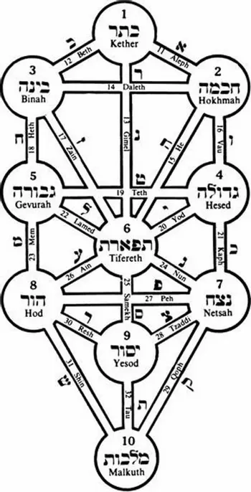
The Zohar discusses the creation of Man, and the uniqueness of man in the idea of God giving us a Neshamah, spiritual understanding and connection to Him. This is something that is absent from the rest of creation (animal kingdom). The significant point is how the tree of life is divided in half by the center line, and the left represents evil. For example, knowledge (binah) puffs up (1 Corinthians 8:1), and wisdom (hokhmah) makes one humble (Mishley / Proverbs 15:33). If we consider this analogous to a scale, note how these things (bina/hokhmah) are opposite ends of the scale.
Isaiah / ישעיה
http://www.matsati.com

Slide 15
References to DSS Sectarian Documents on Belial
The Coming of Melchizedek: 11Q13
A Collection of Messianic Proof Texts: 4Q175
The Last Days: An Interpretation of Selected Verses: 4Q177
Apocryphal Psalms: 4Q88
Incantation of the Sage: 4Q444
The Exhortation, dead sea scrolls a new translation
The Last Days: A Commentary on Selected Verses: 4Q174
A Sectarian Rule: 5Q13
Section C, dead sea scrolls a new translation
A Liturgy of Blessing and Cursing: 4Q280, 4Q286–289
The War Scroll: 1QM, 4Q491–496
Charter of a Jewish Sectarian Association: 1Qs, 4Q255–264a, 5Q11
Israel and the Holy Land: 4Q226
An Ezekiel Apocryphon: 4Q385, 4Q385b, 4Q386, 4Q388
Assorted Manuscripts: 4Q471–471a, 4Q471c
A Paraphrase of Genesis and Exodus: 4Q225
Songs to Disperse Demons: 11Q11
The War of the Messiah: 4Q285, 11Q14
Thanksgiving Hymns (The Thanksgiving Scroll): 1QHa, 1Q35, 4Q427–432
In Praise of God’s Grace (Barki Nafshi): 4Q434, 4Q436–437, 4Q439
The Book of Secrets: 1Q27, 4Q299–301
Second Temple Period, dead sea scrolls a new translation
Apocryphal Joshua: 4Q378–379
Commentaries on Psalms: 4Q171, 4Q173, 1Q16
The Laws, dead sea scrolls a new translation
Isaiah / ישעיה
http://www.matsati.com

Slide 16
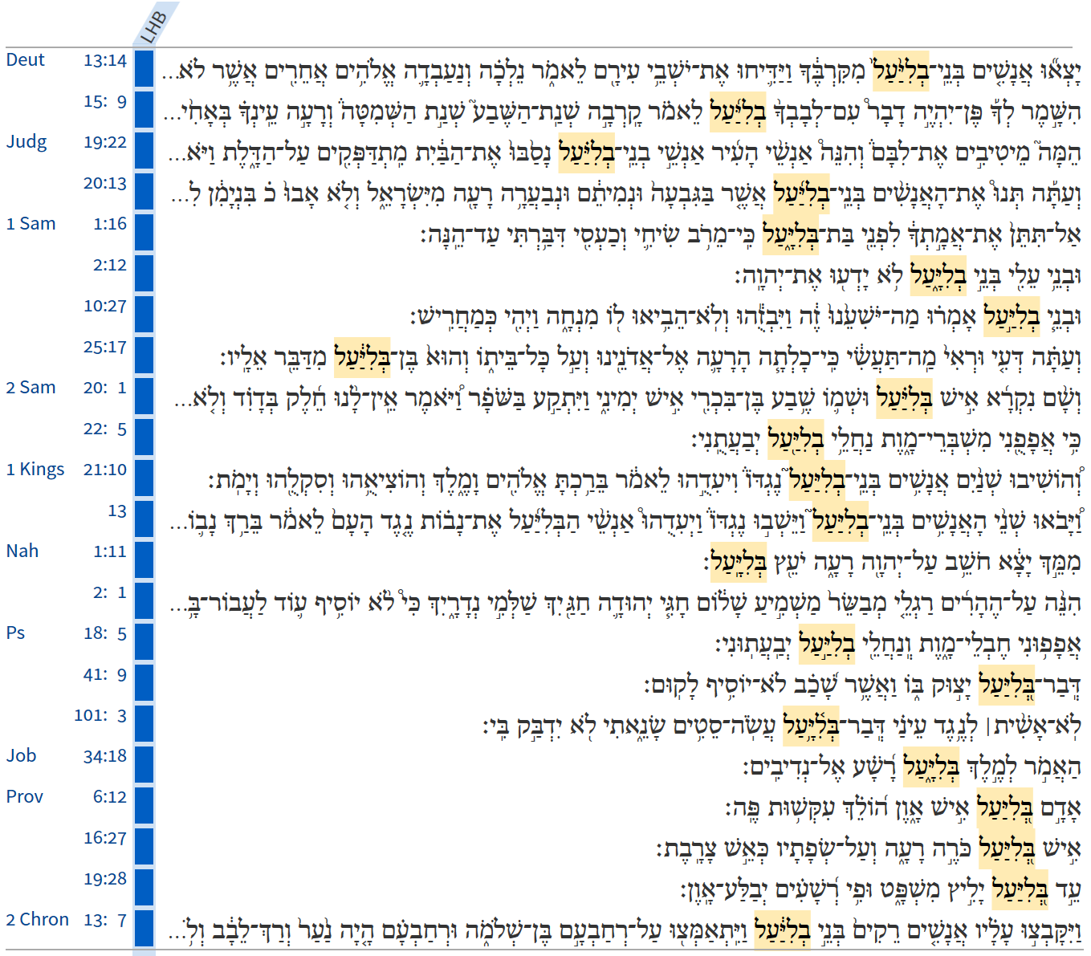
Occurrences ofבליעל Belial in the Tanakh (תנך)
Ephesians 6:10-12
6:10 Finally, my brethren, be strong in the Lord, and in the power of his might. 6:11 Put on the whole armour of God, that ye may be able to stand against the wiles of the devil. 6:12 For we wrestle not against flesh and blood, but against principalities, against powers, against the rulers of the darkness of this world, against spiritual wickedness in high places. (KJV)
Isaiah / ישעיה
http://www.matsati.com

Slide 17
2 Thessalonians 2:1-17
2:1 Now we beseech you, brethren, by the coming of our Lord Jesus Christ, and by our gathering together unto him, 2:2 That ye be not soon shaken in mind, or be troubled, neither by spirit, nor by word, nor by letter as from us, as that the day of Christ is at hand. 2:3 Let no man deceive you by any means: for that day shall not come, except there come a falling away first, and that man of sin be revealed, the son of perdition; 2:4 Who opposeth and exalteth himself above all that is called God, or that is worshipped; so that he as God sitteth in the temple of God, shewing himself that he is God. 2:5 Remember ye not, that, when I was yet with you, I told you these things? 2:6 And now ye know what withholdeth that he might be revealed in his time. 2:7 For the mystery of iniquity doth already work: only he who now letteth will let, until he be taken out of the way. 2:8 And then shall that Wicked be revealed, whom the Lord shall consume with the spirit of his mouth, and shall destroy with the brightness of his coming: 2:9 Even him, whose coming is after the working of Satan with all power and signs and lying wonders, 2:10 And with all deceivableness of unrighteousness in them that perish; because they received not the love of the truth, that they might be saved. 2:11 And for this cause God shall send them strong delusion, that they should believe a lie: 2:12 That they all might be damned who believed not the truth, but had pleasure in unrighteousness. 2:13 But we are bound to give thanks alway to God for you, brethren beloved of the Lord, because God hath from the beginning chosen you to salvation through sanctification of the Spirit and belief of the truth: 2:14 Whereunto he called you by our gospel, to the obtaining of the glory of our Lord Jesus Christ. 2:15 Therefore, brethren, stand fast, and hold the traditions which ye have been taught, whether by word, or our epistle. 2:16 Now our Lord Jesus Christ himself, and God, even our Father, which hath loved us, and hath given us everlasting consolation and good hope through grace, 2:17 Comfort your hearts, and stablish you in every good word and work. (KJV)
Isaiah / ישעיה
http://www.matsati.com

Slide 18
2 Thessalonians 2:1-17
2:8 And then shall that Wicked be revealed, whom the Lord shall consume with the spirit of his mouth, and shall destroy with the brightness of his coming: אֶת הָרָשָׁע אֲשֶׁר בּוֹאוֹ הוּא בְּהֶתְאֵם לִפְעֻלַּת הַשָּׂטָן, מְלֻוֶּה בְּכָל גְּבוּרָה, בְּאוֹתוֹת וּבְמוֹפְתֵי שֶׁקֶרוּבְכָל תַּרְמִית רֶשַׁע הַמְיֻעָדִים לִבְנֵי הָאֲבַדּוֹן, וְזֹאת מִפְּנֵי שֶׁלֹּא קִבְּלוּ אֶת אַהֲבַת הָאֱמֶת אֲשֶׁר יָכְלוּ לְהִוָּשַׁע בָּהּ; 2:9 Even him, whose coming is after the working of Satan with all power and signs and lying wonders, 2:10 And with all deceivableness of unrighteousness in them that perish; because they received not the love of the truth, that they might be saved. 2:11 And for this cause God shall send them strong delusion, that they should believe a lie: 2:12 That they all might be damned who believed not the truth, but had pleasure in unrighteousness. (KJV)
οὗ ἐστιν ἡ παρουσία κατʼ ἐνέργειαν τοῦ Σατανᾶ ἐν πάσῃ δυνάμει καὶ σημείοις καὶ τέρασιν ψεύδους καὶ ἐν πάσῃ ἀπάτῃ ἀδικίας τοῖς ἀπολλυμένοις, ἀνθʼ ὧν τὴν ἀγάπην τῆς ἀληθείας οὐκ ἐδέξαντο εἰς τὸ σωθῆναι αὐτούς·
Isaiah / ישעיה
http://www.matsati.com

Slide 19
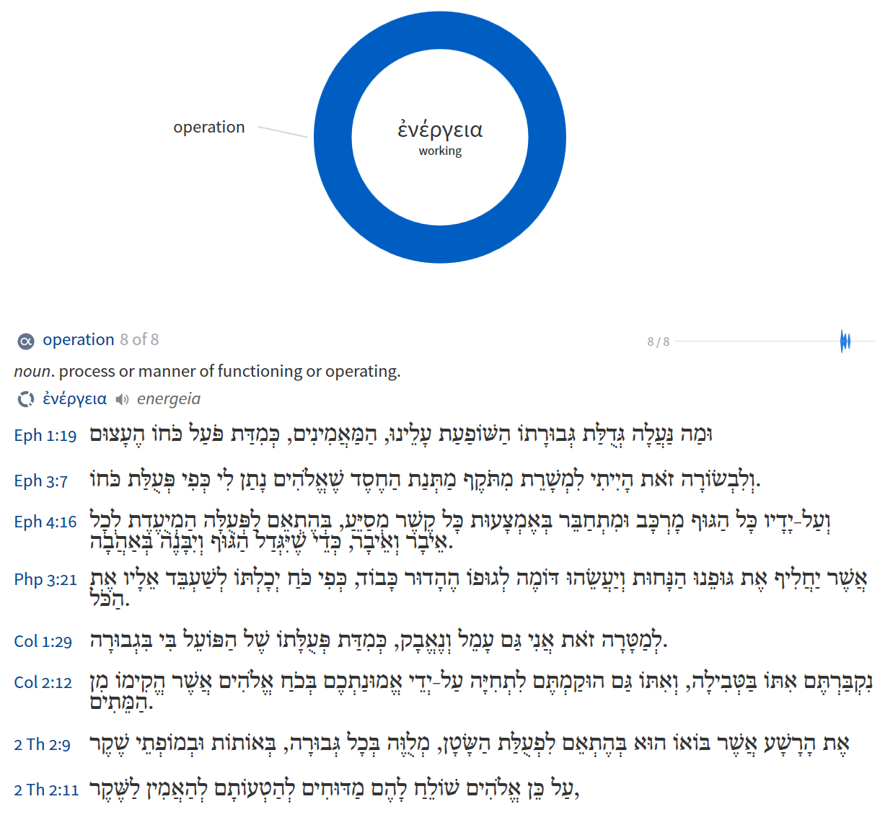
2 Thessalonians 2:9
οὗ ἐστιν ἡ παρουσία κατʼ ἐνέργειαν τοῦ Σατανᾶ ἐν πάσῃ δυνάμει καὶ σημείοις καὶ τέρασιν ψεύδους καὶ ἐν πάσῃ ἀπάτῃ ἀδικίας τοῖς ἀπολλυμένοις, ἀνθʼ ὧν τὴν ἀγάπην τῆς ἀληθείας οὐκ ἐδέξαντο εἰς τὸ σωθῆναι αὐτούς·
DSS Sectarian Doc 1QpHab 12:8-9
1QpHab 12:8 אשר פעל בה הכוהן ^הרשע^ מעשי תועבות ויטמא את
1QpHab 12:9 מקדש אל
Isaiah / ישעיה
http://www.matsati.com

