Slide 1
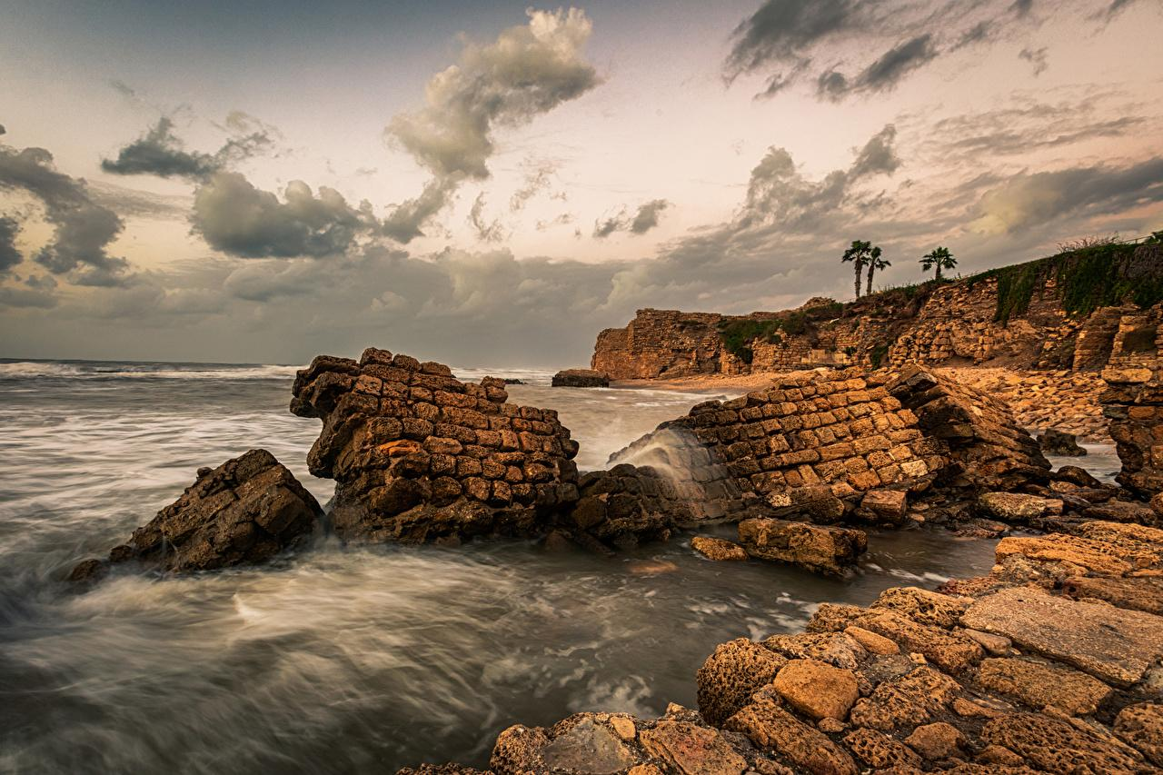


Isaiah 13:12-22
ישעיהו יג:יב-כב
Isaiah / ישעיה
http://www.matsati.com

Slide 2

ספר שמואל א פרק כא
﻿ה וַיַּעַן הַכֹּהֵן אֶת-דָּוִד וַיֹּאמֶר אֵין-לֶחֶם חֹל אֶל-תַּחַת יָדִי כִּי-אִם-לֶחֶם קֹדֶשׁ יֵשׁ אִם-נִשְׁמְרוּ הַנְּעָרִים אַךְ מֵאִשָּׁה: ו וַיַּעַן דָּוִד אֶת-הַכֹּהֵן וַיֹּאמֶר לוֹ כִּי אִם-אִשָּׁה עֲצֻרָה-לָנוּ כִּתְמוֹל שִׁלְשֹׁם בְּצֵאתִי וַיִּהְיוּ כְלֵי-הַנְּעָרִים קֹדֶשׁ וְהוּא דֶּרֶךְ חֹל וְאַף כִּי הַיּוֹם יִקְדַּשׁ בַּכֶּלִי: ז וַיִּתֶּן-לוֹ הַכֹּהֵן קֹדֶשׁ כִּי לֹא-הָיָה שָׁם לֶחֶם כִּי-אִם-לֶחֶם הַפָּנִים הַמּוּסָרִים מִלִּפְנֵי יְהֹוָה לָשֹוּם לֶחֶם חֹם בְּיוֹם הִלָּקְחוֹ:
1 Samuel 21:4-6
21:4 And the priest answered David and said, “There is no common bread on hand; but there is holy bread, if the young men have at least kept themselves from women.” 21:5 Then David answered the priest, and said to him, “Truly, women have been kept from us about three days since I came out. And the vessels of the young men are holy, and the bread is in effect common, even though it was consecrated in the vessel this day.” 21:6 So the priest gave him holy bread; for there was no bread there but the showbread which had been taken from before the Lord, in order to put hot bread in its place on the day when it was taken away. (KJV)
Isaiah / ישעיה
http://www.matsati.com

Slide 3







ספר ישעיה פרק יג
﻿יב אוֹקִיר אֱנוֹשׁ מִפָּז וְאָדָם מִכֶּתֶם אוֹפִיר: יג עַל-כֵּן שָׁמַיִם אַרְגִּיז וְתִרְעַשׁ הָאָרֶץ מִמְּקוֹמָהּ בְּעֶבְרַת יְהֹוָה צְבָאוֹת וּבְיוֹם חֲרוֹן אַפּוֹ: יד וְהָיָה כִּצְבִי מֻדָּח וּכְצֹאן וְאֵין מְקַבֵּץ אִישׁ אֶל-עַמּוֹ יִפְנוּ וְאִישׁ אֶל-אַרְצוֹ יָנוּסוּ: טו כָּל-הַנִּמְצָא יִדָּקֵר וְכָל-הַנִּסְפֶּה יִפּוֹל בֶּחָרֶב: טז וְעֹלְלֵיהֶם יְרֻטְּשׁוּ לְעֵינֵיהֶם יִשַּׁסּוּ בָּתֵּיהֶם וּנְשֵׁיהֶם תִּשָּׁגַלְנָה [תִּשָּׁכַבְנָה]: יז הִנְנִי מֵעִיר עֲלֵיהֶם אֶת-מָדָי אֲשֶׁר-כֶּסֶף לֹא יַחְשֹׁבוּ וְזָהָב לֹא יַחְפְּצוּ-בוֹ: יח וּקְשָׁתוֹת נְעָרִים תְּרַטַּשְׁנָה וּפְרִי-בֶטֶן לֹא יְרַחֵמוּ עַל-בָּנִים לֹא-תָחוּס עֵינָם: יט וְהָיְתָה בָבֶל צְבִי מַמְלָכוֹת תִּפְאֶרֶת גְּאוֹן כַּשְֹדִּים כְּמַהְפֵּכַת אֱלֹהִים אֶת-סְדֹם וְאֶת-עֲמֹרָה: כ לֹא-תֵשֵׁב לָנֶצַח וְלֹא תִשְׁכֹּן עַד-דּוֹר וָדוֹר וְלֹא-יַהֵל שָׁם עֲרָבִי וְרֹעִים לֹא-יַרְבִּצוּ שָׁם: כא וְרָבְצוּ-שָׁם צִיִּים וּמָלְאוּ בָתֵּיהֶם אֹחִים וְשָׁכְנוּ שָׁם בְּנוֹת יַעֲנָה וּשְֹעִירִים יְרַקְּדוּ-שָׁם: כב וְעָנָה אִיִּים בְּאַלְמְנוֹתָיו וְתַנִּים בְּהֵיכְלֵי עֹנֶג וְקָרוֹב לָבוֹא עִתָּהּ וְיָמֶיהָ לֹא יִמָּשֵׁכוּ:
Isaiah / ישעיה
http://www.matsati.com

Slide 4




אוֹקִ֥יר אֱנ֖וֹשׁ מִפָּ֑ז וְאָדָ֖ם מִכֶּ֥תֶם אוֹפִֽיר
ספר דברים פרק לב
י יִמְצָאֵהוּ בְּאֶרֶץ מִדְבָּר וּבְתֹהוּ יְלֵל יְשִׁמֹן יְסֹבֲבֶנְהוּ יְבוֹנֲנֵהוּ יִצְּרֶנְהוּ כְּאִישׁוֹן עֵינוֹ:
Devarim / Deuteronomy 32:10
“He found him in a desert land, And in the howling waste of a wilderness; He encircled him, He cared for him, He guarded him as the pupil of His eye.
﻿ספר תהילים פרק יז
ח שָׁמְרֵנִי כְּאִישׁוֹן בַּת-עָיִן בְּצֵל כְּנָפֶיךָ תַּסְתִּירֵנִי:
Tehillim / Psalm 17:8
Keep me as the apple of the eye; Hide me in the shadow of Your wings
Isaiah / ישעיה
http://www.matsati.com

Slide 5

ספר זְכַרְיָה פרק ב
יב כִּ֣י כֹ֣ה אָמַר֮ יְהוָ֣ה צְבָאוֹת֒ אַחַ֣ר כָּב֔וֹד שְׁלָחַ֕נִי אֶל־הַגּוֹיִ֖ם הַשֹּׁלְלִ֣ים אֶתְכֶ֑ם כִּ֚י הַנֹּגֵ֣עַ בָּכֶ֔ם נֹגֵ֖עַ בְּבָבַ֥ת עֵינֽוֹ׃
Zechariah 2:8
For thus says the Lord of hosts, “After glory He has sent me against the nations which plunder you, for he who touches you, touches the apple of His eye.
﻿ספר משלי פרק ז
ב שְׁמֹר מִצְוֹתַי וֶחְיֵה וְתוֹרָתִי כְּאִישׁוֹן עֵינֶיךָ:
Mishley / Proverbs 7:2
Keep my commandments and live, And my teaching as the apple of your eye.
Isaiah / ישעיה
http://www.matsati.com

Slide 6
Rabbinic Literature
ספרות רבנית
Part 2
Isaiah / ישעיה
http://www.matsati.com

Slide 7
Targum Jonathan son of Uziel Isaiah 13:12-22
13:12 And I will love them that fear me more than gold, in which the sons of men glory; and those that keep the law more than the fine gold of Ophir. 13:13 Therefore I will shake the heavens, and the earth shall remove out of her place, from before the presence of the Lord of hosts, and in the day of the fierceness of His anger. 13:14 And he shall be as a roe chased, and as sheep when there is none to gather them together: they shall every man turn to his own people, and flee every one into his own land. 13:15 Every one that shall be found in her shall be slain, and every one that shall enter into the fortified cities shall be slain by the sword. 13:16 And their children shall be dashed before their eyes; their houses shall be plundered, and their wives ravished. 13:17 Behold, I am bringing upon them the Medes, who are not impelled by silver; and as for gold, they delight not in it. 13:18 And their bows shall strike through the young men; and they shall not compassionate the child of the womb; their eye shall not spare the children. 13:19 And Babylon shall become, she that was aforetimes the joy of kings, the beauty of the Chaldeens’ excellency, as the overthrow wherewith the Lord overthrew Sodom and Gomorrah. 13:20 It shall not be inhabited for ever; nor shall it be dwelt in from generation to generation: neither shall the Arabian pitch his tent there, neither shall the shepherds dwell there. 13:21 But the martens shall lodge there; and their houses shall be filled with howling monsters: and there shall the ostriches dwell; and devils shall delight themselves there. 13:22 The wild cats shall shriek in their palaces; and dragons in the place of the abodes of their luxuries. And nigh to come is the time of the destruction of Babylon, and her days shall not be prolonged. (TgJ)
Isaiah / ישעיה
http://www.matsati.com

Slide 8


Likutei Moharan 11:8 Part 6
וּבָעֵינַן לִנְחוּתֵי – לְשׁוֹן שִׁפְלוּת, הַיְנוּ לִהְיוֹת שָׁפָל וְעָנָו. אַךְ שֶׁהָיָה לְאַקוּרֵי נַפְשִׁין – לְשׁוֹן (ישעיהו י״ג:י״ב): אוֹקִיר אֱנוֹשׁ מִפָּז, הַיְנוּ שֶׁהָיָה הָעֲנָוָה בִּשְׁבִיל גַּדְלוּת, כְּדֵי לְהִתְכַּבֵּד וּלְהִתְיַקֵּר, כִּי מֵחֲמַת שֶׁיּוֹדְעִין גֹּדֶל בִּזּוּי הַגַּדְלוּת, עַל כֵּן הֵם עֲנָוִים, בִּשְׁבִיל לְהִתְכַּבֵּד וּלְהִתְיַקֵּר עַל־יְדֵי הָעֲנָוָה, וְזֶהוּ בְּחִינַת עֲנִיווּת שֶׁהוּא תַּכְלִית הַגַּדְלוּת.
and we wanted to go down into it — [To go down] indicates lowliness, being lowly and humble. But it was: l’OKuRei nafshin (to cool ourselves) — This is similar to (Isaiah 13:12), “OKiR enosh (I will make man more prominent) than fine gold.” That is, his humbleness was egotistical—so as to gain glory and yaKaR (prominence). Because people know just how despicable haughtiness is, they act humbly, in order to acquire glory and prominence through humility. This is the concept of humility that is the ultimate degree of haughtiness.
Isaiah / ישעיה
http://www.matsati.com

Slide 9
Rashi on Isaiah 13:12 Part 1-2
אוקיר אנוש מפז. בו בלילה אכבד את דניאל מפז כשהביאוהו לקרות מכתב מנא מנא תקל ופרסין (דניאל ה׳:כ״ה) באדין אמר בלטשצר והלבישו ית דניאל ארגונא וגו':
I will make mortal man dearer than fine gold On that night I will honor Daniel more than fine gold. When they brought him to read the writing (Dan. 5:25): “Mene mene tekel ufarsin”; (ibid. 5: 25) “Then Belshazzar ordered, and they dressed Daniel in purple...”
כתם אופיר. קבוצת זהב אופיר:
more than a collection of the gold of Ophir Heb. מִכֶּתֶם אוֹפִיר, a collection of the gold of Ophir.
Isaiah / ישעיה
http://www.matsati.com

Slide 10


Rashi on Isaiah 13:13 Part 1
שמים ארגיז. כל צבאה ירגז ואומר איך נפלת משמים הילל בן שחר (לקמן יד) ואחר כך נגדעת לארץ חולש על גוים אף כאן תחלה שמים ארגיז ואחר כך ותרעש הארץ ירעשו יושביה לקול מפלתה שיתמהו בדבר:
I will make heaven quake. All their host will quake when I cast down the prince of Babylon, for the Holy One, blessed be He, does not punish the nations until He punishes their heavenly princes first, as Scripture states (infra 24:21): “The Lord shall visit upon the heavenly host on high,” and afterwards, “on the kings of the earth on the earth.” Scripture states further (infra 14:12): “How have you fallen from heaven, Lucifer, the morning star?” And then, “You have been cut down to the ground, you who cast lots on nations.” Here too, first, “I will make heaven quake,” and afterwards, “the earth will quake.” Its inhabitants shall quake at the news of its downfall, for they shall be astonished at the event.
Isaiah / ישעיה
http://www.matsati.com

Slide 11


Esther Rabbah 5:3
…Rabbi Ḥanina bar Shilka and Rabbi Yehoshua of Sikhnin and Rabbi Levi in the name of Rabbi Yoḥanan said: When a Jew and a gentile are residing in one courtyard, and the Jew places his pot on the fire and the gentile touches it, it is not ritually impure. If the gentile places his pot on the fire and the Jew touches it, he [the gentile] would say it is impure. Even if several repugnant creatures and creeping animals fall into it, he would eat it, but if a Jew places his food in it, he [the gentile] would break it. …
Isaiah / ישעיה
http://www.matsati.com

Slide 12


Mishley / Proverbs 9:1-12
9:1 Wisdom hath built her house, she hath hewn out her seven pillars: 9:2 She hath killed her beasts; she mingled her wine; she hath also furnished her table. 9:3 She hath sent forth her maidens: she crieth upon the highest places of the city, 9:4 Whoso is simple, let him turn in hither: as for him that wanteth understanding, she saith to him, 9:5 Come, eat of my bread, and drink of the wine which I have mingled. 9:6 Forsake the foolish, and live; and go in the way of understanding. 9:7 He that reproveth a scorner getteth to himself shame: and he that rebuketh a wicked man getteth himself a blot. 9:8 Reprove not a scorner, lest he hate thee: rebuke a wise man, and he will love thee. 9:9 Give instruction to a wise man, and he will be yet wiser: teach a just man, and he will increase in learning. 9:10 The fear of the LORD is the beginning of wisdom: and the knowledge of the holy is understanding. 9:11 For by me thy days shall be multiplied, and the years of thy life shall be increased. 9:12 If thou be wise, thou shalt be wise for thyself: but if thou scornest, thou alone shall bear it. (KJV)
Isaiah / ישעיה
http://www.matsati.com

Slide 13
ספר דברים פרק ח
א כָּל-הַמִּצְוָה אֲשֶׁר אָנֹכִי מְצַוְּךָ הַיּוֹם תִּשְׁמְרוּן לַעֲשֹוֹת לְמַעַן תִּחְיוּן וּרְבִיתֶם וּבָאתֶם וִירִשְׁתֶּם אֶת-הָאָרֶץ אֲשֶׁר-נִשְׁבַּע יְהוָֹה לַאֲבֹתֵיכֶם: ב וְזָכַרְתָּ אֶת-כָּל-הַדֶּרֶךְ אֲשֶׁר הוֹלִיכְךָ יְהוָֹה אֱלֹהֶיךָ זֶה אַרְבָּעִים שָׁנָה בַּמִּדְבָּר לְמַעַן עַנֹּתְךָ לְנַסֹּתְךָ לָדַעַת אֶת-אֲשֶׁר בִּלְבָבְךָ הֲתִשְׁמֹר מִצְוֹתָו [מִצְוֹתָיו] אִם-לֹא:
Devarim / Deuteronomy 8:1-2
8:1 All the commandments which I command thee this day shall ye observe to do, that ye may live, and multiply, and go in and possess the land which the LORD sware unto your fathers. 8:2 And thou shalt remember all the way which the LORD thy God led thee these forty years in the wilderness, to humble thee, and to prove thee, to know what was in thine heart, whether thou wouldest keep his commandments, or no. (KJV)
Isaiah / ישעיה
http://www.matsati.com

