Slide 1
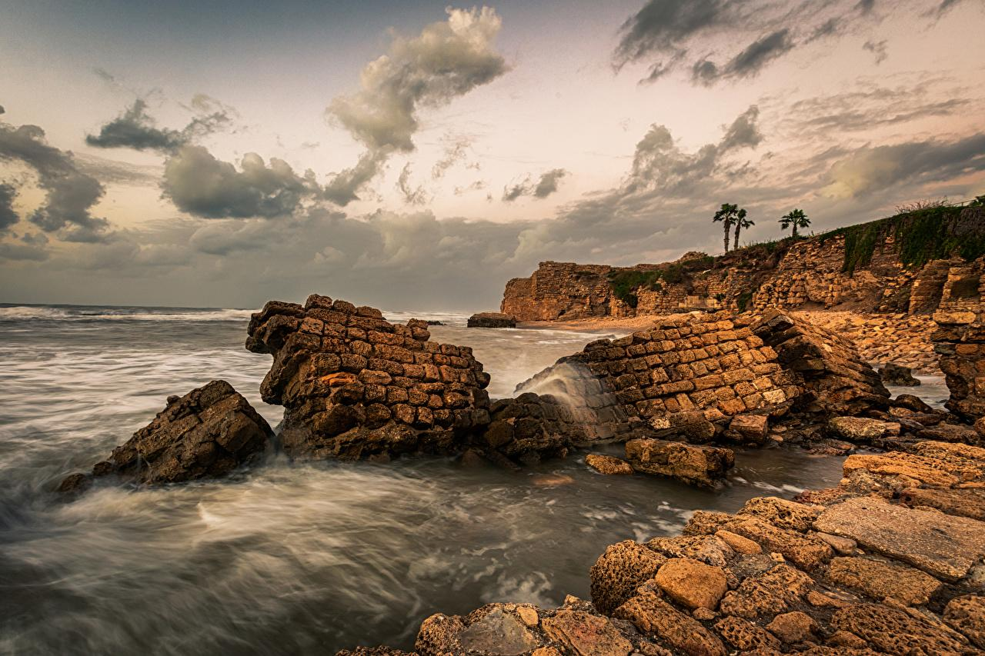

Isaiah 13:1-11
ישעיהו יג:א-יא
Isaiah / ישעיה
http://www.matsati.com

Slide 2













ספר ישעיה פרק יג
א מַשָּׂא בָּבֶל אֲשֶׁר חָזָה יְשַׁעְיָהוּ בֶּן-אָמוֹץ: ב עַל הַר-נִשְׁפֶּה שְֹאוּ-נֵס הָרִימוּ קוֹל לָהֶם הָנִיפוּ יָד וְיָבֹאוּ פִּתְחֵי נְדִיבִים: ג אֲנִי צִוֵּיתִי לִמְקֻדָּשָׁי גַּם קָרָאתִי גִבּוֹרַי לְאַפִּי עַלִּיזֵי גַּאֲוָתִי: ד קוֹל הָמוֹן בֶּהָרִים דְּמוּת עַם-רָב קוֹל שְׁאוֹן מַמְלְכוֹת גּוֹיִם נֶאֱסָפִים יְהֹוָה צְבָאוֹת מְפַקֵּד צְבָא מִלְחָמָה: ה בָּאִים מֵאֶרֶץ מֶרְחָק מִקְצֵה הַשָּׁמָיִם יְהֹוָה וּכְלֵי זַעְמוֹ לְחַבֵּל כָּל-הָאָרֶץ: ו הֵילִילוּ כִּי קָרוֹב יוֹם יְהֹוָה כְּשֹׁד מִשַּׁדַּי יָבוֹא: ז עַל-כֵּן כָּל-יָדַיִם תִּרְפֶּינָה וְכָל-לְבַב אֱנוֹשׁ יִמָּס: ח וְנִבְהָלוּ | צִירִים וַחֲבָלִים יֹאחֵזוּן כַּיּוֹלֵדָה יְחִילוּן אִישׁ אֶל-רֵעֵהוּ יִתְמָהוּ פְּנֵי לְהָבִים פְּנֵיהֶם: ט הִנֵּה יוֹם-יְהֹוָה בָּא אַכְזָרִי וְעֶבְרָה וַחֲרוֹן אָף לָשֹוּם הָאָרֶץ לְשַׁמָּה וְחַטָּאֶיהָ יַשְׁמִיד מִמֶּנָּה: י כִּי-כוֹכְבֵי הַשָּׁמַיִם וּכְסִילֵיהֶם לֹא יָהֵלּוּ אוֹרָם חָשַׁךְ הַשֶּׁמֶשׁ בְּצֵאתוֹ וְיָרֵחַ לֹא-יַגִּיהַ אוֹרוֹ: יא וּפָקַדְתִּי עַל-תֵּבֵל רָעָה וְעַל-רְשָׁעִים עֲוֹנָם וְהִשְׁבַּתִּי גְּאוֹן זֵדִים וְגַאֲוַת עָרִיצִים אַשְׁפִּיל
Isaiah / ישעיה
http://www.matsati.com

Slide 3


The Peshitta Romans 9:22
ܐܷܢ ܕܷ݁ܝܢ ܨܒ݂ܳܐ ܐܱܠܴܗܳܐ ܕܱ݁ܢܚܰܘܶܐ ܪܾܘܓ݂ܙܶܗ ܂ ܘܢܰܘܕܱ݁ܥ ܚܰܝܠܷܗ ܆ ܐܱܝܬܻ݁ܝ ܒ݁ܣܽܘܓ݂ܳܐܐ ܕ݁ܡܰܓ݁ܪܱܬ݂ ܪܾܘܚܶܗ ܪܾܘܓ݂ܙܳܐ ܇ ܥܰܠ ܡܳܐܢܷ̈ܐ ܕ݁ܪܾܘܓ݂ܙܳܐ ܕܱ݁ܓ݂ܡܺܝܪܻܝܢ ܠܱܐܒ݂ܕ݂ܳܢܳܐ ܆
Romans 9:22
What if God, willing to shew his wrath, and to make his power known, endured with much longsuffering the vessels of wrath fitted to destruction (KJV)
Isaiah / ישעיה
http://www.matsati.com

Slide 4


ספר דברים פרק כח
טו וְהָיָ֗ה אִם־לֹ֤א תִשְׁמַע֙ בְּקוֹל֙ יְהוָ֣ה אֱלֹהֶ֔יךָ לִשְׁמֹ֤ר לַעֲשׂוֹת֙ אֶת־כָּל־מִצְוֺתָ֣יו וְחֻקֹּתָ֔יו אֲשֶׁ֛ר אָנֹכִ֥י מְצַוְּךָ֖ הַיּ֑וֹם וּבָ֧אוּ עָלֶ֛יךָ כָּל־הַקְּלָל֥וֹת הָאֵ֖לֶּה וְהִשִּׂיגֽוּךָ׃
Devarim / Deuteronomy 28:15
28:15 But it shall come to pass, if thou wilt not hearken unto the voice of the Lord thy God, to observe to do all his commandments and his statutes which I command thee this day; that all these curses shall come upon thee, and overtake thee: (KJV)
Isaiah / ישעיה
http://www.matsati.com

Slide 5



ספר דברים פרק כח
א וְהָיָ֗ה אִם־שָׁמ֤וֹעַ תִּשְׁמַע֙ בְּקוֹל֙ יְהוָ֣ה אֱלֹהֶ֔יךָ לִשְׁמֹ֤ר לַעֲשׂוֹת֙ אֶת־כָּל־מִצְוֺתָ֔יו אֲשֶׁ֛ר אָנֹכִ֥י מְצַוְּךָ֖ הַיּ֑וֹם וּנְתָ֨נְךָ֜ יְהוָ֤ה אֱלֹהֶ֙יךָ֙ עֶלְי֔וֹן עַ֖ל כָּל־גּוֹיֵ֥י הָאָֽרֶץ׃ ב וּבָ֧אוּ עָלֶ֛יךָ כָּל־הַבְּרָכ֥וֹת הָאֵ֖לֶּה וְהִשִּׂיגֻ֑ךָ כִּ֣י תִשְׁמַ֔ע בְּק֖וֹל יְהוָ֥ה אֱלֹהֶֽיךָ׃
Devarim / Deuteronomy 28:1-2
28:1 And it shall come to pass, if thou shalt hearken diligently unto the voice of the Lord thy God, to observe and to do all his commandments which I command thee this day, that the Lord thy God will set thee on high above all nations of the earth: 28:2 And all these blessings shall come on thee, and overtake thee, if thou shalt hearken unto the voice of the Lord thy God. (KJV)
Isaiah / ישעיה
http://www.matsati.com

Slide 6
Matthew 24:29
24:29 “Immediately after the tribulation of those days the sun will be darkened, and the moon will not give its light, and the stars will fall from heaven, and the powers of the heavens will be shaken." (ESV)
Mark 13:24
13:24 But in those days, after that tribulation, the sun shall be darkened, and the moon shall not give her light, (KJV)
Isaiah / ישעיה
http://www.matsati.com

Slide 7
Rabbinic Literature
ספרות רבנית
Part 2
Isaiah / ישעיה
http://www.matsati.com

Slide 8


Targum Jonathan son of Uziel Isaiah 13:1-11
13:1 THE BURDEN OF THE CUP OF CURSING TO GIVE TO BABYLON TO DRINK, WHICH ISAIAH THE SON OF AMOZ DID PROPHESY. 13:2 Against the fortified city that dwells securely lift up the ensign, exalt the voice unto them, shake the hand, that they may go into the gates of the nobles. 13:3 I have commanded those that are prepared by me, I have also called together my mighty ones, that they may avenge my wrath upon them, my strength, and my praise. 13:4 There is a voice of a multitude in the mountains, like as of a great people: the voice of the tumultuous assembly of kings, of nations being assembled, the Lord of hosts is mustering the armies for battle. 13:5 They are coming from a far country, from the ends of the earth: the Lord and the vessels of the cup of cursing before Him, to destroy all the wicked of the earth. 13:6 Howl ye, for nigh is the day, ready to come from before the Lord; like spoil from before the Almighty it shall come. 13:7 Therefore shall all hands be slackened, and every man’s heart shall melt. 13:8 They shall be struck with consternation; distress and pangs shall take hold of them; they shall tremble as with the trembling of a woman that travaileth: they shall be amazed one at another; their countenances shall be like flames of fire. 13:9 Behold, the day from before the presence of the Lord cometh, cruel both with wrath and fierce anger, to lay the land desolate: and He shall destroy the sinners out of it. 13:10 For the stars of heaven and their constellations shall not give their light: the sun shall be darkened in his going forth; and the moon shall not cause her light to shine. 13:11 And I will visit the inhabitants of the world with the punishment for evil, and the wicked for their iniquity: and I will put an end to the greatness of the wicked, and the strength of the mighty I will humble. (TgJ)
Isaiah / ישעיה
http://www.matsati.com

Slide 9
DSS 1QpHab: A Commentary on Habakkuk
“You are satisfied with disgrace, not honor? So go ahead and drink until you stagger; the cup of the LORD’s right hand will come around for you, and then shame will cover your honor” (2:16).
This refers to the priest whose disgrace became greater than his honor, because he had not circumcised his heart’s foreskin, and he walked in the ways of drunkenness in order to put an end to thirst. But the cup of God’s wrath will destroy him, increas[ing only his dis]honor and pain […] 16[…]
[“For the crimes perpetrated against Lebanon he will bury you, for the robbery of beasts,] Col. 12 he will smite you; because of murder and injustice in the land, he will destroy the city and all who live in it” (2:17).
The passage refers to the Wicked Priest, that he will be paid back for what he did to the poor, for “Lebanon” refers to the party of the Yahad, and “beasts” refers to the simple-hearted of Judah who obey the Law. God will condemn him to utter destruction, just as he planned to destroy the poor. As for the verse that says, “because of murder in the city and injustice in the land,” “the city” refers to Jerusalem, where the Wicked Priest committed his abhorrent deeds, defiling the Temple of God. “Injustice in the land” refers to the cities of Judah where he stole the assets of the poor.
Isaiah / ישעיה
http://www.matsati.com

Slide 10
Talmud Bavli Berakhot 8b.16
״אֲנִי צִוֵּיתִי לִמְקֻדָּשָׁי״, תָּנֵי רַב יוֹסֵף: אֵלּוּ הַפַּרְסִיִּים הַמְקוּדָּשִׁין וּמְזוּמָּנִין לְגֵיהִנָּם.
While they have been praised here regarding certain specific aspects of their conduct, the Gemara proceeds to offer another perspective on the Persians based on a verse describing the destruction of Babylonia at the hands of the Persian and Medean armies: “I have commanded My consecrated ones; I have also called My mighty ones for My anger, even My proudly exulting ones” (Isaiah 13:3). Rav Yosef taught a baraita: These are the Persians who are consecrated and designated for Gehenna, for they have been sent by God to carry out his mission of anger, and they will be sent to Gehenna.
Rashi on Isaiah 13.3 Part 1-2
אני צויתי למקודשי. שיבאו ויתחילו להתגרות בם והם פרס ומדי אנשי כורש ודריוש שזמנתים לכך:
I commanded My appointed ones that they come and commence to incite them, and they are Persia and Media, the men of Cyrus and Darius, whom I appointed for this.
קראתי גבורי לאפי. לעשות חרון אפי בהם שהם עליזי גאותי שאני מתפאר בהם:
I summoned My heroes to [execute] My wrath To execute My wrath upon them, for they rejoice in My pride that I boast of them.
Isaiah / ישעיה
http://www.matsati.com

Slide 11
Midrash Tanchuma, Tazria 9.1
אָדָם כִּי יִהְיֶה בְעוֹר בְּשָׂרוֹ. זֶה שֶׁאָמַר הַכָּתוּב: כִּי לֹא אֵל חָפֵץ רֶשַׁע אַתָּה, לֹא יְגֻרְךָ רָע. לְלַמֶּדְךָ, שֶׁאֵין הַקָּדוֹשׁ בָּרוּךְ הוּא חָפֵץ לְחַיֵּב בְּרִיָּה, שֶׁנֶּאֱמַר: חַי אָנִי נְאֻם ה' אֱלֹהִים אִם אֶחְפֹּץ בְּמוֹת הָרָשָׁע וְגוֹ' (יחזקאל לג, יא). וּבְמַה חָפֵץ. לְהַצְדִּיק בְּרִיּוֹתָיו, שֶׁנֶּאֱמַר: ה' חָפֵץ לְמַעַן צִדְקוֹ יַגְדִּיל וְגוֹ' (ישעיה מב, כא), לְמַעַן לְצַדֵּק בְּרִיּוֹתָיו וְלֹא לְחַיֵּב. וְכֵן אַתָּה מוֹצֵא בְּאָדָם הָרִאשׁוֹן, כְּשֶׁבְּרָאוֹ נְתָנוֹ בְּגַן עֵדֶן וְצִוָּהוּ וְאָמַר לוֹ: מִזֶּה אֱכֹל וּמִזֶּה לֹא תֹּאכַל, כִּי בְּיוֹם אָכְלְךָ מִמֶּנּוּ מוֹת תָּמוּת (בראשית ב, יז). עָבַר עַל צִוּוּי הַקָּדוֹשׁ בָּרוּךְ הוּא, הֵבִיא עָלָיו אַפּוֹפְּסִין. בָּא הַשַּׁבָּת וּפְטָרוֹ. הִתְחִיל מֵסִיחַ עִמּוֹ אוּלַי יַעֲשֶׂה תְּשׁוּבָה,
(Lev. 13:2), “When anyone has on the skin of his flesh.” This text is related (to Ps. 5:5), “For You are not a God who delights in wickedness. [This verse is] to teach you that the Holy One, blessed be He, does not delight in convicting a person, as stated (in Ezek. 33:11), “As I live, says the Lord, it is not My delight for the wicked to die.” In what does He delight? In vindicating (rt.: tsdq) His people. Thus it is stated (in Is. 42:21), “The Lord was delighted because of His [servant's] vindication (tsdq)…,” [i.e.] because of His people's vindication (tsdq)] and not [their] conviction. So also you find that in the case of the first Adam, when he created him, He set him in the Garden of Eden. Then He gave him a command and said to him, “Eat this, but do not eat from this, for (according to Gen. 2:17) ‘on the day that you eat from it, you shall surely die.’” [When] he transgressed, he brought a sentence upon himself. [And then] the Sabbath came, and He acquitted him. He began to talk with him [about] whether he would repent.
Isaiah / ישעיה
http://www.matsati.com

Slide 12


Pesikta Rabbati 41:1
… He said: and this is the joy of the entire earth?! He hadn’t finished saying this before he sold everything that was in his hands. “…Mount Zion, by the north side…” (Psalms 48:3) And is Zion located in the north, isn’t it actually in the south? What is ‘the north side’? That her sacrifices were offered “…on the northern side of the altar…” (Leviticus 1:11) And what does “…the city of a great king…” (Psalms 48:3) mean? The city of the Great King. Another explanation. ‘The fairest of branches, the joy of the entire earth’ R’ Levi said: joy comes from Zion, “…and they shall come to Zion with song, with joy of days of yore shall be upon their heads…” (Isaiah 35:10) The blessing comes from there, “Like the dew of Hermon, that comes down upon the mountains of Zion; for there the Lord commanded the blessing, even life forever.” (Psalms 133:3) The Torah comes from Zion “…from out of Zion comes the Torah…” (Isaiah 2:3) Help comes to Israel out Zion, “Send forth your help from the sanctuary, and support you out of Zion.” (Psalms 20:3) Life comes from Zion, “…for there the Lord commanded the blessing, even life forever.” (Psalms 133:3) Salvation comes from Zion, as it says “Oh that the salvation of Israel were come out of Zion!” (Psalms 14:7) And the shofar blast which will bring near the redemption of Israel comes out of Zion “Blow the shofar in Zion, and sound an alarm in My holy mountain; Let all the inhabitants of the land tremble; For the day of the Lord comes, for it is at hand…” (Yoel 2:15)
Isaiah / ישעיה
http://www.matsati.com

Slide 13
Midrash Tanchuma, Bereshit 6:2
R. Judah the Levite, the son of Shalum said: The vavs, which the other verses lack, correspond to the six things which the Holy One, blessed be He, took from Adam after he sinned.22Vav has the numerical value of six which is also, according to tradition, the number of the things taken from Adam because of his sin They are as follows: his luster, his stature, his immortality, the fertility of the earth, the garden of Eden, the sun and the moon. Whence do we know about his luster? it is written : Changest his countenance and sendest him away (Job 14:20). Whence do we know of his stature? It is said: Thou hast hemmed me in from behind and before (Ps. 139:5). How do we know about his immortality? If Adam had been worthy, he would have merited living forever. Whence do we know of the fertility of the earth? It is written: Cursed be the ground for thy sake (Gen. 3:17). Whence do we know of his banishment from the Garden of Eden? It is written: He drove out the man (ibid., v. 24). Whence do we know of the sun and the moon? The sun shall be darkened in his going forth, and the moon shall not cause her light to shine (Isa. 13:10).
Isaiah / ישעיה
http://www.matsati.com

