Slide 1
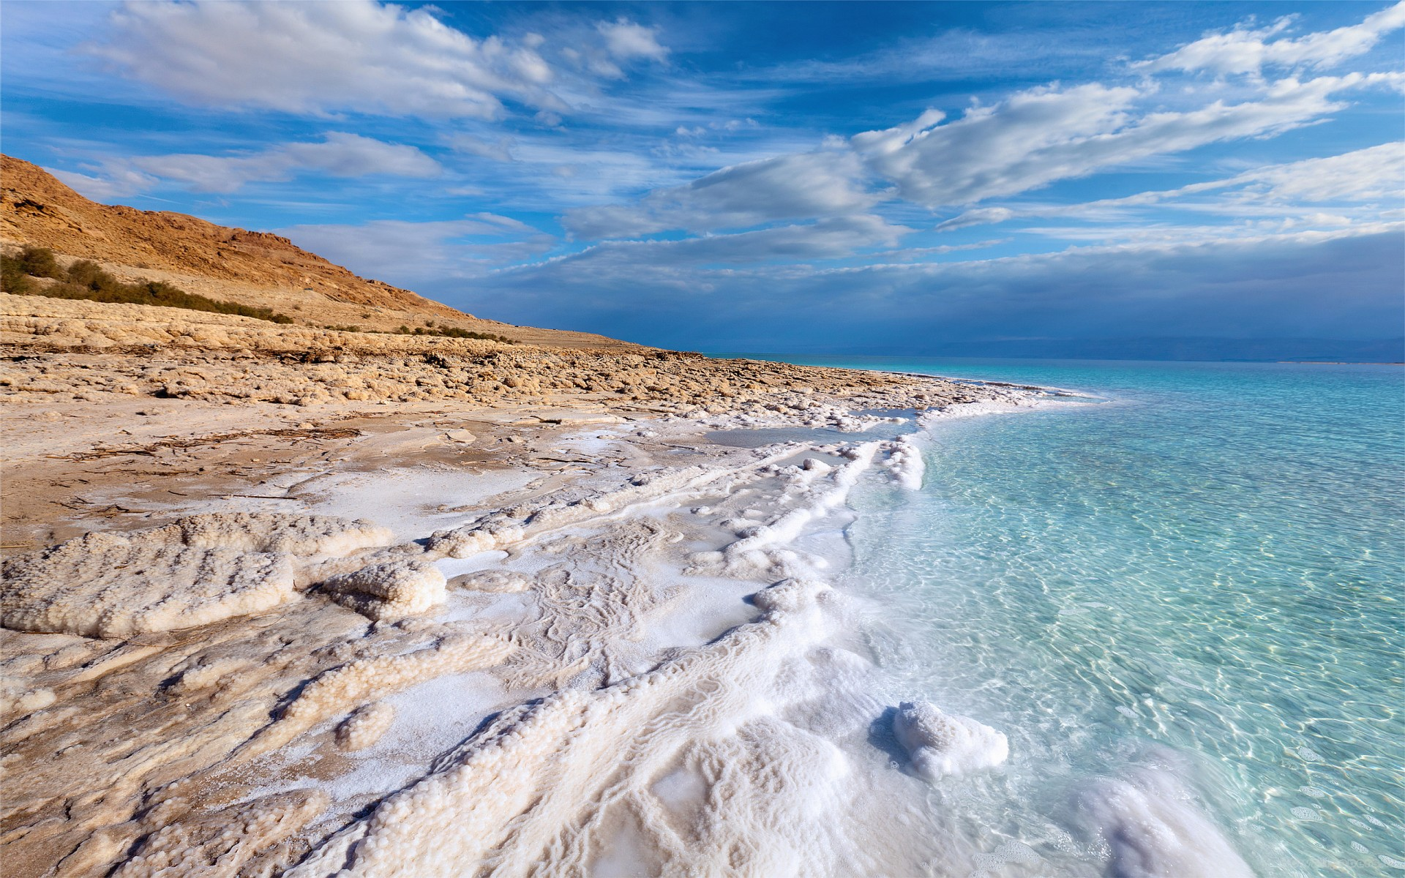

Isaiah 11:10-16
ישעיהו יב:יא-טז
Isaiah / ישעיה
http://www.matsati.com

Slide 2






﻿ספר ישעיה פרק יא
﻿י וְהָיָה בַּיּוֹם הַהוּא שֹׁרֶשׁ יִשַׁי אֲשֶׁר עֹמֵד לְנֵס עַמִּים אֵלָיו גּוֹיִם יִדְרֹשׁוּ וְהָיְתָה מְנֻחָתוֹ כָּבוֹד: יא וְהָיָה | בַּיּוֹם הַהוּא יוֹסִיף אֲדֹנָי | שֵׁנִית יָדוֹ לִקְנוֹת אֶת-שְׁאָר עַמּוֹ אֲשֶׁר יִשָּׁאֵר מֵאַשּׁוּר וּמִמִּצְרַיִם וּמִפַּתְרוֹס וּמִכּוּשׁ וּמֵעֵילָם וּמִשִּׁנְעָר וּמֵחֲמָת וּמֵאִיֵּי הַיָּם: יב וְנָשָֹא נֵס לַגּוֹיִם וְאָסַף נִדְחֵי יִשְֹרָאֵל וּנְפֻצוֹת יְהוּדָה יְקַבֵּץ מֵאַרְבַּע כַּנְפוֹת הָאָרֶץ: יג וְסָרָה קִנְאַת אֶפְרַיִם וְצֹרְרֵי יְהוּדָה יִכָּרֵתוּ אֶפְרַיִם לֹא-יְקַנֵּא אֶת-יְהוּדָה וִיהוּדָה לֹא-יָצֹר אֶת-אֶפְרָיִם: יד וְעָפוּ בְכָתֵף פְּלִשְׁתִּים יָמָּה יַחְדָּו יָבֹזּוּ אֶת-בְּנֵי-קֶדֶם אֱדוֹם וּמוֹאָב מִשְׁלוֹחַ יָדָם וּבְנֵי עַמּוֹן מִשְׁמַעְתָּם: טו וְהֶחֱרִים יְהֹוָה אֵת לְשׁוֹן יָם-מִצְרַיִם וְהֵנִיף יָדוֹ עַל-הַנָּהָר בַּעְיָם רוּחוֹ וְהִכָּהוּ לְשִׁבְעָה נְחָלִים וְהִדְרִיךְ בַּנְּעָלִים: טז וְהָיְתָה מְסִלָּה לִשְׁאָר עַמּוֹ אֲשֶׁר יִשָּׁאֵר מֵאַשּׁוּר כַּאֲשֶׁר הָיְתָה לְיִשְֹרָאֵל בְּיוֹם עֲלֹתוֹ מֵאֶרֶץ מִצְרָיִם:
Isaiah / ישעיה
http://www.matsati.com

Slide 3

Romans 15:1-13
15:1 We then that are strong ought to bear the infirmities of the weak, and not to please ourselves. 15:2 Let every one of us please his neighbor for his good to edification. 15:3 For even Christ pleased not himself; but, as it is written, The reproaches of them that reproached thee fell on me. 15:4 For whatsoever things were written aforetime were written for our learning, that we through patience and comfort of the scriptures might have hope. 15:5 Now the God of patience and consolation grant you to be like minded one toward another according to Christ Jesus: 15:6 That ye may with one mind and one mouth glorify God, even the Father of our Lord Jesus Christ. 15:7 Wherefore receive ye one another, as Christ also received us to the glory of God. 15:8 Now I say that Jesus Christ was a minister of the circumcision for the truth of God, to confirm the promises made unto the fathers: 15:9 And that the Gentiles might glorify God for his mercy; as it is written, For this cause I will confess to thee among the Gentiles, and sing unto thy name. 15:10 And again he saith, Rejoice, ye Gentiles, with his people. 15:11 And again, Praise the Lord, all ye Gentiles; and laud him, all ye people. 15:12 And again, Esaias saith, There shall be a root of Jesse, and he that shall rise to reign over the Gentiles; in him shall the Gentiles trust. 15:13 Now the God of hope fill you with all joy and peace in believing, that ye may abound in hope, through the power of the Holy Ghost. (KJV)
Isaiah / ישעיה
http://www.matsati.com

Slide 4
1 John 1:5-10
1:5 This then is the message which we have heard of him, and declare unto you, that God is light, and in him is no darkness at all. 1:6 If we say that we have fellowship with him, and walk in darkness, we lie, and do not the truth: 1:7 But if we walk in the light, as he is in the light, we have fellowship one with another, and the blood of Jesus Christ his Son cleanseth us from all sin. 1:8 If we say that we have no sin, we deceive ourselves, and the truth is not in us. 1:9 If we confess our sins, he is faithful and just to forgive us our sins, and to cleanse us from all unrighteousness. 1:10 If we say that we have not sinned, we make him a liar, and his word is not in us. (KJV)
Isaiah / ישעיה
http://www.matsati.com

Slide 5
Rabbinic Literature
ספרות רבנית
Part 2
Isaiah / ישעיה
http://www.matsati.com

Slide 6
Targum Jonathan son of Uziel Isaiah 11:10-16
11:10 And there shall be at that time a son of the son of Jesse, who shall stand for an ensign of the people; kings shall obey Him, and the place of His dwelling shall be in glory. 11:11 And it shall come to pass at that time, that the Lord shall use a second time His might to redeem the remnant of His people, which shall be left, from Assyria, and from Egypt, and from Pattros, and from India, and from Elam, and from Babylon, and from Hamath, and from the islands of the sea. 11:12 And He shall lift up an ensign for the nations, and shall assemble the scattered of Israel, and the captivity of Judah He shall gather together from the four winds of the earth. 11:13 The envy of the house of Ephraim shall depart, and those that oppress the house of Judah shall come to an end: those of the house of Ephraim shall not envy the house of Judah; and those of the house of Judah shall not oppress the house of Ephraim. 11:14 They shall be united in one mind to smite the Philistines towards the west: they shall spoil the children of the east. Against Edom and Moab they shall stretch out their hands, and the children of Ammon shall obey them. 11:15 And the Lord shall dry up the tongue of the Egyptian sea, and shall lift the stroke of His strength upon Euphrates by the word of His prophets, and shall smite it in seven streams, and men shall walk through it dryshod. 11:16 And there shall be a paved way for the remnant of His people, which shall be left, from Assyria, like as it was to Israel in the day of their coming up from the land of Egypt. (TgJ)
Isaiah / ישעיה
http://www.matsati.com

Slide 7

ספר ישעיה פרק מג
א וְעַתָּ֞ה כֹּֽה־אָמַ֤ר יְהוָה֙ בֹּרַאֲךָ֣ יַעֲקֹ֔ב וְיֹצֶרְךָ֖ יִשְׂרָאֵ֑ל אַל־תִּירָא֙ כִּ֣י גְאַלְתִּ֔יךָ קָרָ֥אתִי בְשִׁמְךָ֖ לִי־אָֽתָּה׃ ב כִּֽי־תַעֲבֹ֤ר בַּמַּ֙יִם֙ אִתְּךָ־אָ֔נִי וּבַנְּהָר֖וֹת לֹ֣א יִשְׁטְפ֑וּךָ כִּֽי־תֵלֵ֤ךְ בְּמוֹ־אֵשׁ֙ לֹ֣א תִכָּוֶ֔ה וְלֶהָבָ֖ה לֹ֥א תִבְעַר־בָּֽךְ׃ ג כִּ֗י אֲנִי֙ יְהוָ֣ה אֱלֹהֶ֔יךָ קְד֥וֹשׁ יִשְׂרָאֵ֖ל מוֹשִׁיעֶ֑ךָ נָתַ֤תִּי כָפְרְךָ֙ מִצְרַ֔יִם כּ֥וּשׁ וּסְבָ֖א תַּחְתֶּֽיךָ׃
Isaiah 43:1-3
43:1 But now thus saith the Lord that created thee, O Jacob, and he that formed thee, O Israel, Fear not: for I have redeemed thee, I have called thee by thy name; thou art MINE. 43:2 When thou passest through the waters, I will be with thee; and through the rivers, they shall not overflow thee: when thou walkest through the fire, thou shalt not be burned; neither shall the flame kindle upon THEE. 43:3 For I am the Lord thy God, the Holy One of Israel, thy Saviour: I gave Egypt for thy ransom, Ethiopia and Seba for thee. (KJV)
Isaiah / ישעיה
http://www.matsati.com

Slide 8

Ibn Ezra on Isaiah 11:10 Part 1
והיה וגו'. אם על המשיח, שכל העולם כלו תחת רשותו, ועל דעת ר' משה הכהן הנזכר על אות השמש, כי כן כתוב לדרוש המופת (דברי הימים ב' ל"ב ל"א):
To him shall nations seek. To him, that is, to Messiah, shall nations seek, that is, shall all nations be subjected. But according to the above-mentioned view of R. Moses Hakkohen,That this chapter refers to King Hezekiah, not to Messiah. this verse may predict the circumstances which would accompany the miracle of the sun; comp. the princes of Babylon, who sent unto him to enquire of the wonder (2 Chron. 32:31).
Isaiah / ישעיה
http://www.matsati.com

Slide 9
Ibn Ezra on Isaiah 11:11 Part 1
והיה. שנית, כנגד גאולת מצרים, והנה לאות כי על ימי המשיח ידבר, כי גאולת בית שני לא היתה גאולה שלימה, כי כל השבטים גם כל יהודה לא שבו אל ארצם, והמפרש על חזקיהו שהתקבצו למלכותו כאשר ראו כי נמלטה ירושלם ומת סנחריב אחרי מות רובי [צ"ל רוב] מחנהו:
The second time, with regard to the deliverance from Egypt. This verse may be taken as a proof According to the view of the majority of commentators mentioned in the beginning of this chapter. The general redemption of Israel, as predicted in this verse, did not take place in the days of Hezekiah; for the ten tribes remained in exile. that the prophet in the whole passage refers to the Messianic period; for the restoration during the second temple was not. Complete, The deliverance of Judah from the Assyrian invasion in the days of Hezekiah did not correspond to the promise given in this and the following verses. since not all the tribes, and not even all the men of Judah, returned to Palestine. He who refers the chapter to Hezekiah finds in this verse the description of the return of the people In consequence of the Assyrian invasion, a great many of the Israelites seem to have left Palestine, in order to avoid the miseries and dangers of war and foreign occupation. to Palestine, when they found that Jerusalem had escaped uninjured, and that Sennacherib had died after the loss of the greater part of his army. This is not quite in accordance with 37:36; there it is said that all his men died, but I. E. in his commentaries frequently remarks that כל all, is not to be taken literally. Compare I. E. on Ex. 16:6.
Isaiah / ישעיה
http://www.matsati.com

Slide 10
Rashi on Isaiah 11:11 Parts 1-2
שנית. כמו שקנאם ממצרים שהיתה גאולתם ברורה מאין שיעבוד אבל גאולת בית שני אינה מן המניין שהרי משועבדים היו לכורש:
a second time. Just as he acquired them from Egypt, when their redemption was absolute, without subjugation, but the redemption preceding the building of the Second Temple is not counted, since they were subjugated to Cyrus.
ומאיי הים. הן איי כתים יונים:
and from the islands of the sea the islands of the Kittim, the Romans, the descendants of Esau.
Isaiah / ישעיה
http://www.matsati.com

Slide 11
Akeidat Yitzchak 72:1 Part 7
The many flags that the Jews displayed in the desert will be replaced in messianic times by a single flag symbolising "One nation, One G'd." (compare Isaiah 11, 12-13) Ephrayim, though the "senior," whose encampment in the desert was behind the tabernacle, and who harboured resentment of that fact, will no longer have cause for such resentment. A single flag will serve the entire nation alike. There will no longer be a need to have visible symbols to help concentrate on the presence of G'd, His hashgachah, etc. Rivalry between various parts of the nation, i.e. Yehudah and Ephrayim will cease at that time .Seems like the idea of Jew and Gentile here…
Rashi on Isaiah 11:12 Part 1
And he shall raise a banner Perka, perche in O.F. [i.e., the verse is literally referring to the pole upon which the banner is attached.] And it shall be for a sign to gather to him and to bring the exiles of Israel to Him as a present.
Isaiah / ישעיה
http://www.matsati.com

Slide 12
John 3:14
And as Moses lifted up the serpent in the wilderness, even so must the Son of man be lifted up (KJV)
John 12:32
12:32 And I, if I be lifted up from the earth, will draw all men unto me. (KJV)
Isaiah / ישעיה
http://www.matsati.com

Slide 13
Ibn Ezra on Isaiah 11:13 Part 1
וסרה. שלא יקנא אפרים בעבור שהמשיח הוא ממשפחת יהודה, ואם חזקיהו בעבור עמוד מלכותו:
The envy also of Ephraim, etc. Ephraim will not be jealous, that Messiah will be of the tribe of Judah; or, if Hezekiah be the person here indicated, that his kingdom will be strengthened.
Ibn Ezra on Isaiah 11:13 Part 2
וצוררי יהודה. שונאיהם. ואם על חזקיהו על ארם, והנה לא יצור את אפרים להשיב להם גמולם בימי פקח:
And the adversaries of Judah. The enemies of Israel generally;17של ישראל must be supplied in the text; the phraseשונאיהם של ישראל is a phrase often met with in the Talmud and the Midrash. It is perhaps omitted by the carelessness of the copyist. Without this interpolation the remark of I. E. remains without sense. if the prophecy refers to Hezekiah, Aram is named as the ally of Israel against Judah. is to be understood. Shall not vex Ephraim, by taking revenge for their hostilities in the days of Pekah.
Isaiah / ישעיה
http://www.matsati.com

Slide 14
Rashi on Isaiah 11:13 Part 1
Ephraim shall not envy Judah The Messiah, the son of David, and the Messiah, the son of Joseph, shall not envy each other.
Rashi on Isaiah 11:16 Part 1
והיתה מסילה. בתוך המים לשאר עמו:
And there shall be a highway. in the midst of the water for the remnant of His people
Isaiah / ישעיה
http://www.matsati.com

