Slide 1
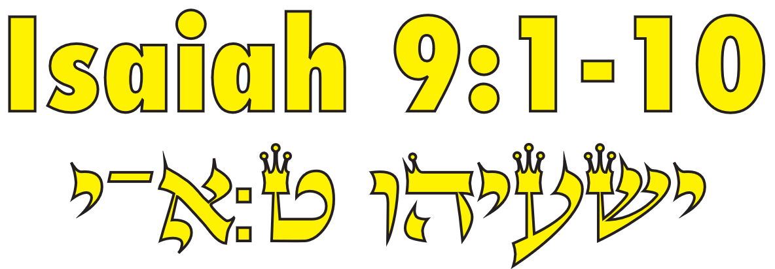
Isaiah / ישעיה
http://www.matsati.com

Slide 2
﻿ספר ישעיה פרק ט
﻿א הָעָם הַהֹלְכִים בַּחֹשֶׁךְ רָאוּ אוֹר גָּדוֹל יֹשְׁבֵי בְּאֶרֶץ צַלְמָוֶת אוֹר נָגַהּ עֲלֵיהֶם: ב הִרְבִּיתָ הַגּוֹי לֹא [לוֹ] הִגְדַּלְתָּ הַשִּׂמְחָה שָֹמְחוּ לְפָנֶיךָ כְּשִֹמְחַת בַּקָּצִיר כַּאֲשֶׁר יָגִילוּ בְּחַלְּקָם שָׁלָל: ג כִּי | אֶת-עֹל סֻבֳּלוֹ וְאֵת מַטֵּה שִׁכְמוֹ שֵׁבֶט הַנֹּגֵשֹ בּוֹ הַחִתֹּתָ כְּיוֹם מִדְיָן: ד כִּי כָל-סְאוֹן סֹאֵן בְּרַעַשׁ וְשִֹמְלָה מְגוֹלָלָה בְדָמִים וְהָיְתָה לִשְֹרֵפָה מַאֲכֹלֶת אֵשׁ: ה כִּי-יֶלֶד יֻלַּד-לָנוּ בֵּן נִתַּן-לָנוּ וַתְּהִי הַמִּשְֹרָה עַל-שִׁכְמוֹ וַיִּקְרָא שְׁמוֹ פֶּלֶא יוֹעֵץ אֵל גִּבּוֹר אֲבִי-עַד שַֹר-שָׁלוֹם: ו לְםַרְבֵּה [לְמַרְבֵּה] הַמִּשְֹרָה וּלְשָׁלוֹם אֵין-קֵץ עַל-כִּסֵּא דָוִד וְעַל-מַמְלַכְתּוֹ לְהָכִין אֹתָהּ וּלְסַעֲדָהּ בְּמִשְׁפָּט וּבִצְדָקָה מֵעַתָּה וְעַד-עוֹלָם קִנְאַת יְהֹוָה צְבָאוֹת תַּעֲשֶֹה-זֹּאת: ז דָּבָר שָׁלַח אֲדֹנָי בְּיַעֲקֹב וְנָפַל בְּיִשְֹרָאֵל: ח וְיָדְעוּ הָעָם כֻּלּוֹ אֶפְרַיִם וְיוֹשֵׁב שֹׁמְרוֹן בְּגַאֲוָה וּבְגֹדֶל לֵבָב לֵאמֹר: ט לְבֵנִים נָפָלוּ וְגָזִית נִבְנֶה שִׁקְמִים גֻּדָּעוּ וַאֲרָזִים נַחֲלִיף: י וַיְשַֹגֵּב יְהֹוָה אֶת-צָרֵי רְצִין עָלָיו וְאֶת-אֹיְבָיו יְסַכְסֵךְ: יא אֲרָם מִקֶּדֶם וּפְלִשְׁתִּים מֵאָחוֹר וַיֹּאכְלוּ אֶת-יִשְֹרָאֵל בְּכָל-פֶּה בְּכָל-זֹאת לֹא-שָׁב אַפּוֹ וְעוֹד יָדוֹ נְטוּיָה:
Isaiah / ישעיה
http://www.matsati.com

Slide 3
ספר דברי הימים ב פרק יב
ט וַיְהִ֗י כְּהָכִ֞ין מַלְכ֤וּת רְחַבְעָם֙ וּכְחֶזְקָת֔וֹ עָזַ֖ב אֶת־תּוֹרַ֣ת יְהוָ֑ה וְכָל־יִשְׂרָאֵ֖ל עִמּֽוֹ׃ ב וַיְהִ֞י בַּשָּׁנָ֤ה הַֽחֲמִישִׁית֙ לַמֶּ֣לֶךְ רְחַבְעָ֔ם עָלָ֛ה שִׁישַׁ֥ק מֶֽלֶךְ־מִצְרַ֖יִם עַל־יְרוּשָׁלִָ֑ם כִּ֥י מָעֲל֖וּ בַּיהוָֽה׃ ג בְּאֶ֤לֶף וּמָאתַ֙יִם֙ רֶ֔כֶב וּבְשִׁשִּׁ֥ים אֶ֖לֶף פָּרָשִׁ֑ים וְאֵ֣ין מִסְפָּ֗ר לָעָ֞ם אֲשֶׁר־בָּ֤אוּ עִמּוֹ֙ מִמִּצְרַ֔יִם לוּבִ֥ים סֻכִּיִּ֖ים וְכוּשִֽׁים׃ ד וַיִּלְכֹּ֛ד אֶת־עָרֵ֥י הַמְּצֻר֖וֹת אֲשֶׁ֣ר לִֽיהוּדָ֑ה וַיָּבֹ֖א עַד־יְרוּשָׁלִָֽם׃ ה וּֽשְׁמַֽעְיָ֤ה הַנָּבִיא֙ בָּ֣א אֶל־רְחַבְעָ֔ם וְשָׂרֵ֣י יְהוּדָ֔ה אֲשֶׁר־נֶאֶסְפ֥וּ אֶל־יְרוּשָׁלִַ֖ם מִפְּנֵ֣י שִׁישָׁ֑ק וַיֹּ֨אמֶר לָהֶ֜ם כֹּה־אָמַ֣ר יְהוָ֗ה אַתֶּם֙ עֲזַבְתֶּ֣ם אֹתִ֔י וְאַף־אֲנִ֛י עָזַ֥בְתִּי אֶתְכֶ֖ם בְּיַד־שִׁישָֽׁק׃
Isaiah / ישעיה
http://www.matsati.com

Slide 4
Matthew 4:12-17
412: Now when Jesus had heard that John was cast into prison, he departed into Galilee 4:13 And leaving Nazareth, he came and dwelt in Capernaum, which is upon the sea coast, in the borders of Zabulon and Nephthalim 4::14 That it might be fulfilled which was spoken by Esaias the prophet, saying, 4:15 The land of Zabulon, and the land of Nephthalim, by the way of the sea, beyond Jordan, Galilee of the Gentiles 4:16 The people which sat in darkness saw great light; and to them which sat in the region and shadow of death light is sprung up. 4:17 From that time Jesus began to preach, and to say, Repent: for the kingdom of heaven is at hand. (KJV, יב כַּאֲשֶׁר שָׁמַע יֵשׁוּעַ כִּי הִסְגִּירוּ אֶת יוֹחָנָן יָצָא אֶל הַגָּלִיל. יג הוּא עָזַב אֶת נָצְרַת וּבָא לָגוּר בִּכְפַר נַחוּם לְיַד הַיָּם, בְּחֶבֶל זְבוּלוּן וְנַפְתָּלִי, יד לְמַעַן יִתְקַיֵּם הַנֶּאֱמָר בְּפִי יְשַׁעְיָהוּ הַנָּבִיא׃ טו ״אַרְצָה זְבֻלוּן וְאַרְצָה נַפְתָּלִי, דֶּרֶךְ הַיָּם, עֵבֶר הַיַּרְדֵּן, גְּלִיל הַגּוֹיִם. (ישעיהו ח׳ כג׳) טז הָעָם הַהֹלְכִים בַּחֹשֶׁךְ רָאוּ אוֹר גָּדוֹל, יֹשְׁבֵי בְּאֶרֶץ צַלְמָוֶת אוֹר נָגַהּ עֲלֵיהֶם.״ (ישעיהו ט׳ א׳–ב׳) חז מִן הָעֵת הַהִיא הֵחֵל יֵשׁוּעַ לְהַכְרִיז וְלוֹמַר׃ ״חִזְרוּ בִּתְשׁוּבָה, כִּי קָרְבָה מַלְכוּת שָׁמַיִם.״)
Isaiah / ישעיה
http://www.matsati.com

Slide 5
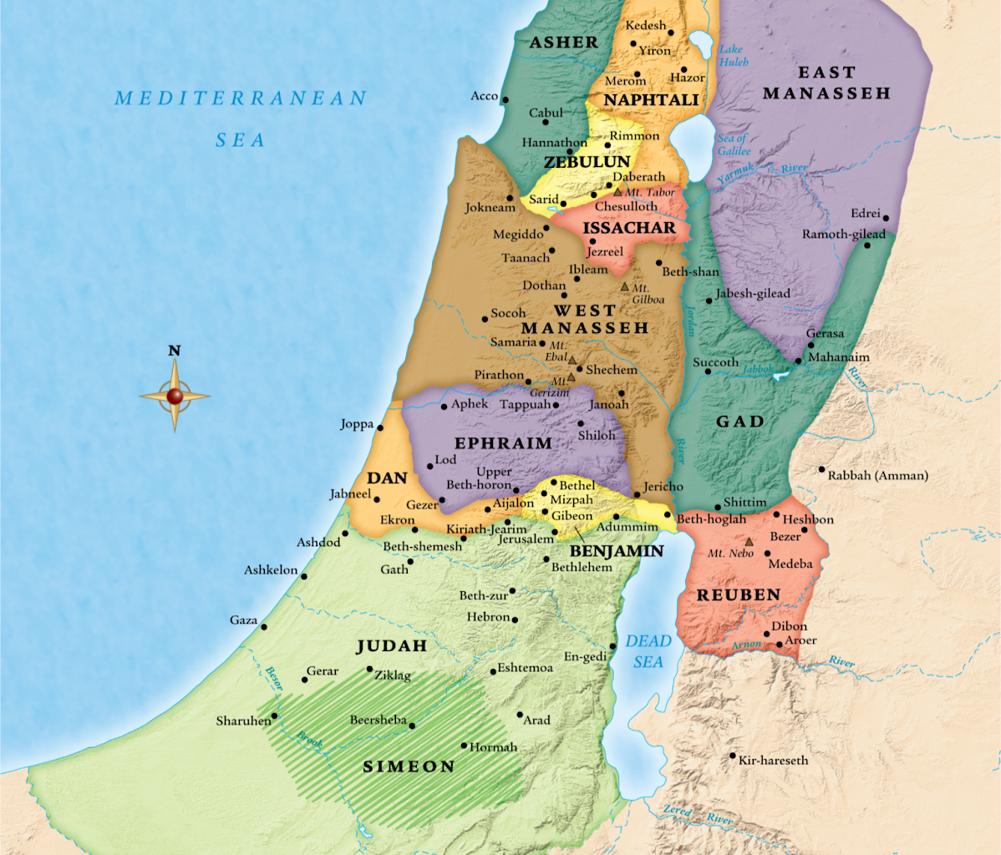
Isaiah / ישעיה
http://www.matsati.com

Slide 6
Romans 3:20
3:20 Therefore by the deeds of the law no flesh will be justified in His sight, for by the law is the knowledge of sin. (KJV)
Romans 7:7
7:7 What shall we say then? Is the law sin? Certainly not! On the contrary, I would not have known sin except through the law. (KJV)
Romans 7:12
7:12 Therefore the law is holy, and the commandment holy and just and good. (KJV)
Isaiah / ישעיה
http://www.matsati.com

Slide 7
Tehillim / Psalm 19:7-14
19:7 The law of the LORD is perfect, converting the soul: the testimony of the LORD is sure, making wise the simple. 19:8 The statutes of the LORD are right, rejoicing the heart: the commandment of the LORD is pure, enlightening the eyes. 19:9 The fear of the LORD is clean, enduring for ever: the judgments of the LORD are true and righteous altogether. 19:10 More to be desired are they than gold, yea, than much fine gold: sweeter also than honey and the honeycomb. 19:11 Moreover by them is thy servant warned: and in keeping of them there is great reward. 19:12 Who can understand his errors? cleanse thou me from secret faults. 19:13 Keep back thy servant also from presumptuous sins; let them not have dominion over me: then shall I be upright, and I shall be innocent from the great transgression. 19:14 Let the words of my mouth, and the meditation of my heart, be acceptable in thy sight, O LORD, my strength, and my redeemer.
Isaiah / ישעיה
http://www.matsati.com

Slide 8
Ephesians 6:12
For we wrestle not against flesh and blood, but against principalities, against powers, against the rulers of the darkness of this world, against spiritual wickedness in high places. (KJV, כִּי לֹא עִם בָּשָׂר–וָדָם מִלְחָמָה לָנוּ, אֶלָּא עִם רָשֻׁיּוֹת וּשְׂרָרוֹת, עִם מוֹשְׁלֵי חֶשְׁכַת הָעוֹלָם הַזֶּה, עִם כֹּחוֹת רוּחָנִיִּים רָעִים בַּשָּׁמַיִם.)
Isaiah / ישעיה
http://www.matsati.com

Slide 9
Rabbinic Literature
ספרות רבנית
Part 2
Isaiah / ישעיה
http://www.matsati.com

Slide 10
Targum Jonathan son of Uziel Isaiah 9:1-5
9:2 The people, the house of Israel, which walked in Egypt as in the darkness, went forth to see a great light. They that dwelt in the land of the shadow of death, upon them hath the light shined. 9:3 Thou hast multiplied the people, the house of Israel, unto them Thou hast multiplied the joy: they joy before Thee as the joy of the conquerors of battle, as men rejoice when they divide the spoil. 9:4 For Thou hast taken away the yoke of his dominion, and the government of oppression, the government wherewith he enslaved him is broken as in the day of Midian. 9:5 All their transactions are in wickedness; they are polluted with sins, as a garment dipped in blood, the marks of its filth cannot be purified; thus it is like something, in which there is no use, but to be burned in fire: thus He shall bring forth against them nations, who are mighty as fire, and they shall slay them. (TgJ)
Isaiah / ישעיה
http://www.matsati.com

Slide 11
Targum Jonathan son of Uziel Isaiah 9:6-11
9:6 The prophet said to the house of David, For unto us a Child is born, unto us a Son is given, and He has taken the law upon Himself to keep it. His name is called from eternity, Wonderful, The Mighty God, who liveth to eternity, The Messiah, whose peace shall be great upon us in His days. 9:7 The greatness of those who do the law shall be magnified, and to those that preserve peace. There shall be no end to the throne of David, and of his kingdom, to establish it and to build it in judgment and in righteousness from henceforth, even for ever. By the WORD of the Lord of hosts this shall be done. 9:8 The Lord sent a word into the house of Jacob, and it was heard in Israel. 9:9 The people, all of them have become great; Ephraim and the inhabitants of Samaria, that say in greatness and stoutness of heart, 9:10 The princes are carried captive; but we will appoint better ones than they. Treasures are plundered, but we will purchase more beautiful ones than they. 9:11 Therefore the Lord shall make strong the hatred of Rezin against him, and he will stir up his adversaries. (TgJ)
Isaiah / ישעיה
http://www.matsati.com

Slide 12
Midrash Tanchuma, Noach 3:7
The second part of the Shema contains the words With all thy heart, with all thy soul, but the words with all thy might are omitted. These words are omitted to inform us that anyone who loves material riches and earthly pleasures is incapable of studying the Oral Law. There is considerable anguish and sleeplessness in (store for him who does study) it; one wastes and neglects himself on its account. Therefore its reward is in the hereafter, as it is said: The people that walk in darkness have seen a great light (Isa. 9:1).
Isaiah / ישעיה
http://www.matsati.com

Slide 13
Talmud Bavli Sanhedrin 94a:11
(ישעיהו י, טז) לכן ישלח האדון ה' צבאות במשמניו רזון מאי במשמניו רזון אמר הקב"ה יבא חזקיהו שיש לו שמונה שמות ויפרע מסנחריב שיש לו שמונה שמות חזקיה דכתיב (ישעיהו ט, ה) כי ילד יולד לנו בן ניתן לנו ותהי המשרה על שכמו ויקרא שמו פלא יועץ אל גבור אבי עד שר שלום והאיכא חזקיה שחזקו יה דבר אחר חזקיה שחיזק את ישראל לאביהם שבשמים
§ The verse states: “Therefore shall the Master, the Lord of hosts, send among his fat ones [mishmanav] leanness” (Isaiah 10:16). What is the meaning of the phrase “send among his fat ones leanness”? The meaning is that the Holy One, Blessed be He, said: Let Hezekiah, who has eight [shemona] names, come, and exact retribution from Sennacherib, who has eight names. The Gemara elaborates: The eight names of Hezekiah are as it is written: “For to us a child is born, to us a son is given; and the government is upon his shoulder; and his name is called Pele Joez El Gibbor Abi Ad Sar Shalom” (Isaiah 9:5). The Gemara asks: But isn’t there an additional name, Hezekiah? The Gemara explains: That was not a given name; rather, it is an appellation based on the fact that God strengthened him [ḥizzeko]. Alternatively, he was called Hezekiah due to the fact that he strengthened the devotion of the Jewish people to their Father in Heaven
Isaiah / ישעיה
http://www.matsati.com

Slide 14
Iggerot HaRambam, Iggeret Teiman 13
The Messiah, indeed, ranks after Moses in eminence and distinction, and God has bestowed some gifts upon him which he did not bestow upon Moses, as may be gathered from the following verses: "His delight shall be in the fear of the Lord." (Isaiah 11:3). "The Spirit of the Lord shall rest upon him." (11:2). "And Righteousness shall be the girdle of his loins." (11:5). Six appellations were divinely conferred upon him as the following passage indicates: "For a child is born unto us, and a son is given unto us, and the government is upon his shoulder, and he is called Pele, Yoetz, el, Gibbor, Abiad, Sar-Shalom." (Isaiah 9:5). And another verse alluding to the Messiah culminates in the following manner "Thou art my son, this day have I begotten thee." (Psalms 2:7). All these statements demonstrate the pre-eminence of the Messiah.
Isaiah / ישעיה
http://www.matsati.com

Slide 15
Rashi on Isaiah 9:6 Part 2
משרה. לשון שררה זו לתשובת אחרים, אך יש לומר שאף שר שלום משמותיו של הקב"ה וקריאת שם זה אינה לשם ממש אלא לשם גדולה ושררה כמו וקרא שם בבית לחם וכמו ועשיתי לך שם, אף כאן ויקרא שמו ויתן לו שם וממשלה:
authority, an expression of government. [This is to refute those who disagree with us [the Christians]. But it is possible to say that “Prince of Peace,” too, is one of the names of the Holy One, blessed be He, and this calling of a name is not actually a name but an expression of (var. for the purpose of) greatness and authority. Comp. (Ruth 4:11) “And be famous (וּקְרָא שֵׁם) in Bethlehem. Also (II Sam. 7:9, I Chron. 17:8): “And I shall make for you a name.” Here too, Scripture means, “And He gave him a name and authority.”]
Isaiah / ישעיה
http://www.matsati.com

Slide 16
Rashi on Isaiah 9:6 Part 2
משרה. לשון שררה זו לתשובת אחרים, אך יש לומר שאף שר שלום משמותיו של הקב"ה וקריאת שם זה אינה לשם ממש אלא לשם גדולה ושררה כמו וקרא שם בבית לחם וכמו ועשיתי לך שם, אף כאן ויקרא שמו ויתן לו שם וממשלה:
authority, an expression of government. [This is to refute those who disagree with us [the Christians]. But it is possible to say that “Prince of Peace,” too, is one of the names of the Holy One, blessed be He, and this calling of a name is not actually a name but an expression of (var. for the purpose of) greatness and authority. Comp. (Ruth 4:11) “And be famous (וּקְרָא שֵׁם) in Bethlehem. Also (II Sam. 7:9, I Chron. 17:8): “And I shall make for you a name.” Here too, Scripture means, “And He gave him a name and authority.”]
Isaiah / ישעיה
http://www.matsati.com

