Slide 1
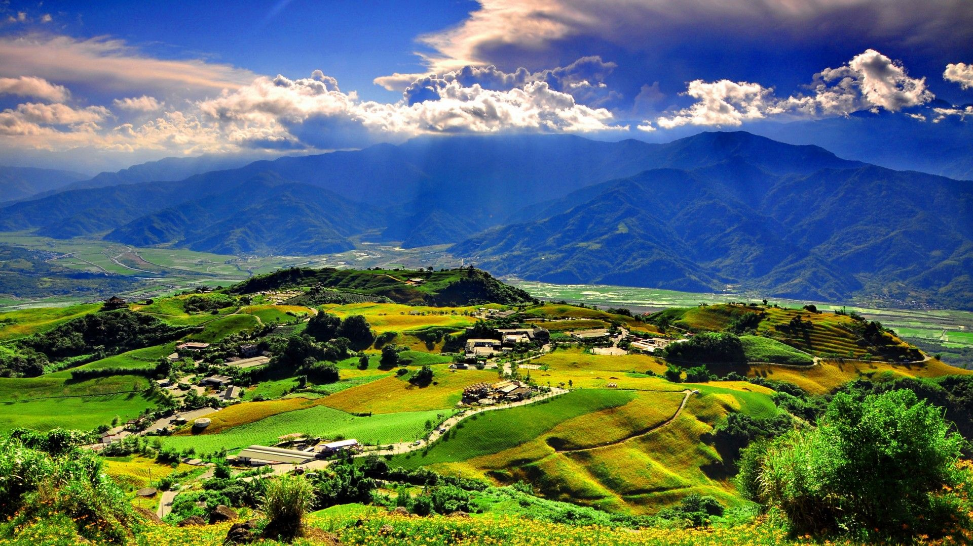

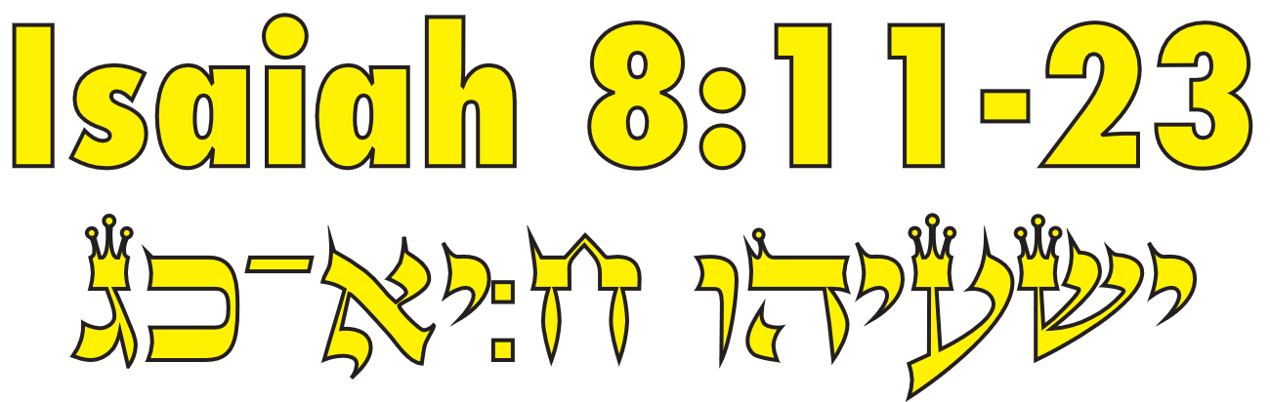
Isaiah / ישעיה
http://www.matsati.com

Slide 2
























﻿ספר ישעיה פרק ח
﻿יא כִּי כֹה אָמַר יְהֹוָה אֵלַי בְּחֶזְקַת הַיָּד וְיִסְּרֵנִי מִלֶּכֶת בְּדֶרֶךְ הָעָם-הַזֶּה לֵאמֹר: יב לֹא-תֹאמְרוּן קֶשֶׁר לְכֹל אֲשֶׁר-יֹאמַר הָעָם הַזֶּה קָשֶׁר וְאֶת-מוֹרָאוֹ לֹא-תִירְאוּ וְלֹא תַעֲרִיצוּ: יג אֶת-יְהֹוָה צְבָאוֹת אֹתוֹ תַקְדִּישׁוּ וְהוּא מוֹרַאֲכֶם וְהוּא מַעֲרִצְכֶם: יד וְהָיָה לְמִקְדָּשׁ וּלְאֶבֶן נֶגֶף וּלְצוּר מִכְשׁוֹל לִשְׁנֵי בָתֵּי יִשְֹרָאֵל לְפַח וּלְמוֹקֵשׁ לְיוֹשֵׁב יְרוּשָׁלָם: טו וְכָשְׁלוּ בָם רַבִּים וְנָפְלוּ וְנִשְׁבָּרוּ וְנוֹקְשׁוּ וְנִלְכָּדוּ: טז צוֹר תְּעוּדָה חֲתוֹם תּוֹרָה בְּלִמֻּדָי: יז וְחִכִּיתִי לַיהֹוָה הַמַּסְתִּיר פָּנָיו מִבֵּית יַעֲקֹב וְקִוֵּיתִי-לוֹ: יח הִנֵּה אָנֹכִי וְהַיְלָדִים אֲשֶׁר נָתַן-לִי יְהֹוָה לְאֹתוֹת וּלְמוֹפְתִים בְּיִשְֹרָאֵל מֵעִם יְהֹוָה צְבָאוֹת הַשֹּׁכֵן בְּהַר צִיּוֹן: יט וְכִי-יֹאמְרוּ אֲלֵיכֶם דִּרְשׁוּ אֶל-הָאֹבוֹת וְאֶל-הַיִּדְּעֹנִים הַמְצַפְצְפִים וְהַמַּהְגִּים הֲלוֹא-עַם אֶל-אֱלֹהָיו יִדְרֹשׁ בְּעַד הַחַיִּים אֶל-הַמֵּתִים: כ לְתוֹרָה וְלִתְעוּדָה אִם-לֹא יֹאמְרוּ כַּדָּבָר הַזֶּה אֲשֶׁר אֵין-לוֹ שָׁחַר: כא וְעָבַר בָּהּ נִקְשֶׁה וְרָעֵב וְהָיָה כִי-יִרְעַב וְהִתְקַצַּף וְקִלֵּל בְּמַלְכּוֹ וּבֵאלֹהָיו וּפָנָה לְמָעְלָה: כב וְאֶל-אֶרֶץ יַבִּיט וְהִנֵּה צָרָה וַחֲשֵׁכָה מְעוּף צוּקָה וַאֲפֵלָה מְנֻדָּח: כג כִּי לֹא מוּעָף לַאֲשֶׁר מוּצָק לָהּ כָּעֵת הָרִאשׁוֹן הֵקַל אַרְצָה זְבֻלוּן וְאַרְצָה נַפְתָּלִי וְהָאַחֲרוֹן הִכְבִּיד דֶּרֶךְ הַיָּם עֵבֶר הַיַּרְדֵּן גְּלִיל הַגּוֹיִם:
Isaiah / ישעיה
http://www.matsati.com

Slide 3






ספר דברים פרק כו
כו וַיּוֹצִאֵ֤נוּ יְהוָה֙ מִמִּצְרַ֔יִם בְּיָ֤ד חֲזָקָה֙ וּבִזְרֹ֣עַ נְטוּיָ֔ה וּבְמֹרָ֖א גָּדֹ֑ל וּבְאֹת֖וֹת וּבְמֹפְתִֽים׃
Devarim / Deuteronomy 28:6
So the LORD brought us out of Egypt with a strong hand and powerful arm, with overwhelming terror, and with miraculous signs and wonders. (KJV)
Isaiah / ישעיה
http://www.matsati.com

Slide 4
ספר ויקרא פרק יח
ב דַּבֵּר֙ אֶל־בְּנֵ֣י יִשְׂרָאֵ֔ל וְאָמַרְתָּ֖ אֲלֵהֶ֑ם אֲנִ֖י יְהוָ֥ה אֱלֹהֵיכֶֽם׃
Vayikra / Leviticus 18:3
After the doings of the land of Egypt, wherein ye dwelt, shall ye not do: and after the doings of the land of Canaan, whither I bring you, shall ye not do: neither shall ye walk in their ordinances. (KJV)
﻿ספר ויקרא פרק יח
כד אַל־תִּֽטַּמְּא֖וּ בְּכָל־אֵ֑לֶּה כִּ֤י בְכָל־אֵ֙לֶּה֙ נִטְמְא֣וּ הַגּוֹיִ֔ם אֲשֶׁר־אֲנִ֥י מְשַׁלֵּ֖חַ מִפְּנֵיכֶֽם׃
Vayikra / Leviticus 18:24
Do not defile yourselves by any of these practices, for by all these things the nations I am driving out before you have defiled themselves.
Isaiah / ישעיה
http://www.matsati.com

Slide 5

ספר ויקרא פרק כ
כג וְלֹ֤א תֵֽלְכוּ֙ בְּחֻקֹּ֣ת הַגּ֔וֹי אֲשֶׁר־אֲנִ֥י מְשַׁלֵּ֖חַ מִפְּנֵיכֶ֑ם כִּ֤י אֶת־כָּל־אֵ֙לֶּה֙ עָשׂ֔וּ וָאָקֻ֖ץ בָּֽם׃
Vayikra / Leviticus 20:23
You must not follow the statutes of the nations I am driving out before you. Because they did all these things, I abhorred them.
﻿ספר ירמיה פרק י
﻿ב כֹּה | אָמַר יְהֹוָה אֶל-דֶּרֶךְ הַגּוֹיִם אַל-תִּלְמָדוּ וּמֵאֹתוֹת הַשָּׁמַיִם אַל-תֵּחָתּוּ כִּי-יֵחַתּוּ הַגּוֹיִם מֵהֵמָּה:
Jeremiah 10:2
Thus says the LORD: “Do not learn the way of the Gentiles; Do not be dismayed at the signs of heaven, For the Gentiles are dismayed at them. (KJV)
Isaiah / ישעיה
http://www.matsati.com

Slide 6


ספר ישעיה פרק מ
לא וְקוֹיֵ֤ יְהוָה֙ יַחֲלִ֣יפוּ כֹ֔חַ יַעֲל֥וּ אֵ֖בֶר כַּנְּשָׁרִ֑ים יָר֙וּצוּ֙ וְלֹ֣א יִיגָ֔עוּ יֵלְכ֖וּ וְלֹ֥א יִיעָֽפוּ׃
Isaiah 40:31
But they that wait upon the LORD shall renew their strength; they shall mount up with wings as eagles; they shall run, and not be weary; and they shall walk, and not faint. (KJV)
Isaiah / ישעיה
http://www.matsati.com

Slide 7
Hebrews 2:8-18
2:8 Thou hast put all things in subjection under his feet. For in that he put all in subjection under him, he left nothing that is not put under him. But now we see not yet all things put under him. 2:9 But we see Jesus, who was made a little lower than the angels for the suffering of death, crowned with glory and honour; that he by the grace of God should taste death for every man. 2:10 For it became him, for whom are all things, and by whom are all things, in bringing many sons unto glory, to make the captain of their salvation perfect through sufferings. 2:11 For both he that sanctifieth and they who are sanctified are all of one: for which cause he is not ashamed to call them brethren, 2:12 Saying, I will declare thy name unto my brethren, in the midst of the church will I sing praise unto thee. 2:13 And again, I will put my trust in him. And again, Behold I and the children which God hath given me. 2:14 Forasmuch then as the children are partakers of flesh and blood, he also himself likewise took part of the same; that through death he might destroy him that had the power of death, that is, the devil; 2:15 And deliver them who through fear of death were all their lifetime subject to bondage. 2:16 For verily he took not on him the nature of angels; but he took on him the seed of Abraham. 2:17 Wherefore in all things it behoved him to be made like unto his brethren, that he might be a merciful and faithful high priest in things pertaining to God, to make reconciliation for the sins of the people. 2:18 For in that he himself hath suffered being tempted, he is able to succour them that are tempted. (KJV)
Isaiah / ישעיה
http://www.matsati.com

Slide 8
ספר דברים פרק ל
﻿טו רְאֵה נָתַתִּי לְפָנֶיךָ הַיּוֹם אֶת-הַחַיִּים וְאֶת-הַטּוֹב וְאֶת-הַמָּוֶת וְאֶת-הָרָע: טז אֲשֶׁר אָנֹכִי מְצַוְּךָ הַיּוֹם לְאַהֲבָה אֶת-יְהוָֹה אֱלֹהֶיךָ לָלֶכֶת בִּדְרָכָיו וְלִשְׁמֹר מִצְוֹתָיו וְחֻקֹּתָיו וּמִשְׁפָּטָיו וְחָיִיתָ וְרָבִיתָ וּבֵרַכְךָ יְהוָֹה אֱלֹהֶיךָ בָּאָרֶץ אֲשֶׁר-אַתָּה בָא-שָׁמָּה לְרִשְׁתָּהּ: יז וְאִם-יִפְנֶה לְבָבְךָ וְלֹא תִשְׁמָע וְנִדַּחְתָּ וְהִשְׁתַּחֲוִיתָ לֵאלֹהִים אֲחֵרִים וַעֲבַדְתָּם:
Devarim / Deuteronomy 30:15-17
30:15 See, I have set before thee this day life and good, and death and evil; 30:16 In that I command thee this day to love the LORD thy God, to walk in his ways, and to keep his commandments and his statutes and his judgments, that thou mayest live and multiply: and the LORD thy God shall bless thee in the land whither thou goest to possess it. 30:17 But if thine heart turn away, so that thou wilt not hear, but shalt be drawn away, and worship other gods, and serve them; (KJV)
Isaiah / ישעיה
http://www.matsati.com

Slide 9
Matthew 4:13-17
4:13 And leaving Nazareth, he came and dwelt in Capernaum, which is upon the sea coast, in the borders of Zabulon and Nephthalim: 4:14 That it might be fulfilled which was spoken by Esaias the prophet, saying, 4:15 The land of Zabulon, and the land of Nephthalim, by the way of the sea, beyond Jordan, Galilee of the Gentiles; 4:16 The people which sat in darkness saw great light; and to them which sat in the region and shadow of death light is sprung up. 4:17 From that time Jesus began to preach, and to say, Repent: for the kingdom of heaven is at hand. (KJV)
Isaiah / ישעיה
http://www.matsati.com

Slide 10
Rabbinic Literature
ספרות רבנית
Part 2
Isaiah / ישעיה
http://www.matsati.com

Slide 11
Targum Jonathan son of Uziel Isaiah 8:11-17
8:11 For the Lord spake thus to me by the power of prophecy, and instructed me that I should not walk in the way of this people, saying, 8:12 Say ye not a rebellion to all that this people shall say a rebellion; neither fear ye their fear; and concerning their strength say ye not strength. 8:13 The Lord of hosts Him shall ye call holy; and let Him be your fear, and let Him be your strength. 8:14 And if ye will not obey, His WORD shall be amongst you for revenge, and for a stone of stumbling, and for a rock of offence to both of the houses of the princes of Israel, for destruction and for a snare, because they contend against those of the house of Judah, who are dwelling in Jerusalem. 8:15 And many among them shall stumble, and fall, and be broken, and be snared, and be taken. 8:16 O prophet, keep the testimony, testify not the testimony among them, because they do not obey; seal and hide the law, they are not willing to learn it. 8:17 The prophet said, On account of this I prayed before the Lord, who has said that he would take away His Shekinah from the house of Jacob, and I intreated before Him.
Isaiah / ישעיה
http://www.matsati.com

Slide 12
Targum Jonathan son of Uziel Isaiah 8:18-23
8:18 Behold, whilst I live with the children, which the Lord has given me, the signs and the wonders, which are promised to come upon Israel shall be established among us. But if they would see and repent, the decree should be annulled, which He decreed against them, that they should go into captivity, and that they should not appear before the Lord of hosts, whose Shekinah is in the mountain of Zion. 8:19 And when the nations amongst whom you shall be shall say to you, Seek of necromancers, and of the wizards, that peep, and that mutter. Is not this the way of nations, the worshippers of idols? A people seek from their idol, the living from the dead. 8:20 Thus ye shall say unto them: We will listen to the law which has been given to us, and to the testimony: yet ye shall go into captivity amongst the nations, and they shall speak to you according to this word. Now there is none amongst them, who would search and seek after it. 8:21 And one shall pass through the land, stumbling along, and there shall be oppression and famine. And it shall come to pass, when he shall see famine and affliction, he shall curse and despise the name of his Moloch and his idolatry: and he shall look upwards to seek deliverance after the decree has been sealed, and he shall not be able to obtain it. 8:22 And he shall seek help from the inhabitants of the earth, because there shall come upon him oppression, famine, weariness of oppression, darkness, and dispersion. 8:23/9:1 For none shall be weary who shall come to oppress them, as at the former time, when the people of the land of Zebulun, and the people of the land of Naphtali went into captivity: and those that were left, a mighty king led into captivity, because they did not remember the power of the Red Sea, neither the wonders of the Jordan, the war of the fortifications of the nations. (TgJ)
Isaiah / ישעיה
http://www.matsati.com

Slide 13


Rashi on Isaiah 8:11 Part 1
בחזקת היד. בהתגבר הנבואה עלי כשהוסיף לדבר עלי בדבר זה כמו שכתוב למעלה ויוסף ה' דבר אלי (לעיל ז) ובלשון זה אמר (יחזקאל יז) ויד ה' עלי חזקה לשון נבואה:
with the overwhelming power of prophecy [Lit., with strength of the hand.] When the prophecy became more intensive over me, when He continued to speak concerning this matter, as it is written above (v. 5): “And the Lord continued to speak to me.” And in this language, Ezekiel said, (3: 14): “And the hand of the Lord became strong over me.” This is an expression of prophecy.
ספר יחזקאל פרק ג
יד וְר֥וּחַ נְשָׂאַ֖תְנִי וַתִּקָּחֵ֑נִי וָאֵלֵ֥ךְ מַר֙ בַּחֲמַ֣ת רוּחִ֔י וְיַד־יְהוָ֥ה עָלַ֖י חָזָֽקָה׃
Ezekiel 3:14
So the spirit lifted me up, and took me away, and I went in bitterness, in the heat of my spirit; but the hand of the LORD was strong upon me. (KJV)
Isaiah / ישעיה
http://www.matsati.com

Slide 14
Talmud Bavli Sanhedrin 38a.2
יהודה וחזקיה בני רבי חייא הוו יתבי בסעודתא קמי רבי ולא הוו קא אמרי ולא מידי אמר להו אגברו חמרא אדרדקי כי היכי דלימרו מילתא כיון דאיבסום פתחו ואמרו אין בן דוד בא עד שיכלו שני בתי אבות מישראל ואלו הן ראש גולה שבבבל ונשיא שבארץ ישראל שנאמר (ישעיהו ח, יד) והיה למקדש ולאבן נגף ולצור מכשול לשני בתי ישראל
Having mentioned the sons of Rabbi Ḥiyya, the Gemara relates: Yehuda and Ḥizkiyya, sons of Rabbi Ḥiyya, were sitting at a meal before Rabbi Yehuda HaNasi, and they were not saying anything. Rabbi Yehuda HaNasi said to his servants: Add more wine for the young men, so that they will say something. Once they were inebriated, they loosened their tongues and said: The son of David, i.e., the Messiah, will not come until two fathers’ houses are destroyed from Israel, as those two families are preventing the redemption. And they are the head of the exile who is in Babylonia, i.e., the family of the Exilarch, and the Nasi who is in Eretz Yisrael, i.e., the family of Rabbi Yehuda HaNasi (see 5a), as it is stated in reference to the Messiah: “And he shall be for a sanctuary; but for a stone of stumbling and for a rock of offense to both the houses of Israel” (Isaiah 8:14).
Isaiah / ישעיה
http://www.matsati.com

Slide 15


Talmud Bavli Sanhedrin 38a.8
לפיכך כו': תנו רבנן אדם יחידי נברא ומפני מה שלא יהו המינים אומרין הרבה רשויות בשמים דבר אחר מפני הצדיקים ומפני הרשעים שלא יהו הצדיקים אומרים אנו בני צדיק ורשעים אומרים אנו בני רשע §
The mishna teaches: Therefore, Adam the first man was created alone. The Sages taught in a baraita: Adam was created alone, and for what reason? So that the heretics will not say: There are many authorities in Heaven, and each created a different person. Alternatively, Adam was created alone due to the righteous and due to the wicked. It was so that the righteous will not say: We are the children of the righteous, and righteousness is natural for us, so there is no need for us to exert ourselves to be righteous, and so that the wicked will not say: We are the children of the wicked and cannot change our ways
Isaiah / ישעיה
http://www.matsati.com

Slide 16
Talmud Bavli Sanhedrin 103b.10
[אחז בטל את העבודה] וחתם את התורה שנאמר (ישעיהו ח, טז) צור תעודה חתום תורה בלמודי מנשה קדר את האזכרות והרס את המזבח אמון [שרף את התורה] והעלה שממית על גבי המזבח אחז התיר את הערוה מנשה בא על אחותו
Ahaz nullified the Temple service and sealed the Torah, prohibiting its study, as it is stated: “Bind up the testimony, seal the Torah among my disciples” (Isaiah 8:16). Manasseh excised the mentions of God’s names from sacred books and destroyed the altar. Amon burned the Torah and sacrificed a gecko, an impure creeping animal, upon the altar. Ahaz permitted engaging in sexual intercourse with forbidden relatives, and announced that marriage between those relatives is permitted. Manasseh exploited that pronouncement and engaged in sexual intercourse with his sister.
Isaiah / ישעיה
http://www.matsati.com

Slide 17
Midrash Tanchuma Buber, Toldot 1 Part 1
(Gen. 25:19:) THESE ARE THE GENERATIONS OF ISAAC BEN ABRAHAM. This text is related (to Prov. 17:6): GRANDCHILDREN ARE A CROWN FOR ELDERS, AND THE GLORY OF CHILDREN IS THEIR PARENTS. Who caused Abraham to be magnified? Jacob, as stated (in Is. 29:22): THUS SAYS THE LORD UNTO THE HOUSE OF JACOB, WHICH REDEEMED ABRAHAM. Why? Because, if one is meritorious as a Torah scholar together with his son and his grandson, it will never again be cut off from him. Thus it is stated (in Deut. 4:9f.): AND MAKE THEM (the statutes and ordinances) KNOWN TO YOUR CHILDREN AND GRANDCHILDREN AS ON THE DAY THAT YOU STOOD BEFORE THE LORD YOUR GOD AT HOREB;. Just as the gift of the Torah did not cease on the day it was given; so for one who teaches his son and his grandson Torah, it shall never again depart from him. And so it was when the Holy One saw Abraham was busy with the Torah. Where is it shown? Where it is stated (in Gen. 26:5): BECAUSE ABRAHAM HEEDED MY VOICE AND KEPT MY CHARGE: MY COMMANDMENTS, MY STATUTES, AND MY LAWS. It is also written (above, in 18:19): FOR I HAVE KNOWN HIM. Then Jacob arose up and did not move from the Torah, as stated (in Gen. 25:27): BUT JACOB WAS A PERFECT MAN WHO SAT IN THE TENTS (i.e., in the academies). What stipulation did the Holy One make with them? (According to Josh. 1:8:) THIS BOOK OF THE LAW SHALL NOT DEPART FROM YOUR MOUTH …. It is also written (in Prov. 10:1): A WISE SON SHALL MAKE A FATHER GLAD. This is Isaac, since it is stated (in Gen. 21:12): FOR IN ISAAC SHALL YOUR SEED BE NAMED. (Prov. 10:1, cont.:) BUT A FOOLISH SON. This is Ishmael. Thus it is written (in Gen. 25:12): NOW THESE ARE THE GENERATIONS OF ISHMAEL BEN ABRAHAM. There are children who suffer disgrace through their parents. Josiah suffered disgrace through his father, as stated (in II Chron. 33:23): FOR AMON INCURRED A LOT OF GUILT. Hezekiah suffered disgrace through his father Ahaz, as stated (in Is. 8:16): BIND UP THE TESTIMONY. There are also parents who suffer disgrace through their children. Eli suffered disgrace through his sons, [as stated (in I Sam. 2:12): NOW ELI'S SONS WERE SCOUNDRELS. And Samuel also suffered disgrace through his sons], as stated (in I Sam. 8:3): BUT HIS SONS DID NOT WALK IN HIS WAYS. It did not, however, turn out in this way for Abraham. Instead he was magnified through Isaac, as stated (in Gen. 25:19, cont.): ABRAHAM SIRED ISAAC. Did he sire no one but Isaac? Now look, it is written {(in Gen. 25:19): THESE ARE THE GENERATIONS OF ISHMAEL.} [(in Gen. 16:15): SO HAGAR BORE A SON TO ABRAM.] And in addition there are the sons of Keturah: Zimran and Jokshan, etc. (cf. Gen. 25:2). But it does not say that Abraham sired anyone but Isaac, simply because Isaac was righteous. It is therefore stated (in Gen. 25:19): ABRAHAM SIRED ISAAC.
Isaiah / ישעיה
http://www.matsati.com

Slide 18

Rashi on Isaiah 8:20 Part 1
לתורה ולתעודה. מחובר למעלה הימנו שמא נדרוש אל המתים לתורה ולתעודה בעד החיים להורות לנו מה נעשה כל זה לפי המדרש, ולפי פשוטו יש לפתור וכי יאמרו אליכם וגו', גמר נבואתו הוא שאמר ויסרני מלכת בדרך העם הזה והוכיחו הקב"ה לנביא ולסיעתו של חזקיה כשיאמרו אליכם שבנא וסיעתו שיראו את חזקיה מבעט בעבודת כוכבים דרשו אל האבות ואל הידעונים ובררו בעבודת כוכבים באשר עשו אבות הראשונים והשיבו את המלוכה אל סנחרב הלא (כל) עם אל אלהיו ידרוש. עובדים עבודת כוכבים ודורשי' בעד החיים אל המתים אף אתם יש לכם לעשות כן:
For the Torah and the warning This is related to the above: Shall we inquire of the dead for the Torah and for the warning for the living, to instruct us what to do? All this is according to the Midrash. According to the simple meaning, however, we can interpret: And when they say to you...This is the end of his prophecy, for he said (v. 11), “and admonished me from going in the way of this people,” and the Holy One, blessed be He, admonished the prophet and Hezekiah’s company, that when Shebna and his company, who will see Hezekiah condemning idolatry, say to you, Inquire of the necromancers and those who divine by the Jidoa bone, and select idolatry as the early forefathers did, and switch the kingdom over to Sennacherib. Does not every people inquire of its god, they worship idols and inquire for the living of the dead? You too should do this.
Isaiah / ישעיה
http://www.matsati.com

