Slide 1
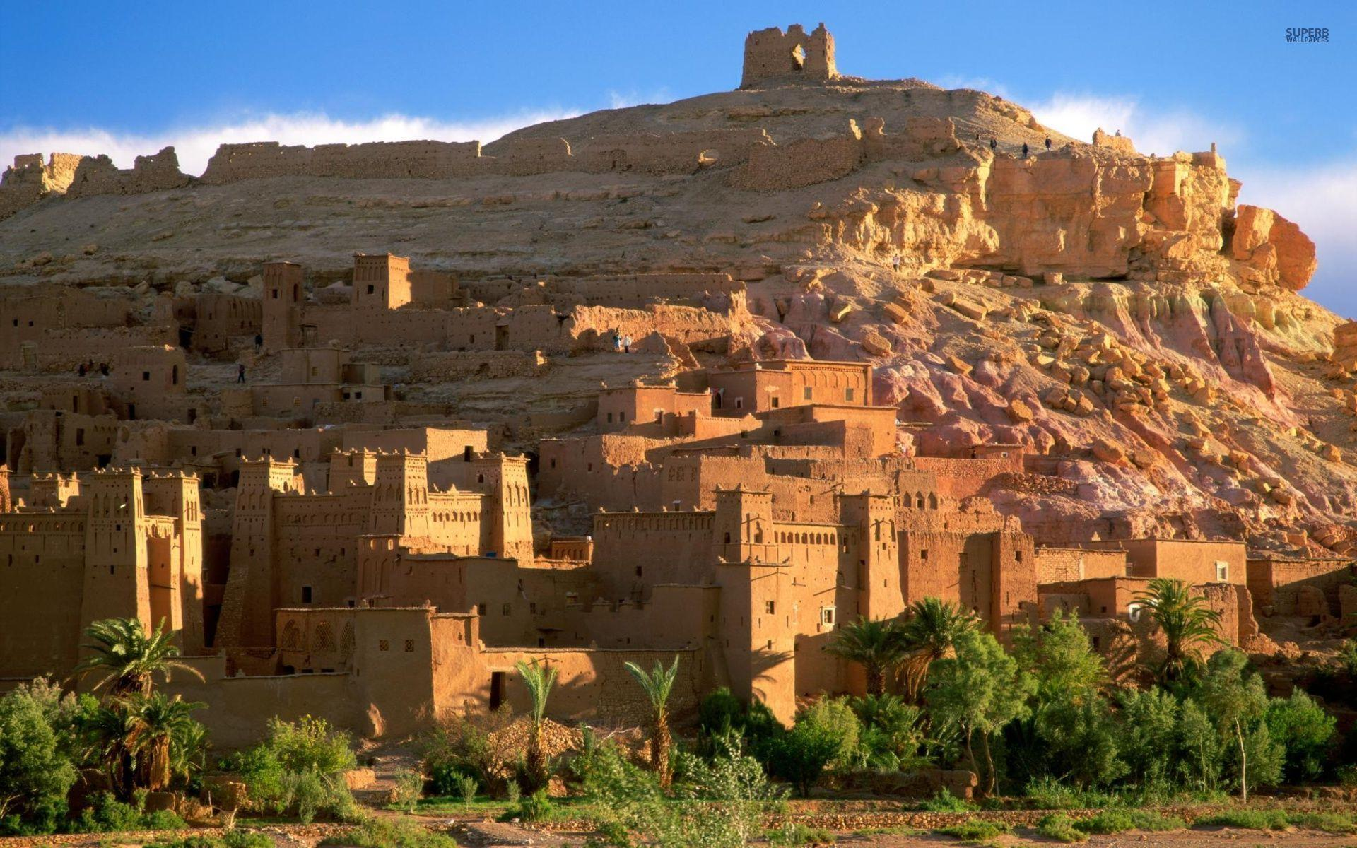































ספר ישעיה פרק א
﻿א חֲזוֹן יְשַׁעְיָהוּ בֶן-אָמוֹץ אֲשֶׁר חָזָה עַל-יְהוּדָה וִירוּשָׁלָם בִּימֵי עֻזִּיָּהוּ יוֹתָם אָחָז יְחִזְקִיָּהוּ מַלְכֵי יְהוּדָה: ב שִׁמְעוּ שָׁמַיִם וְהַאֲזִינִי אֶרֶץ כִּי יְהֹוָה דִּבֵּר בָּנִים גִּדַּלְתִּי וְרוֹמַמְתִּי וְהֵם פָּשְׁעוּ בִי: ג יָדַע שׁוֹר קֹנֵהוּ וַחֲמוֹר אֵבוּס בְּעָלָיו יִשְֹרָאֵל לֹא יָדַע עַמִּי לֹא הִתְבּוֹנָן: ד הוֹי | גּוֹי חֹטֵא עַם כֶּבֶד עָוֹן זֶרַע מְרֵעִים בָּנִים מַשְׁחִיתִים עָזְבוּ אֶת-יְהֹוָה נִאֲצוּ אֶת-קְדוֹשׁ יִשְֹרָאֵל נָזֹרוּ אָחוֹר: ה עַל-מֶה תֻכּוּ עוֹד תּוֹסִיפוּ סָרָה כָּל-רֹאשׁ לָחֳלִי וְכָל-לֵבָב דַּוָּי: ו מִכַּף-רֶגֶל וְעַד-רֹאשׁ אֵין-בּוֹ מְתֹם פֶּצַע וְחַבּוּרָה וּמַכָּה טְרִיָּה לֹא-זֹרוּ וְלֹא חֻבָּשׁוּ וְלֹא רֻכְּכָה בַּשָּׁמֶן: ז אַרְצְכֶם שְׁמָמָה עָרֵיכֶם שְֹרֻפוֹת אֵשׁ אַדְמַתְכֶם לְנֶגְדְּכֶם זָרִים אֹכְלִים אֹתָהּ וּשְׁמָמָה כְּמַהְפֵּכַת זָרִים: ח וְנוֹתְרָה בַת-צִיּוֹן כְּסֻכָּה בְכָרֶם כִּמְלוּנָה בְמִקְשָׁה כְּעִיר נְצוּרָה: ט לוּלֵי יְהֹוָה צְבָאוֹת הוֹתִיר לָנוּ שָֹרִיד כִּמְעָט כִּסְדֹם הָיִינוּ לַעֲמֹרָה דָּמִינוּ:
Isaiah / ישעיה
http://www.matsati.com

Slide 2
DEVARIM / DEUTERONOMY 28:20
יְשַׁלַּ֣ח יְהוָ֣ה׀ בְּ֠ךָ אֶת־הַמְּאֵרָ֤ה אֶת־הַמְּהוּמָה֙ וְאֶת־הַמִּגְעֶ֔רֶת בְּכָל־מִשְׁלַ֥ח יָדְךָ֖ אֲשֶׁ֣ר תַּעֲשֶׂ֑ה עַ֣ד הִשָּֽׁמֶדְךָ֤ וְעַד־אֲבָדְךָ֙ מַהֵ֔ר מִפְּנֵ֛י רֹ֥עַ מַֽעֲלָלֶ֖יךָ אֲשֶׁ֥ר עֲזַבְתָּֽנִי׃
DEVARIM / DEUTERONOMY 29:25-26
וַיֵּלְכ֗וּ וַיַּֽעַבְדוּ֙ אֱלֹהִ֣ים אֲחֵרִ֔ים וַיִּֽשְׁתַּחֲוּ֖וּ לָהֶ֑ם אֱלֹהִים֙ אֲשֶׁ֣ר לֹֽא־יְדָע֔וּם וְלֹ֥א חָלַ֖ק לָהֶֽם׃ וַיִּֽחַר־אַ֥ף יְהוָ֖ה בָּאָ֣רֶץ הַהִ֑וא לְהָבִ֤יא עָלֶ֙יהָ֙ אֶת־כָּל־הַקְּלָלָ֔ה הַכְּתוּבָ֖ה בַּסֵּ֥פֶר הַזֶּֽה׃
DEVARIM / DEUTERONOMY 31:16
וַיֹּ֤אמֶר יְהוָה֙ אֶל־מֹשֶׁ֔ה הִנְּךָ֥ שֹׁכֵ֖ב עִם־אֲבֹתֶ֑יךָ וְקָם֩ הָעָ֨ם הַזֶּ֜ה וְזָנָ֣ה׀ אַחֲרֵ֣י׀ אֱלֹהֵ֣י נֵֽכַר־הָאָ֗רֶץ אֲשֶׁ֨ר ה֤וּא בָא־שָׁ֙מָּה֙ בְּקִרְבּ֔וֹ וַעֲזָבַ֕נִי וְהֵפֵר֙ אֶת־בְּרִיתִ֔י אֲשֶׁ֥ר כָּרַ֖תִּי אִתּֽוֹ׃
Isaiah / ישעיה
http://www.matsati.com

Slide 3
Rabbinic Literature
Isaiah / ישעיה
http://www.matsati.com

Slide 4
Targum Jonathan ben Uziel on Isaiah Chapter 1:4-9
1:4 Woe to those who are called a holy people, because they have sinned; a chosen congregation, but they have multiplied sins; they are surnamed a beloved seed, but they have done evil; they are called beloved sons, but they have corrupted their paths; they have forsaken the worship of the Lord; they abhorred the fear of the Holy Oné of Israel, and because their works are evil they are turned away, and they are turned back. 1:5 They do not consider so as to say, Wherefore has He smitten us? They continue in sin; they do not say, Why is all the head sick, and the whole heart faint? 1:6 From the lowest of my people even unto the chief of them, there is not one amongst them who is perfect in my fear: all of them are disobedient and rebellious; they are polluted with sins, they are like an ulcerous wound; they have not forsaken their pride, neither long for repentance; they have also no righteousness to protect them. 1:7 Your land is desolate, your cities each burnt with fire; in your presence the nations possess it. On account of their sins it is laid desolate: from you it is transferred, and it belongs to aliens. 1:8 The congregation of Zion is left as a booth in a vineyard after they have gathered the grapes; as a lodge for passing the night in, in a garden of cucumbers after they have gleaned it; as a city against which they lay siege. 1:9 Except the exceeding goodness of the Lord of hosts had caused to remain unto us in His mercy a deliverance, we had sins, on account of which we certainly had perished as the men of Sodom, and as the inhabitants of Gomorrah we would have been consumed.
Isaiah / ישעיה
http://www.matsati.com

Slide 5
Talmud Bavli Kiddushin 36a:12 on Isaiah 1:4
And Rabbi Meir says: Either way you are still called sons, as it is stated: “They are foolish sons” (Jeremiah 4:22). And it also states: “Sons in whom there is no faithfulness” (Deuteronomy 32:20). And it states: “A seed of evildoers, sons who deal corruptly” (Isaiah 1:4). And it states: “And it shall come to pass that, instead of what was said to them: You are not My people, it shall be said to them: Sons of the living God” (Hosea 2:1).
Ibn Ezra on Isaiah 1:4 Part 2
כֶבֶד Laden with. An adjective in the construct state; comp. עֶרֶל לב ועֶרֶל בשר, uncircumcised in heart and uncircumcised in flesh (Ez. 44:9).כֶּבֶד is, according to Ibn Ezra, not a substantive, the burden of, but the construct state of the adjective כָּבֵד, heavy of, heavy with regard to; like עֶרֶל uncircumcised with regard to—the construct state of the adjective עָרֵל, uncircumcised.
Rashi on Isaiah 1:4 Part 1
Woe Every instance of הוֹי in Scripture is an expression of complaining and lamenting, like a person who sighs from his heart and cries, “Alas!” There are, however, several, which are an expression of a cry, the vocative voice, e.g., “Ho, ho, flee from the land of the north” (Zech. 2:10), which the Targum renders, אַכְלוּ, an expression of announcing. Woe There is a reason to cry about a holy nation that turned into a sinful nation, and a people referred to by the expression, “for you are a holy people” (Deut. 7:6), turned into a people with iniquity.
Rashi on Isaiah 1:4 Part 2
a people heavy with iniquity The heaviness of iniquity. The word denotes a person who is heavy, peasant in French, ponderous. The word כֶבֶד is a substantive of heaviness, pesantoma in French, and is in the construct state, and is connected with the word עָוֹן, iniquity.
Isaiah / ישעיה
http://www.matsati.com

Slide 6


Ephesians 2:1–7
2:1 And you were dead in your trespasses and sins, 2:2 in which you formerly walked according to the course of this world, according to the prince of the power of the air, of the spirit that is now working in the sons of disobedience. 2:3 Among them we too all formerly lived in the lusts of our flesh, indulging the desires of the flesh and of the mind, and were by nature children of wrath, even as the rest. 2:4 But God, being rich in mercy, because of His great love with which He loved us, 2:5 even when we were dead in our transgressions, made us alive together with Christ (by grace you have been saved), 2:6 and raised us up with Him, and seated us with Him in the heavenly places in Christ Jesus, 2:7 so that in the ages to come He might show the surpassing riches of His grace in kindness toward us in Christ Jesus. (NASB)
Rashi on Isaiah 1:6 Part 7
neither was it softened with oil Their wound was not softened with oil, as is customary with other wounds. It would be inappropriate to say here, “They were not softened with oil,” for they soften only the place of the sore, not the wound and the contusion but the sprinkling and the bandaging applies to all three, [i.e., the wound, the contusion, and the lacerated sore.] Therefore, the plural number applies to them; the lesions were not sprinkled and not bandaged. Jonathan interprets the entire verse figuratively, referring to the fact that they were soiled and afflicted with iniquity. Accordingly, he rendered, “From the sole of the foot until the head,” from the smallest to the greatest, there is no soundness. There is none good among them, wounds and contusions, rebellious deeds, iniquities, and inadvertent sins. they have not been sprinkled... i.e., they have not been healed by repenting wholeheartedly, nor has it been softened with oil, not even a trace of repentant thought has entered their heart.
Isaiah / ישעיה
http://www.matsati.com

Slide 7
Talmud Bavli Berakhot 19a:21 on Isaiah 1:9
And Rav Yosef said: What is the verse from which it is derived? As it is stated: “We should have almost been as Sodom, we should have been like unto Gomorrah” (Isaiah 1:9), after which what did the prophet reply to them? “Hear the word of the Lord, rulers of Sodom; give ear unto the law of our God, people of Gomorrah” (Isaiah 1:10).
Rashi on Isaiah 1:9 Part 1
Had not the Lord of Hosts left us a remnant by His own volition and with His mercy, not because of our merits.
ספר שמות פרק טו
וַיֹּאמֶר֩ אִם־שָׁמ֨וֹעַ תִּשְׁמַ֜ע לְק֣וֹל׀ יְהוָ֣ה אֱלֹהֶ֗יךָ וְהַיָּשָׁ֤ר בְּעֵינָיו֙ תַּעֲשֶׂ֔ה וְהַֽאֲזַנְתָּ֙ לְמִצְוֺתָ֔יו וְשָׁמַרְתָּ֖ כָּל־חֻקָּ֑יו כָּֽל־הַמַּֽחֲלָ֞ה אֲשֶׁר־שַׂ֤מְתִּי בְמִצְרַ֙יִם֙ לֹא־אָשִׂ֣ים עָלֶ֔יךָ כִּ֛י אֲנִ֥י יְהוָ֖ה רֹפְאֶֽךָ׃
Shemot / Exodus 15:26
15:26And He said, “If you will listen carefully to the voice of the LORD your God, and do what is right in His sight, and listen to His commandments, and keep all His statutes, I will put none of the diseases on you which I have put on the Egyptians; for I, the LORD, am your healer.” (NASB)
Isaiah / ישעיה
http://www.matsati.com

